Slide 1
Process Operability Class Materials
Operating Window
Basic flowsheet
Design with Operability
LC
1
FC
1
Copyright © Thomas Marlin 2019
The copyright holder provides a royalty-free license for use of this material at non-profit educational institutions

Slide 2

Key Operability issues
1. Operating window
2. Flexibility/
controllability
3. Reliability
4. Safety & equipment protection
5. Efficiency & profitability
6. Operation during transitions
7. Dynamic Performance
8. Monitoring & diagnosis
Chapter 2 Operating Window
Essentially every device we own has a limited operating window. How do you define an acceptable window?
My cell phone only works when the temperature is 15-25 °C!
My cell phone only works when I’m within 1 km of a cell tower
This operating window is too small; it limits the application of the device!
Figure citation 1 Rebecca Clements (2019)

Slide 3
Key Operability issues
1. Operating window
2. Flexibility/
controllability
3. Reliability
4. Safety & equipment protection
5. Efficiency & profitability
6. Operation during transitions
7. Dynamic Performance
8. Monitoring & diagnosis
Chapter 2 Operating Window
Every process that we design and operate has an operating window that strongly effects the capital and operating costs.
We better learn how to design the best
operating window!
feasible

Slide 4
Key Operability issues
1. Operating window
2. Flexibility/
controllability
3. Reliability
4. Safety & equipment protection
5. Efficiency & profitability
6. Operation during transitions
7. Dynamic Performance
8. Monitoring & diagnosis
Chapter 2 Operating Window
Lesson Outline
Operability Window Problem Definition
- Variability
- Bounds
- Integrity Operating Window (IOW)
- Turndown
- Selecting capacity
Operating Window Calculations
Let’s start here

Slide 5

Key Operability issues
1. Operating window
2. Flexibility/
controllability
3. Reliability
4. Safety & equipment protection
5. Efficiency & profitability
6. Operation during transitions
7. Dynamic Performance
8. Monitoring & diagnosis
Chapter 2 Operating Window
An operating window defines the achievable operation of a flexible process when considering the expected range of variability and the bounds on equipment performance.
Variability - We consider the range of variability that is likely to occur and for which the process should remain in operation. (For very large variability, the process may shutdown or be expected to produce unacceptable products.)
How can the process function successfully, meeting all performance requirements when variability occurs?

Slide 6
Key Operability issues
1. Operating window
2. Flexibility/
controllability
3. Reliability
4. Safety & equipment protection
5. Efficiency & profitability
6. Operation during transitions
7. Dynamic Performance
8. Monitoring & diagnosis
Chapter 2 Operating Window
An operating window defines the achievable operation
Variability - We consider the range of variability that is likely to occur.
Bounds – All equipment have upper and lower limits on the variables defining its operation.
Capacity – The equipment should be designed to have sufficient capacity to achieve desired performance for the defined variability.
Flexibility – The equipment design must be enhanced to allow its performance to be modified in response to variability
Next chapter

Slide 7
Key Operability issues
1. Operating window
2. Flexibility/
controllability
3. Reliability
4. Safety & equipment protection
5. Efficiency & profitability
6. Operation during transitions
7. Dynamic Performance
8. Monitoring & diagnosis
Chapter 2 Operating Window
Sources of variability were introduced in Chapter 1.
Deliberate changes
Disturbances
Mismatch from design models
Equipment performance
Human error
Can you find one example of each in this flash process?

Slide 8
Key Operability issues
1. Operating window
2. Flexibility/
controllability
3. Reliability
4. Safety & equipment protection
5. Efficiency & profitability
6. Operation during transitions
7. Dynamic Performance
8. Monitoring & diagnosis
Chapter 2 Operating Window
Class workshop – Identify at least one source of variability from each category for a distillation tower.
Sources of variability
Deliberate changes
Disturbances
Mismatch from design models
Equipment performance
Human error
x_{D}
F_{R}
F_{V}
x_{B}

Slide 9
Key Operability issues
1. Operating window
2. Flexibility/
controllability
3. Reliability
4. Safety & equipment protection
5. Efficiency & profitability
6. Operation during transitions
7. Dynamic Performance
8. Monitoring & diagnosis
Chapter 2 Operating Window
Sources of variability
Deliberate changes
Disturbances
Mismatch from design models
Equipment performance
Human error
Class workshop – Identify at least one source of variability from each category for a distillation tower.
Model mismatch: Vapor-liquid equilibrium,
Tray efficiencies
x_{D}
Deliberate: feed flow rate
F_{R}
Disturbance:
feed composition
F_{V}
Equipment performance: Reboiler fouling
Human error: important for safety analysis, not for (normal) operating window
x_{B}

Slide 10
Key Operability issues
1. Operating window
2. Flexibility/
controllability
3. Reliability
4. Safety & equipment protection
5. Efficiency & profitability
6. Operation during transitions
7. Dynamic Performance
8. Monitoring & diagnosis
Chapter 2 Operating Window
Class workshop
What is the “worst case” variability (operating conditions) we would use to design the heat exchanger?
What design parameter(s) are selected for the worst case?
Heat exchanger Q = U AY (ΔT)_{lm}
Hot process fluid into shell
Cooling water into tubes
The goal is to cool this stream

Slide 11
Key Operability issues
1. Operating window
2. Flexibility/
controllability
3. Reliability
4. Safety & equipment protection
5. Efficiency & profitability
6. Operation during transitions
7. Dynamic Performance
8. Monitoring & diagnosis
Chapter 2 Operating Window
Solution
1. The design specification will define a boundary of the operating window – The Worst Case gives the largest area for heat exchange.
Highest flow rate,
Highest temperature
Lowest flow rate,
Highest temperature
Hot process fluid into shell
Cooling water into tubes
Lowest temperature
Greatest fouling,
Lowest U

Slide 12
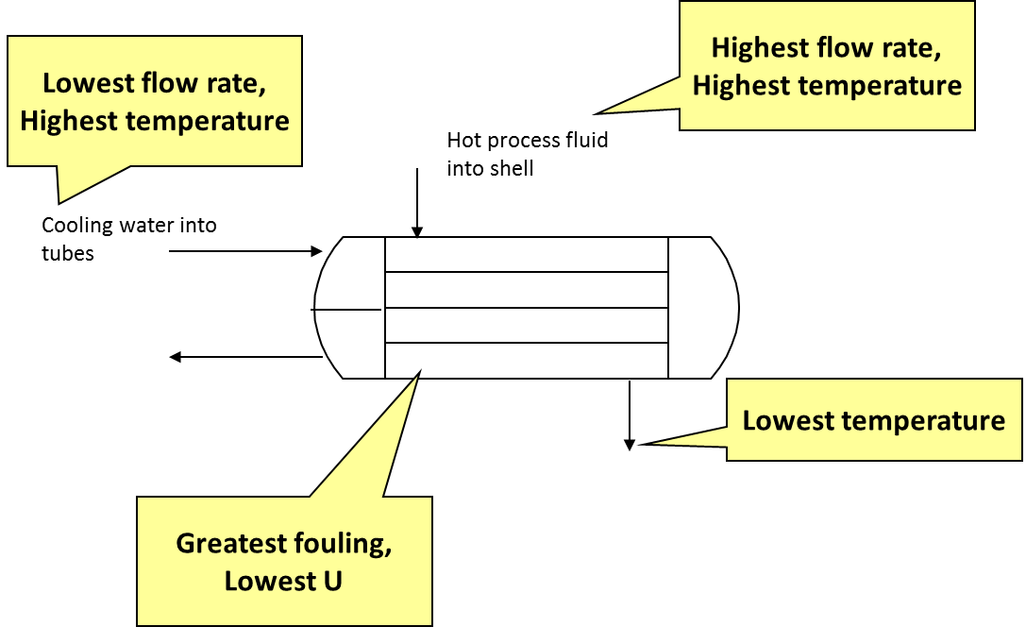
Key Operability issues
1. Operating window
2. Flexibility/
controllability
3. Reliability
4. Safety & equipment protection
5. Efficiency & profitability
6. Operation during transitions
7. Dynamic Performance
8. Monitoring & diagnosis
Chapter 2 Operating Window
Solution
2. Design parameter is area.
Heat exchanger Q= FρC_{p}(T_{in}-T_{out}) = U AY (ΔT)_{lm}
A = {FρC_{p}(T_{in}-T_{out})}/{UY(ΔT)_{lm}}

Slide 13
Key Operability issues
1. Operating window
2. Flexibility/
controllability
3. Reliability
4. Safety & equipment protection
5. Efficiency & profitability
6. Operation during transitions
7. Dynamic Performance
8. Monitoring & diagnosis
Chapter 2 Operating Window
Class Workshop: Determine typical bounds (limitations, constraints) that affect the operating window for a distillation tower.
x_{D}
F_{R}
F_{V}
x_{B}

Slide 14
Key Operability issues
1. Operating window
2. Flexibility/
controllability
3. Reliability
4. Safety & equipment protection
5. Efficiency & profitability
6. Operation during transitions
7. Dynamic Performance
8. Monitoring & diagnosis
Chapter 2 Operating Window
Class Workshop: Solution for Distillation Constraints
Maximum cooling capacity
Maximum and minimum liquid and vapor flow rates
x_{D}
Product composition
F_{R}
Pumping, pipe, valve capacity
Maximum and minimum liquid and vapor flow rates
F_{V}
Maximum heating
Flow pipe, valve capacity
Minimum natural circulation to reboiler
x_{B}
Product composition

Slide 15
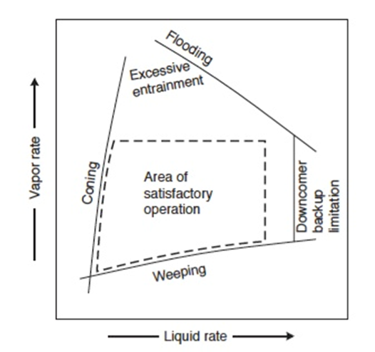
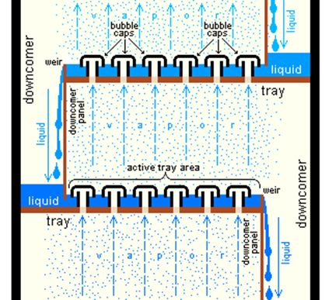
Key Operability issues
1. Operating window
2. Flexibility/
controllability
3. Reliability
4. Safety & equipment protection
5. Efficiency & profitability
6. Operation during transitions
7. Dynamic Performance
8. Monitoring & diagnosis
Chapter 2 Operating Window
Class Workshop: The operating window for the internal flowa in a trayed column
Citation 3
Citation 4
During design, the window size can be changed through selection of tray type (bubble cap, sieve, valve, etc.)
During operation, internal flows determined by feed, reflux, and reboil

Slide 16
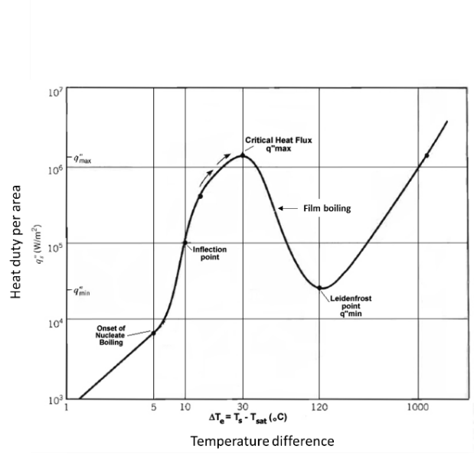
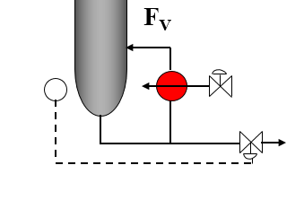
Key Operability issues
1. Operating window
2. Flexibility/
controllability
3. Reliability
4. Safety & equipment protection
5. Efficiency & profitability
6. Operation during transitions
7. Dynamic Performance
8. Monitoring & diagnosis
Chapter 2 Operating Window
Class Workshop: Bound on the reboiler temperature difference to prevent film boiling.
Film boiling –Not OK
Nucleate boiling - OK

Slide 17

Key Operability issues
1. Operating window
2. Flexibility/
controllability
3. Reliability
4. Safety & equipment protection
5. Efficiency & profitability
6. Operation during transitions
7. Dynamic Performance
8. Monitoring & diagnosis
Chapter 2 Operating Window
Lesson Outline
Operability Window Problem Definition
- Variability
- Bounds
- Integrity Operating Window (IOW)
- Turndown
- Selecting capacity
Operating Window Calculations

Slide 18
Chapter 2 Operating Window
Selecting bounds based on the Integrity Operating Window
Ensures that the longer-term operation of the equipment is not sacrificed for short-term gains
Critical limit high Failure occurs quickly
Standard level high Failure occurs with sustained operation
Target range high
Stable, reliable
Target (optimal)
Safe operation
Target range low
Standard level low Failure occurs with sustained operation
Critical limit low Failure occurs quickly

Slide 19
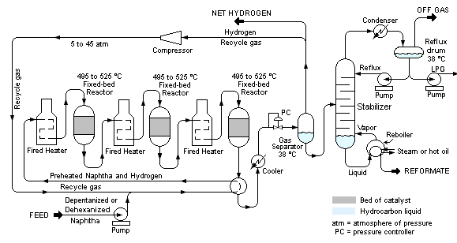
Chapter 2 Operating Window
Class Workshop – For the reforming process, identify bounds
That are “hard’, i.e., cannot be violated
That are “soft”, i.e., can be violated but violation degrades equipment
Citation 2

Slide 20
Chapter 2 Operating Window
Class Workshop – For the reforming process, identify bounds
That are “hard’, i.e., cannot be violated
That are “soft”, i.e., can be violated but violation degrades equipment
Minimum and maximum liquid and vapor flows on each tray
Minimum flow rate through compressor
Minimum excess air to burners in each fired heater
Citation ?

Slide 21
Chapter 2 Operating Window
Class Workshop – For the reforming process, identify bounds
That are “hard’, i.e., cannot be violated
That are “soft”, i.e., can be violated but violation degrades equipment
Maximum tube metal temperature
Maximum catalyst temperature
Flow far from best efficiency point

Slide 22
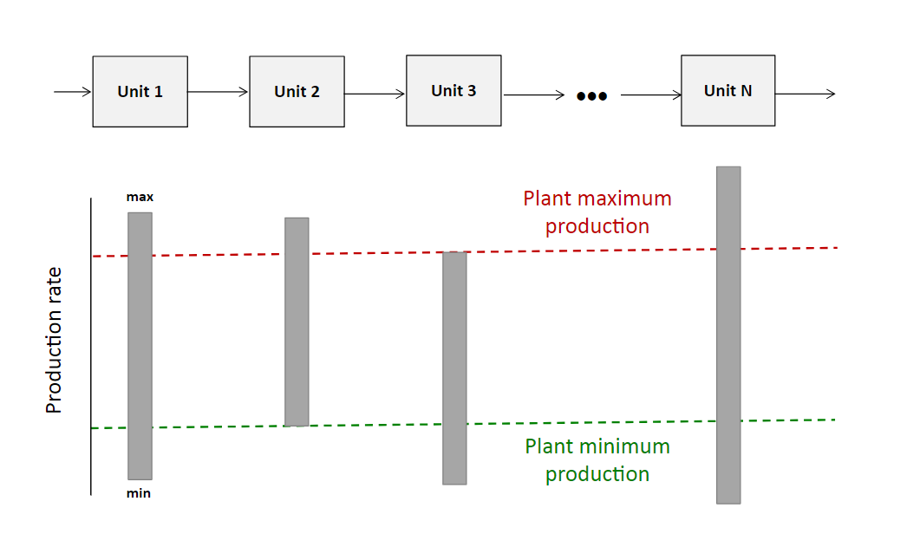
Key Operability issues
1. Operating window
2. Flexibility/
controllability
3. Reliability
4. Safety & equipment protection
5. Efficiency & profitability
6. Operation during transitions
7. Dynamic Performance
8. Monitoring & diagnosis
Chapter 2 Operating Window
High and Low Bounds Exist for Most Equipment
Turndown ratio
is the normal maximum value of a variable divided by the normal minimum valve of the variable. The modifier “normal” is included to limit the range of the variable to values that can be sustained reliably over a long time without hazard or damage to equipment.

Slide 23
Key Operability issues
1. Operating window
2. Flexibility/
controllability
3. Reliability
4. Safety & equipment protection
5. Efficiency & profitability
6. Operation during transitions
7. Dynamic Performance
8. Monitoring & diagnosis
Chapter 2 Operating Window
Engineer must define the variability (set points and disturbances) and identify key bounds in equipment.
Based on above information, the operating window and equipment capacity is determined.
Variability
Bounds (Limits)
Operating window
Flexibility
Next chapter

Slide 24
Key Operability issues
1. Operating window
2. Flexibility/
controllability
3. Reliability
4. Safety & equipment protection
5. Efficiency & profitability
6. Operation during transitions
7. Dynamic Performance
8. Monitoring & diagnosis
Chapter 2 Operating Window
In general, we want a large operating window. Why not always design and construct equipment with very large capacities?
Class Workshop: Complete the following table.
Small equipment*
Large equipment
Advantages
Disadvantages
* = small equipment just satisfies single, base-case design point

Slide 25
Key Operability issues
1. Operating window
2. Flexibility/
controllability
3. Reliability
4. Safety & equipment protection
5. Efficiency & profitability
6. Operation during transitions
7. Dynamic Performance
8. Monitoring & diagnosis
Chapter 2 Operating Window
Class Workshop: Complete the following table.
Small equipment*
Lower capital cost
Most efficient at base case
Achieve “precise” operation (smaller equipment to adjust for flexibility)
Advantages
Cannot achieve higher capacity
Cannot compensate for large range of disturbances
Might not achieve fast transition (no overshoot in manipulated variable)
Disadvantages
* = small equipment just satisfies single, base-case design point

Slide 26
Key Operability issues
1. Operating window
2. Flexibility/
controllability
3. Reliability
4. Safety & equipment protection
5. Efficiency & profitability
6. Operation during transitions
7. Dynamic Performance
8. Monitoring & diagnosis
Chapter 2 Operating Window
Class Workshop: Complete the following table.
Large equipment
Can achieve higher capacity
Can compensate for likely range of disturbances
Can achieve faster transition (allows overshoot in manipulated variable)
Advantages
Higher capital cost
Likely lower efficiency at base case and lower production rates
Might not achieve “precise” operation at base case
Disadvantages

Slide 27
Key Operability issues
1. Operating window
2. Flexibility/
controllability
3. Reliability
4. Safety & equipment protection
5. Efficiency & profitability
6. Operation during transitions
7. Dynamic Performance
8. Monitoring & diagnosis
Chapter 2 Operating Window
How do we select a capacity that is “just right”?
1. The process operation must always be safe.
2. We seek to avoid damage to expensive equipment.
3. We must produce products that satisfy quality requirements.
4. Capacity must satisfy 1-3 above for base case and frequently-occurring variability.
5. We can accept lower production rate for infrequent/abnormal production conditions.
6. We will stop production for extreme deviations.

Slide 28
Key Operability issues
1. Operating window
2. Flexibility/
controllability
3. Reliability
4. Safety & equipment protection
5. Efficiency & profitability
6. Operation during transitions
7. Dynamic Performance
8. Monitoring & diagnosis
Chapter 2 Operating Window
How do we select a capacity that is “just right”?
1. The process operation must always be safe.
2. We seek to avoid damage to expensive equipment.
3. We must produce products that satisfy quality requirements.
4. Capacity must satisfy 1-3 above for base case and frequently-occurring variability.
Conclusion
We design for the smallest capacity that satisfies 1-4 above.

Slide 29
Key Operability issues
1. Operating window
2. Flexibility/
controllability
3. Reliability
4. Safety & equipment protection
5. Efficiency & profitability
6. Operation during transitions
7. Dynamic Performance
8. Monitoring & diagnosis
Chapter 2 Operating Window
We design for the smallest capacity that satisfies 1-4 above.
Equipment capacity too large
Equipment capacity too small
Variable 2
Variable 2
Variable 1
Variable 1
Equipment capacity OK
Variable 2
Variable 1

Slide 30
Key Operability issues
1. Operating window
2. Flexibility/
controllability
3. Reliability
4. Safety & equipment protection
5. Efficiency & profitability
6. Operation during transitions
7. Dynamic Performance
8. Monitoring & diagnosis
Chapter 2 Operating Window
Lesson Outline
Operability Window Problem Definition
Operating Window Calculations
- Method
- Linear Example
- Non-linear Process Example
- Selecting Manipulated Variable
- Limitations

Slide 31
Key Operability issues
1. Operating window
2. Flexibility/
controllability
3. Reliability
4. Safety & equipment protection
5. Efficiency & profitability
6. Operation during transitions
7. Dynamic Performance
8. Monitoring & diagnosis
Chapter 2 Operating Window
Calculating the Steady-state Operating Window
A base case design is simulated using steady-state flowsheeting software.
Sample from the variable parameter distribution is taken to replace their base-case values, and the simulation is repeated.
Iterate often to obtain a good estimate of the operating window size
3. Bounds on all variables are checked; if violation(s) exist, the point is marked as “infeasible. If no violations, mark “feasible”
4. Report results and display graphically.

Slide 32
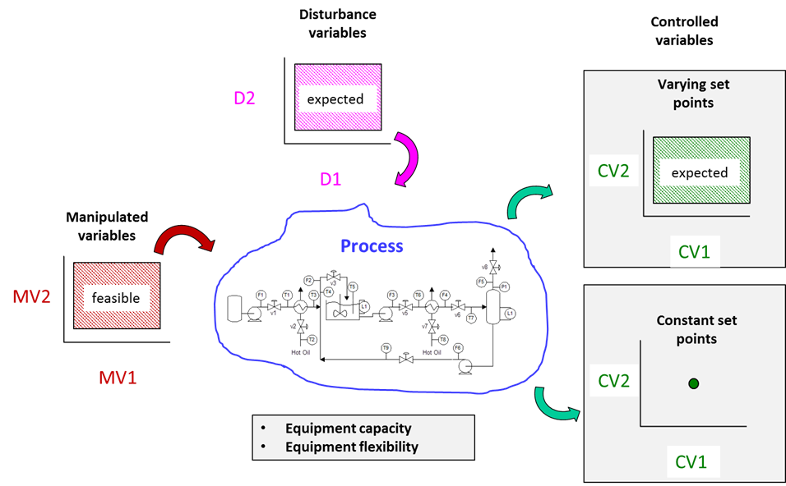
Key Operability issues
1. Operating window
2. Flexibility/
controllability
3. Reliability
4. Safety & equipment protection
5. Efficiency & profitability
6. Operation during transitions
7. Dynamic Performance
8. Monitoring & diagnosis
Chapter 2 Operating Window
Calculating the Steady-state Operating Window
Note: Distributions can (and usually do) have more complex shapes

Slide 33
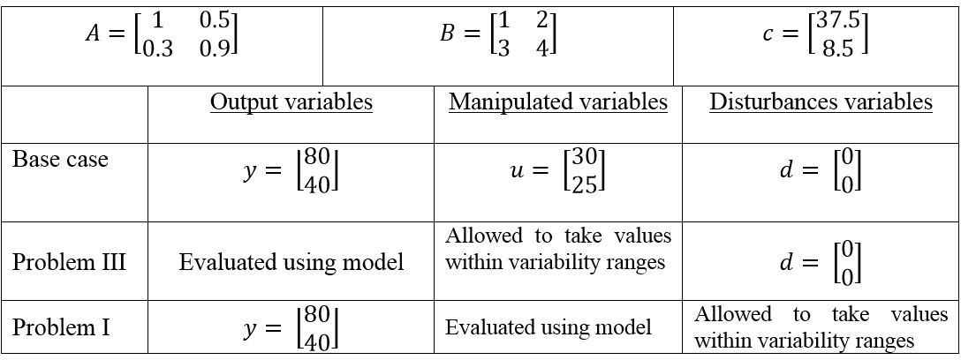
Key Operability issues
1. Operating window
2. Flexibility/
controllability
3. Reliability
4. Safety & equipment protection
5. Efficiency & profitability
6. Operation during transitions
7. Dynamic Performance
8. Monitoring & diagnosis
Chapter 2 Operating Window
Class Workshop: Calculate the operating window for a process described by the following linear model.
y = A *u + B *d + c
y = vector of dependent variables (i.e., controlled variables)
u = vector of adjustable independent variables (i.e., a manipulated variables)
d = vector of independent variables that cannot be directly adjusted (i.e., a disturbances)
A, B, c = parameters, vector or matrix as appropriate

Slide 34
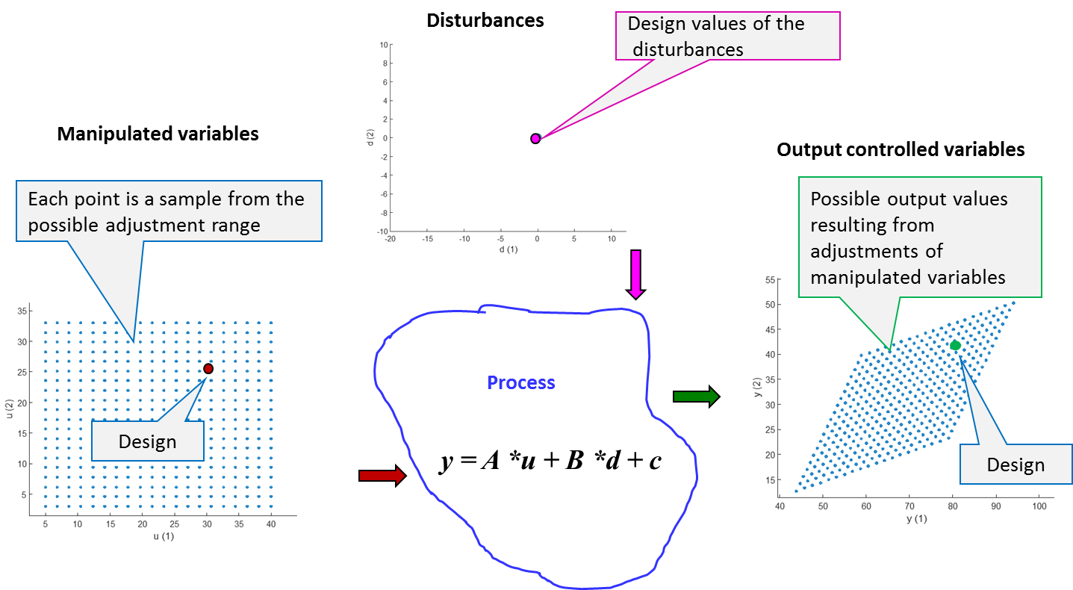
Key Operability issues
1. Operating window
2. Flexibility/
controllability
3. Reliability
4. Safety & equipment protection
5. Efficiency & profitability
6. Operation during transitions
7. Dynamic Performance
8. Monitoring & diagnosis
Chapter 2 Operating Window
Constant; no disturbances
y = A *u + B *d + c
Calculated for each set of values for the manipulated variables.
Allowed to vary over anticipated range.
Note: Arrows show order of calculation, which in this case is the same as causality in physical system.

Slide 35
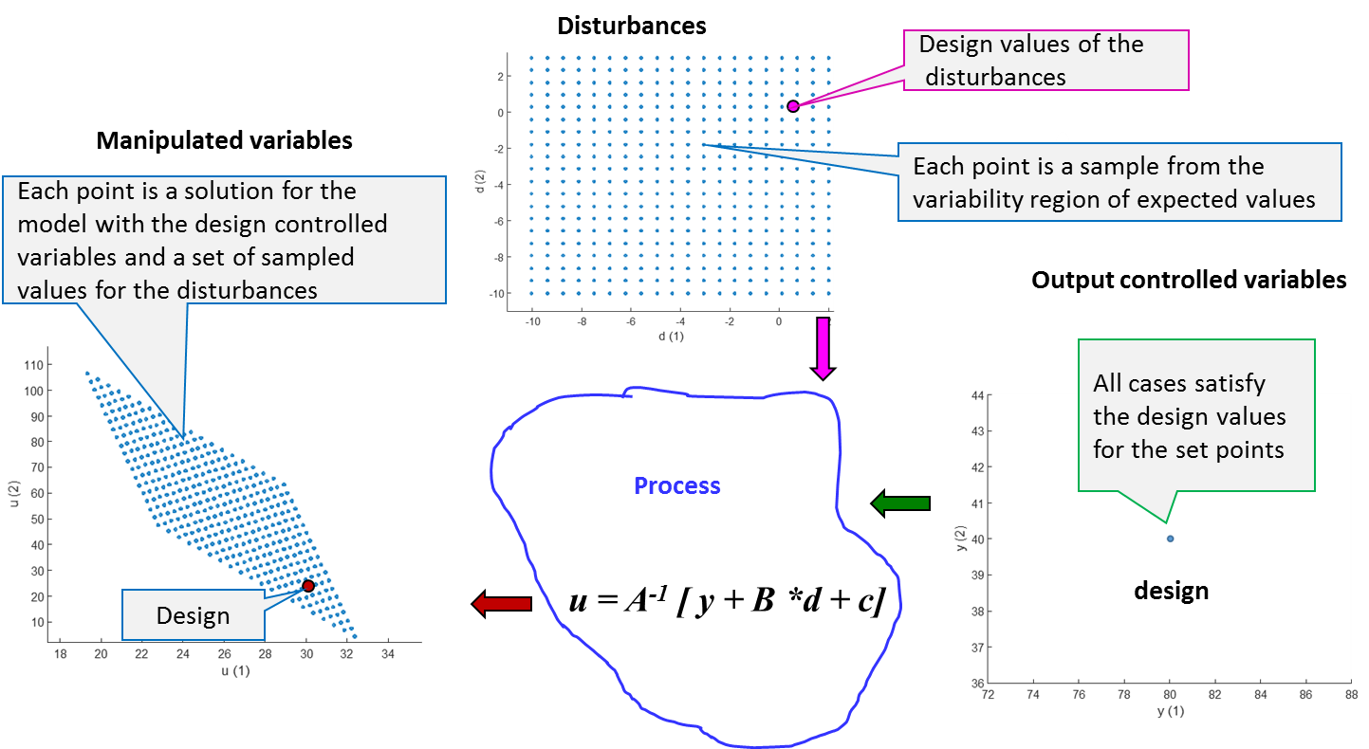
Key Operability issues
1. Operating window
2. Flexibility/
controllability
3. Reliability
4. Safety & equipment protection
5. Efficiency & profitability
6. Operation during transitions
7. Dynamic Performance
8. Monitoring & diagnosis
Chapter 2 Operating Window
Allowed to vary over range
y = A *u + B *d + c
Constant; must satisfy set points.
Calculated for each set of values in the disturbance variability range .
Note: Arrows show order of calculation, not causality in physical system.

Slide 36
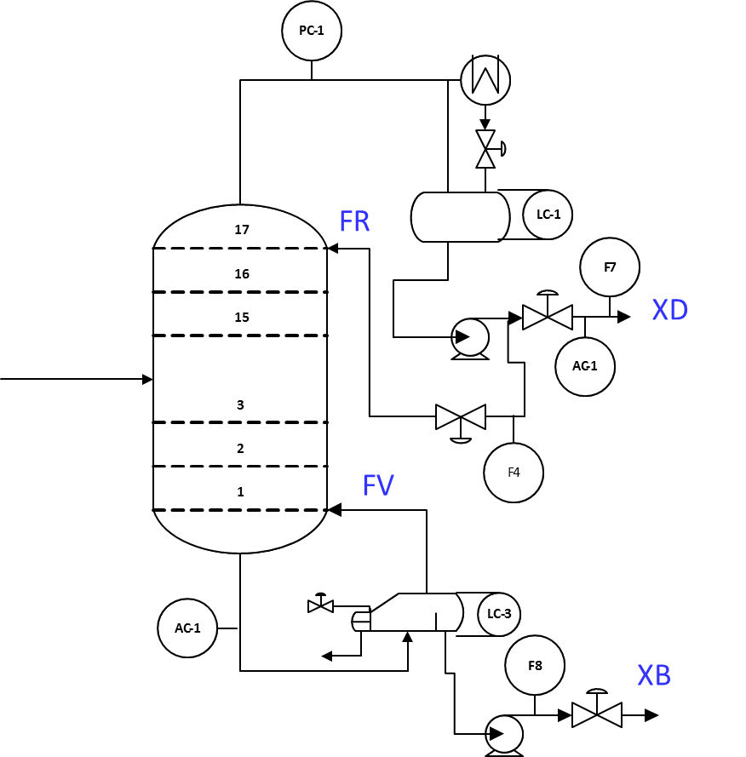
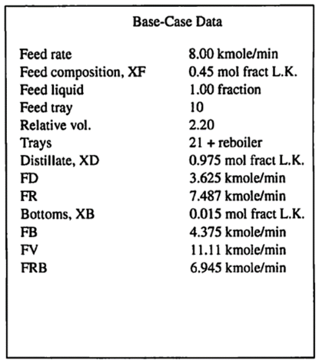
Key Operability issues
1. Operating window
2. Flexibility/
controllability
3. Reliability
4. Safety & equipment protection
5. Efficiency & profitability
6. Operation during transitions
7. Dynamic Performance
8. Monitoring & diagnosis
Chapter 2 Operating Window
Class Workshop – Determine the operating window for the two product distillation tower shown below. Specifically, determine the range of manipulated variables (FV and FR) required for disturbances in the feed flow rate and feed composition.
Feed rate
4-14 kmole/min
Feed L.K.
0.30-0.60 mole fraction

Slide 37
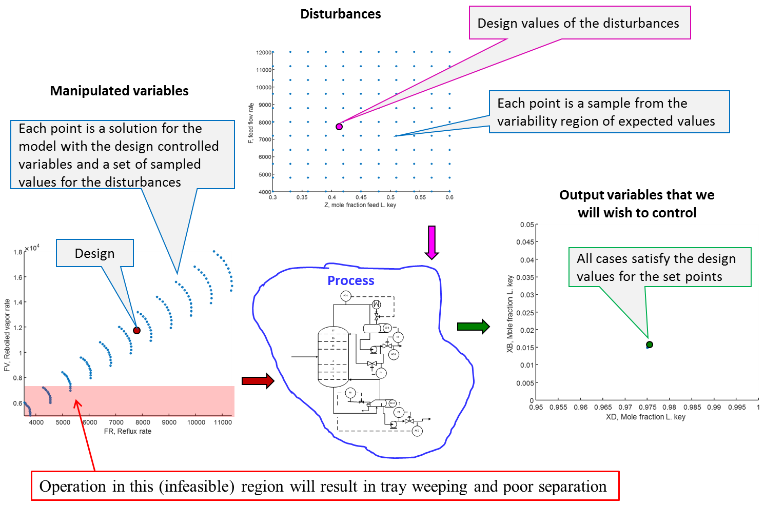
Key Operability issues
1. Operating window
2. Flexibility/
controllability
3. Reliability
4. Safety & equipment protection
5. Efficiency & profitability
6. Operation during transitions
7. Dynamic Performance
8. Monitoring & diagnosis
Chapter 2 Operating Window

Slide 38
Key Operability issues
1. Operating window
2. Flexibility/
controllability
3. Reliability
4. Safety & equipment protection
5. Efficiency & profitability
6. Operation during transitions
7. Dynamic Performance
8. Monitoring & diagnosis
Chapter 2 Operating Window
Lesson Outline
Operability Window Problem Definition
Operating Window Calculations
- Method
- Linear Example
- Non-linear Process Example
- Selecting Manipulated Variable
- Limitations

Slide 39
Key Operability issues
1. Operating window
2. Flexibility/
controllability
3. Reliability
4. Safety & equipment protection
5. Efficiency & profitability
6. Operation during transitions
7. Dynamic Performance
8. Monitoring & diagnosis
Chapter 2 Operating Window
How do we properly select manipulated variables?
Key aspects of manipulated variable selection
1. Each has a strong effect on controlled output variable
u_{i} * K_{i} = y_{i}
K_{i} should be “large” to provide correction for disturbances to one or more y_{i}

Slide 40
Key Operability issues
1. Operating window
2. Flexibility/
controllability
3. Reliability
4. Safety & equipment protection
5. Efficiency & profitability
6. Operation during transitions
7. Dynamic Performance
8. Monitoring & diagnosis
Chapter 2 Operating Window
How do we properly select manipulated variables?
Key aspects of manipulated variable selection
1. Each has a strong effect on controlled output variable
2. Controllable system – Affect all controlled variables independently using all manipulated variables.
y = A *u + B *d + c
y = vector of dependent variables (i.e., controlled variables)
u = vector of adjustable independent variables (i.e., a manipulated variables)
d = vector of independent variables that cannot be directly adjusted (i.e., a disturbances)
A, B, c = parameters, vector or matrix as appropriate
u = A⁻¹ [ y + B *d + c]
Det (A) ≠ 0

Slide 41
Key Operability issues
1. Operating window
2. Flexibility/
controllability
3. Reliability
4. Safety & equipment protection
5. Efficiency & profitability
6. Operation during transitions
7. Dynamic Performance
8. Monitoring & diagnosis
Chapter 2 Operating Window
How do we properly select manipulated variables?
Key aspects of manipulated variable selection
1. Each has a strong effect on controlled output variable
2. Controllable system – Affect all controlled variables independently using all manipulated variables.
3. Range – Able to achieve all desired controlled variable values with disturbances occurring.
Disturbance variables
Process design must be able to achieve this range of adjustments
Manipulated variables
Controlled variables

Slide 42
Key Operability issues
1. Operating window
2. Flexibility/
controllability
3. Reliability
4. Safety & equipment protection
5. Efficiency & profitability
6. Operation during transitions
7. Dynamic Performance
8. Monitoring & diagnosis
Chapter 2 Operating Window
How do we properly select manipulated variables?
Key aspects of manipulated variable selection
1. Each has a strong effect on controlled output variable
2. Controllable system – Affect all controlled variables independently using all manipulated variables.
3. Range – Able to achieve all desired controlled variable values with disturbances occurring.
4. Independence – Adjustments should not cause disturbances or high cost to remainder of process.
5. Dynamics – Fast feedback dynamics able to respond quickly to disturbances.

Slide 43
Key Operability issues
1. Operating window
2. Flexibility/
controllability
3. Reliability
4. Safety & equipment protection
5. Efficiency & profitability
6. Operation during transitions
7. Dynamic Performance
8. Monitoring & diagnosis
Chapter 2 Operating Window
Limitations to this Operating Window Analysis
1. Only steady-state behavior is considered. Transient operation can have a larger range.
2. Large excursions, (e.g., startup and shutdown, major faults, etc.) are not considered.
3. It is assumed that the process has only one steady-state operating point for each case.
4. Model structural uncertainty not addressed.
5. “Curse of dimensionality” when numerous variables are included in the variability cases.

Slide 44
Key Operability issues
1. Operating window
2. Flexibility/
controllability
3. Reliability
4. Safety & equipment protection
5. Efficiency & profitability
6. Operation during transients
7. Dynamic Performance
8. Monitoring & diagnosis
Chapter 2 Operating Window
Typical Industrial Practice
SAFETY FACTORS: Some “safety factor” is built into the design procedure. After we have calculated the required pipe diameter, valve diameter, vessel size, motor power etc., we purchase the closest available size.
Since the manufactured sizes are discrete, we select the next largest size.
This provides some safety margin.

Slide 45
Key Operability issues
1. Operating window
2. Flexibility/
controllability
3. Reliability
4. Safety & equipment protection
5. Efficiency & profitability
6. Operation during transients
7. Dynamic Performance
8. Monitoring & diagnosis
Chapter 2 Operating Window
Typical Industrial Practice
SAFETY FACTORS: Couldn’t we just design for the base case and multiply every capacity by a safety factor,
(1+ X/100) with X = 25%, 35%, 50%, ….
This is not engineering! Any single factor would be too small for some equipment and too large for others.
After applying the proper operating window analysis, a small safety factor can be employed for modelling uncertainty, based on experience. Typical values are 10-15%.
“For well tested process, safety factors can approach 0%” *
* Valle-Riestra, J.F. (Dow Chemical Co.), Project Evaluation in the Process Industries, McGraw-Hill, New York, 1983 (pg 209)

Slide 46
Chapter 2 Operating Window
Important variability should be defined as an integral part of the project definition.
Design Procedure
Set goals and design specifications
Select process technology
Define process structure (sequence)
Simulate the flowsheet
Design equipment
The design must define the range of operations (set points and disturbances) to be achieved.
We can accept less than full production rate or top efficiency for extreme situations.
We must document specifications and range or operations and review with all stakeholders!
These “specifications” are in the
Design Basis Memorandum.
The flowsheet typically involves basic M&E balances, equilibrium and rate processes. It does not consider practical issues for achieving the operation.
Equipment design achieves the base case flowsheet (plus other concerns). This sets the “capacity” of the plant.

Slide 47
Key Operability issues
1. Operating window
2. Flexibility/
controllability
3. Reliability
4. Safety & equipment protection
5. Efficiency & profitability
6. Operation during transitions
7. Dynamic Performance
8. Monitoring & diagnosis
Chapter 2 Operating Window
Conclusions
The operating window analysis determines the capacity of process equipment and the range over which it operates.
How can we change the operation of equipment, e.g.,
“ How can we change the duty of a heat exchanger after is has been built and installed?”
Then, we address subsequent issues;
Reliability
Safety
Control
…………………

Slide 48
Key Operability issues
1. Operating window
2. Flexibility/
controllability
3. Reliability
4. Safety & equipment protection
5. Efficiency & profitability
6. Operation during transients
7. Dynamic Performance
8. Monitoring & diagnosis
Chapter 2 Operating Window
Citations
1. Rebecca Clements (2019) Dopamine, Smartphones and You, SITNBoston is licensed under a Creative Commons Attribution-NonCommercial-ShareAlike 4.0 International License. http://sitn.hms.harvard.edu/flash/2018/dopamine-smartphones-battle-time/
2. Mbeychok, Milton https://commons.wikimedia.org/wiki/File:CatReformer.png
3. Padleckis, H., (2006A) (visited 2019)
https://commons.wikimedia.org/wiki/File:Bubble_Cap_Trays.PNG
4. Pickerton et. al. (2014) visited 2019, Northwestern University https://processdesign.mccormick.northwestern.edu/index.php/Separation_processes

Slide 49
Key Operability issues
1. Operating window
2. Flexibility/
controllability
3. Reliability
4. Safety & equipment protection
5. Efficiency & profitability
6. Operation during transients
7. Dynamic Performance
8. Monitoring & diagnosis
Chapter 2 Operating Window
WORKSHOPS
Flip the Classroom: Since you have engaged the basic material in the eLearning format, you are prepared to perform these workshops as class exercises.
You have complained that lectures are boring; now, you get to be active by solving problems during class !
To improve the learning experience, we recommend that you perform these exercises in small groups.
Please be sure to record your questions and bring them to the attention of your instructor.

Slide 50
Key Operability issues
1. Operating window
2. Flexibility/
controllability
3. Reliability
4. Safety & equipment protection
5. Efficiency & profitability
6. Operation during transitions
7. Dynamic Performance
8. Monitoring & diagnosis
Chapter 2 Operating Window
Workshop 1
Consider the flow system. What variables must we determine? What is the “worst case” we would use to design the system, specifically the required pump outlet pressure?

Slide 51
Key Operability issues
1. Operating window
2. Flexibility/
controllability
3. Reliability
4. Safety & equipment protection
5. Efficiency & profitability
6. Operation during transitions
7. Dynamic Performance
8. Monitoring & diagnosis
Chapter 2 Operating Window
Solution - The design will define a boundary of the operating window - Worst case gives the largest pump.
Highest vessel
pressure
Lowest level
(lowest head)
Highest flow,
largest friction
factor
P_{p}
Highest
pressure drop
Highest
pressure drop
What variables must we determine?
- Pipe diameter - by guideline liquid velocity ≈ 1 m/s ( Gas: 30 m/s)
- Pump horsepower - from highest flow rate and P_{P} and
the lowest suction pressure

Slide 52
Key Operability issues
1. Operating window
2. Flexibility/
controllability
3. Reliability
4. Safety & equipment protection
5. Efficiency & profitability
6. Operation during transitions
7. Dynamic Performance
8. Monitoring & diagnosis
Chapter 2 Operating Window
Workshop 2
Equipment must function correctly within the operating window. Discuss issues that would limit the usefulness of the flow sensor measurement and suggest improvements to the design.
Orifice meter
heating
FC
Cold (20C) liquid

Slide 53
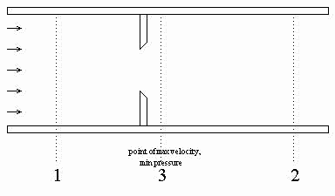
Key Operability issues
1. Operating window
2. Flexibility/
controllability
3. Reliability
4. Safety & equipment protection
5. Efficiency & profitability
6. Operation during transitions
7. Dynamic Performance
8. Monitoring & diagnosis
Chapter 2 Operating Window
ΔP_{orifice}
Measure pressure drop
pressure
ΔP_{orifice}=P₁ – P₃
Distance →

Slide 54



Relate the pressure drop to the flow rate
v = velocity
F = volumetric flow rate
f = frictional losses
= density
A = cross sectional area
Bernoulli’s eqn.
General meter eqn.
Installed orifice meter
(requires density measurement)
ρ₀ = aver. density
C₀ = constant for specific meter
Installed orifice meter
(assuming constant density)
Most common flow calculation, does not require density measurement

Slide 55
When an orifice meter is used, the calculations in yellow are performed. Typically, they are not shown on a process drawing.
“Measured value” to flow controller
Multiply signal by meter constant K
K
FC
Take square root of measurement
√
Measure pressure difference
ΔP
liquid
cooling

Slide 56
Relate the pressure drop to the flow rate
v = velocity
F = volumetric flow rate
f = frictional losses
= density
A = cross sectional area
General meter eqn.
C_{meter}
We assume that the meter coefficient is constant. The flow accuracy is acceptable only for higher values of flow, typically 25-100% of the maximum for an orifice
Reynolds number

Slide 57
What is a key disadvantage of the orifice meter?
ΔP_{loss} = P₁ – P₂
Pressure loss!
When cost of pressure increase (P₁) by pumping or compression is high, we want to avoid the “non-recoverable” pressure loss.
pressure
ΔP_{orifice}=P₁ – P₃
Non-recoverable pressure drop
Distance →

Slide 58
Key Operability issues
1. Operating window
2. Flexibility/
controllability
3. Reliability
4. Safety & equipment protection
5. Efficiency & profitability
6. Operation during transitions
7. Dynamic Performance
8. Monitoring & diagnosis
Chapter 2 Operating Window
Equipment must function correctly within the operating window
Orifice meter
heating
FC
Cold (20C) liquid
The fluid can partially vaporize.
The pressure difference will
not reliability indicate
the flow rate!
Velocity increases; Bernoulli says that pressure decreases

Slide 59
Key Operability issues
1. Operating window
2. Flexibility/
controllability
3. Reliability
4. Safety & equipment protection
5. Efficiency & profitability
6. Operation during transitions
7. Dynamic Performance
8. Monitoring & diagnosis
Chapter 2 Operating Window
Equipment must function correctly within the operating window
heating
FC
Cold (20C) liquid
Simple solution,
Locate flow
measurement where the
pressure is highest
and temperature lowest.
Ensure that flashing does not
occur - design calc’s

Slide 60
Key Operability issues
1. Operating window
2. Flexibility/
controllability
3. Reliability
4. Safety & equipment protection
5. Efficiency & profitability
6. Operation during transitions
7. Dynamic Performance
8. Monitoring & diagnosis
Chapter 2 Operating Window
Workshop 3
Equipment must function correctly within the operating window. Discuss the meaning of cavitation and how it can influence the design of the inventory and pumping at the bottoms of a distillation column.
Centrifugal pump
Bottoms product
reboiler

Slide 61
Key Operability issues
1. Operating window
2. Flexibility/
controllability
3. Reliability
4. Safety & equipment protection
5. Efficiency & profitability
6. Operation during transitions
7. Dynamic Performance
8. Monitoring & diagnosis
Chapter 2 Operating Window
Workshop 3
Centrifugal pump
Bottoms product
reboiler
What happens
in the
pump?
Pressure drop due to the velocity increase in the eye of the pump
Pressure drop due to flow frictional losses

Slide 62
Key Operability issues
1. Operating window
2. Flexibility/
controllability
3. Reliability
4. Safety & equipment protection
5. Efficiency & profitability
6. Operation during transitions
7. Dynamic Performance
8. Monitoring & diagnosis
Chapter 2 Operating Window
Equipment must function correctly within the operating window
Centrifugal pump
Bottoms product
reboiler
Cavitation: The liquid partially vaporizes. As the pressure increases in the pump, the vapor is subsequently condensed. This collapsing of bubbles (cavitation ) causes noise, vibration and erosion - all of which are bad.

Slide 63
Key Operability issues
1. Operating window
2. Flexibility/
controllability
3. Reliability
4. Safety & equipment protection
5. Efficiency & profitability
6. Operation during transitions
7. Dynamic Performance
8. Monitoring & diagnosis
Chapter 2 Operating Window
Equipment must function correctly within the operating window
NPSHR: The manufacturer must define the minimum net positive suction head required.
The process engineer must design to provide it. NPSHA>NPSHR
reboiler
Centrifugal pump
This liquid head increases the pressure at the inlet to the pump and prevents cavitation.
Bottoms product
NPSHA

Slide 64
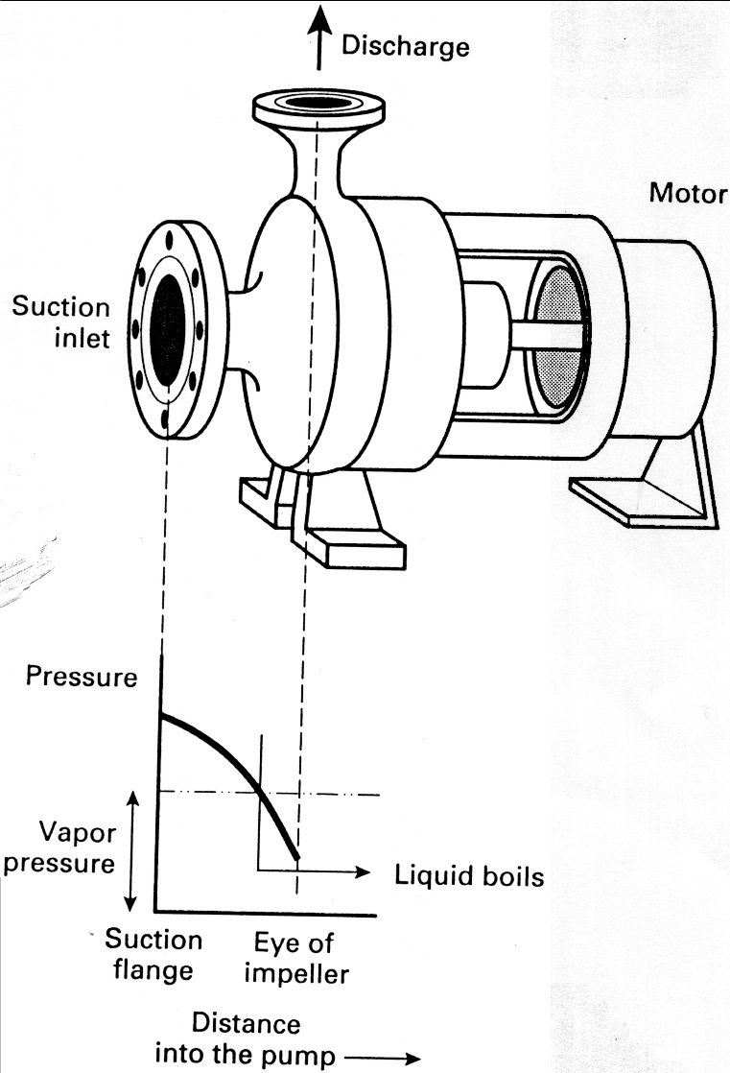
Key Operability issues
1. Operating window
2. Flexibility/
controllability
3. Reliability
4. Safety & equipment protection
5. Efficiency & profitability
6. Operation during transitions
7. Dynamic Performance
8. Monitoring & diagnosis
Chapter 2 Operating Window
Equipment must function correctly within the operating window
NPSHR: The manufacturer must define the minimum net positive suction head required.
The process engineer must design to provide it. How?
Elevate the liquid above the pump (two ways)
Reduce friction losses
Subcool the liquid (careful of added pressure drop)
This is issue when liquid is at (near) its bubble point. Give examples when this is the situation in chemical processes.
From: Woods, D.R., Process Design and Engineering Practice, Prentice -Hall, 1995

Slide 65

Key Operability issues
1. Operating window
2. Flexibility/
controllability
3. Reliability
4. Safety & equipment protection
5. Efficiency & profitability
6. Operation during transitions
7. Dynamic Performance
8. Monitoring & diagnosis
Chapter 2 Operating Window
Equipment must function correctly within the operating window
This is issue when liquid is at (near) its bubble point. Give examples when this is the situation in chemical processes.
We deal with liquids at their bubble points often, for example,
Distillation/stripper bottoms
Distillation/absorber condensers and
OH drums
Flash drums
Concentration by boiling
Vapor compression refrigeration
Reactor cooling by solvent vaporization
From: Woods, D.R., Process Design and Engineering Practice, Prentice -Hall, 1995

Slide 66
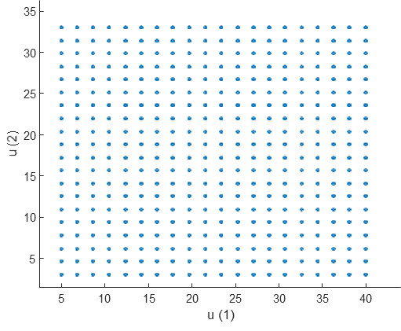
Chapter 2 Operating Window
Workshop 4
Complete the figure below with the general form of the Controlled variable region for as many cases as you can think of, including acceptable and unacceptable controllability.
Disturbances
Design values of the
disturbances
Manipulated variables
Each point is a sample from the possible adjustment range
Output controlled variables
Process
Design
Design

Slide 67
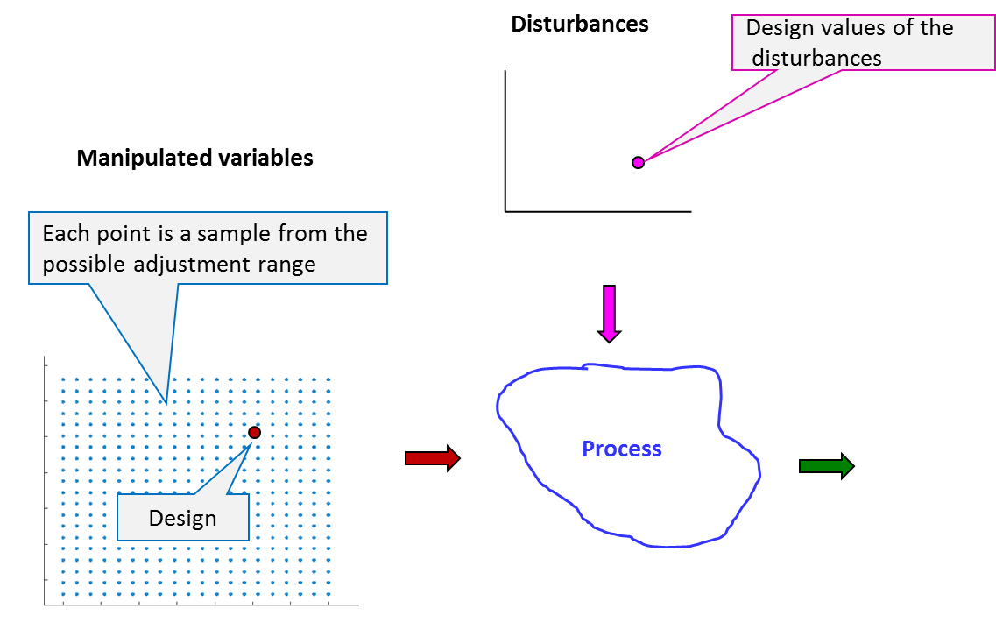
Chapter 2 Operating Window
Workshop 4
Complete the figure below with the general form of the Controlled variable region for as many cases as you can think of, including acceptable and unacceptable controllability.
Controllable
Uncontrollable
Large region
Only CV1 affected
Small region
Only CV2 affected
Both affected, but not independently
Ill-conditioned

Slide 68
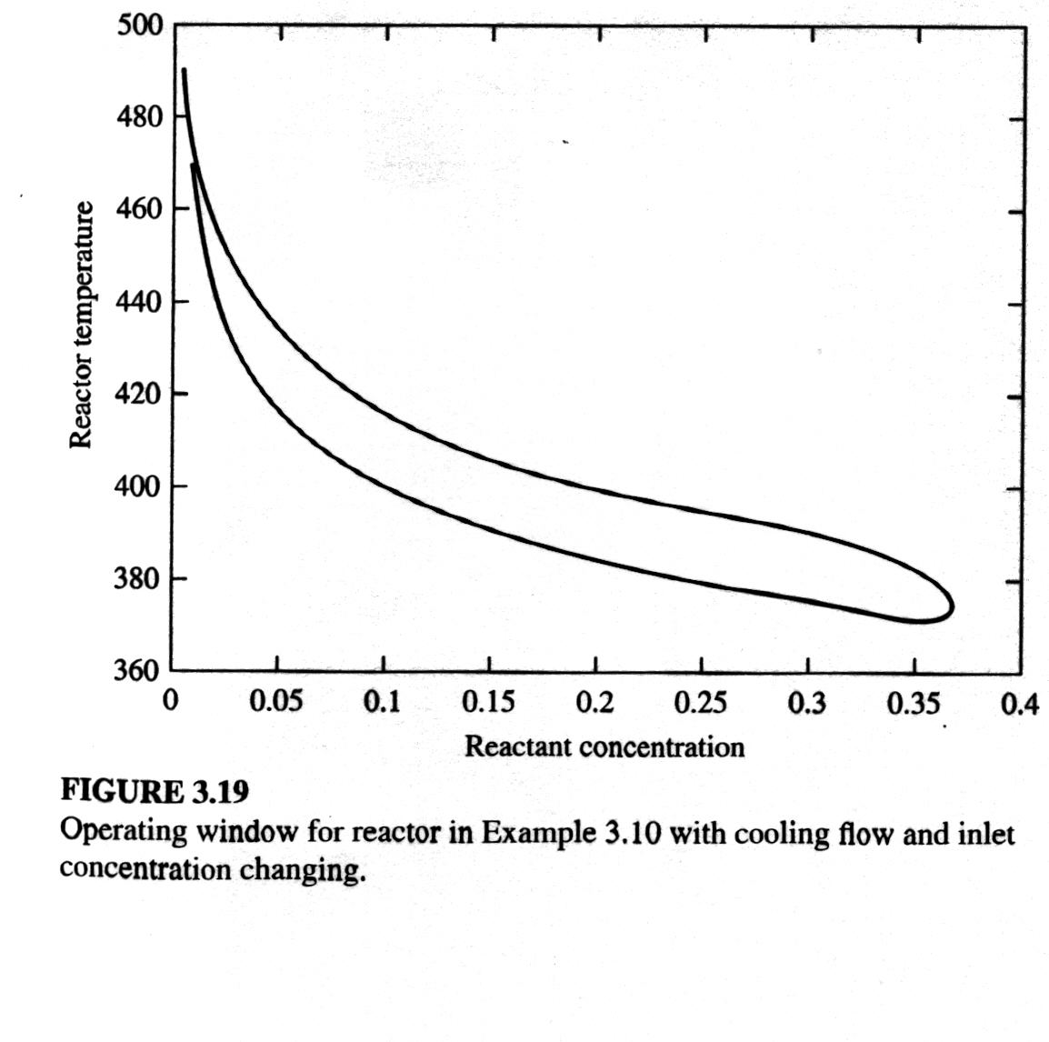
Key Operability issues
1. Operating window
2. Flexibility/
controllability
3. Reliability
4. Safety & equipment protection
5. Efficiency & profitability
6. Operation during transitions
7. Dynamic Performance
8. Monitoring & diagnosis
Chapter 2 Operating Window
Workshop 5
Describe the shape of the operating window for the CSTR below and explain why it is not similar to a rectangle.
Solvent
T
A
Reactant
Coolant
A → B
-r_{A} = k₀ e ^{-E/RT} C_{A}
Reactant concentration in reactor

Slide 69
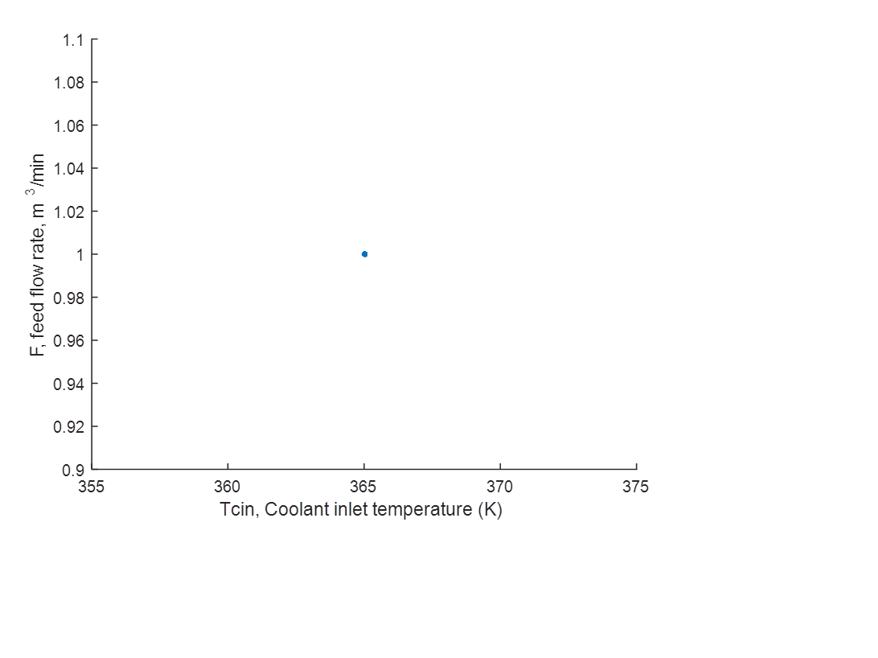
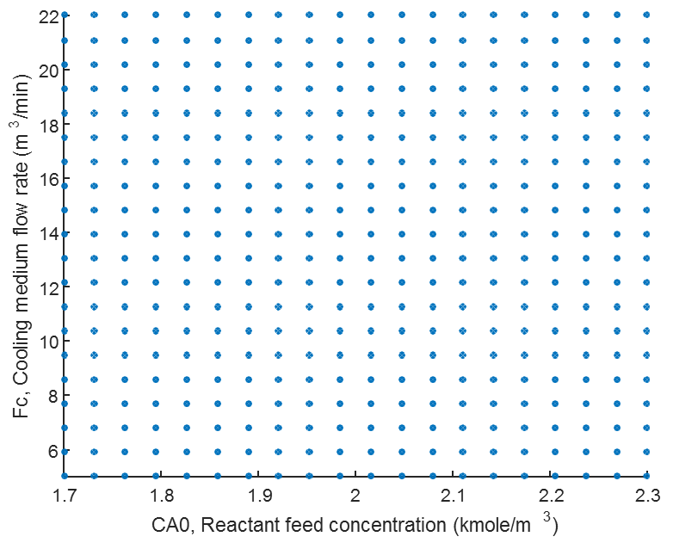
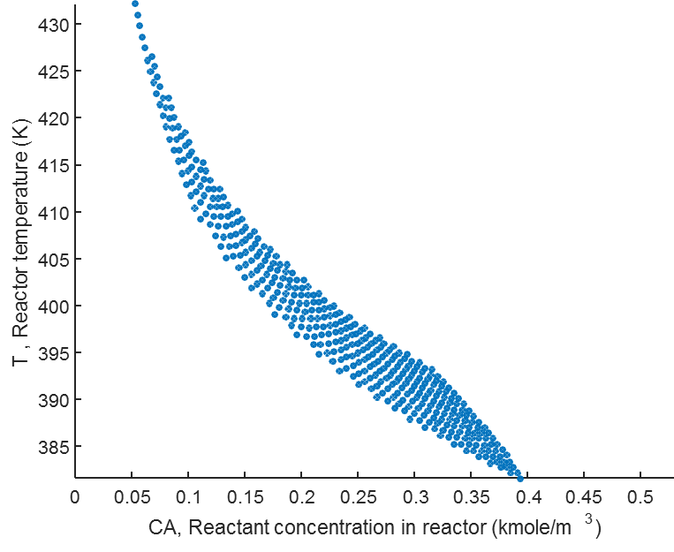
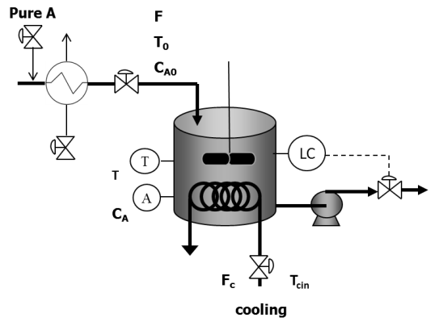
Workshop 5
High temperatures and high concentrations not possible because high temperatures cause fast reaction rate.
Low temperatures and low concentrations not possible because low temperatures cause slow reaction rate.
Disturbances
expected
Manipulated variables
Output variables that we will wish to control
Process without control

Slide 70
Key Operability issues
1. Operating window
2. Flexibility/
controllability
3. Reliability
4. Safety & equipment protection
5. Efficiency & profitability
6. Operation during transitions
7. Dynamic Performance
8. Monitoring & diagnosis
Chapter 2 Operating Window
Workshop 6
Read the following paper and discuss the following issues.
What is the relationship between “capacity” and “turndown”
Evaluate the definition of capacity in the paper; suggest additional issues needed.
Apply the results from part (2) to develop a definition of turndown.
Ogle, R. and A. Carpenter (2014) Calculating the Capacity of Chemical Plants, Chemical Engineering Progress, 110, No. 8, 59-63.

