Slide 1
Process Operability Class Materials
Chapter 4. Reliability
Basic flowsheet
Design with Operability
LC
1
FC
1
Copyright © Thomas Marlin 2013
The copyright holder provides a royalty-free license for use of this material at non-profit educational institutions

Slide 2

Chapter 4 Reliability
Reliability is a Key Aspect of Operability
When you purchase an expensive item on which you depend, such as an automobile, would you consider the reported reliability of the candidates?
Likelihood of breakdowns
(on a snowy road)
Cost of maintenance
Cost of replacement parts
Reduced functionality due to faulty components
Cost of low reliability (missed appointments, late for work)
Citation 1

Slide 3
:
Chapter 4 Reliability
A CONCISE DEFINITION OF RELIABILITY
RELIABILITY
The probability that an item can perform its intended function for a specified interval under stated conditions.
Probability | The likelihood expressed as a fraction 0-1. This says nearly nothing about any one instance; low probability can still occur!
Intended function | The design function required to achieve desired production rate with specified product quality.
Specified interval | For example, the time from startup to shutdown for maintenance (e.g., two years) or for forty batches.
Stated Conditions | The range of conditions expected during operations, broader than the design point, e.g., a range of raw materials, production rate, equipment performance, ambient conditions and so forth.
Notes:
This is a general, concise statement. The instructor might want to indicate that he/she will ask the students to modify and improve the definition after either this lesson or after all topics have been covered.
The instructor could ask the class to discuss what they believe to be the meaning of “robust” as used in this slide.
The instructor might want the class to discuss an every-day item like an automobile to consider the importance of the ability to respond to changes from an idea situation, like driving on a test track.

Slide 4
Key Operability issues
1. Operating window
2. Flexibility/
controllability
3. Reliability
4. Safety & equipment protection
5. Efficiency & profitability
6. Operation during transitions
7. Dynamic Performance
8. Monitoring & diagnosis
Chapter 4 Reliability
Reliability in Perspective
Initiating cause
Process effects
Consequences
When consequences could cause hazards, safety analysis is required (next chapter)
Damage equipment
Safety analysis required to achieve a low likelihood of cause
Production loss
Hazardous material
release
1
When consequences could cause economic losses but no hazards, reliability analysis is appropriate
Reliability analysis required to achieve highest life-cycle profit
2
Damage equipment
Place redundant equipment in operation
Economic loss could result from production rate decrease, poor product quality, low yield, high fuel consumption, equipment repair or replacement, increased working capital, and so forth.

Slide 5
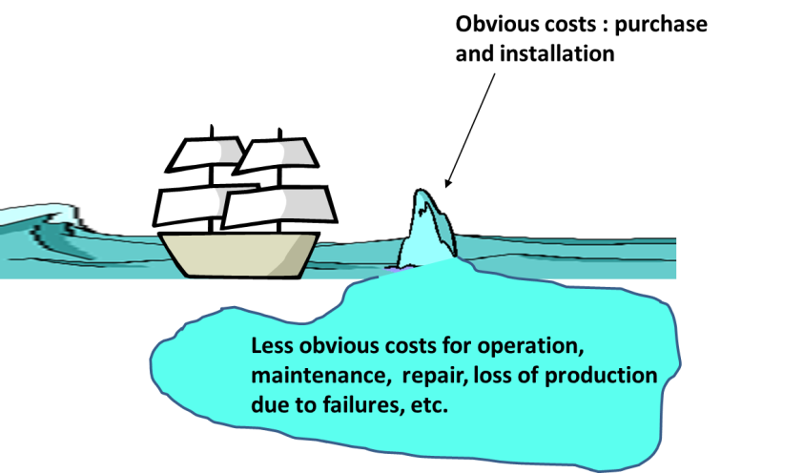
Key Operability issues
1. Operating window
2. Flexibility/
controllability
3. Reliability
4. Safety & equipment protection
5. Efficiency & profitability
6. Operation during transitions
7. Dynamic Performance
8. Monitoring & diagnosis
Chapter 4 Reliability
Motivation
Reduced by high reliability
Total Cost Can be Dominated by Cost of Operation
Raw materials | Spare parts
Fuel consumption | Maintenance
Catalyst purchase | Equipment repair and replacement
Solvents, etc. | Lost sales during unplanned shutdown
Waste treatment | Material storage & disposal due to shutdown
……………….. | Additional wear during heating/cooling during shutdown or startup
Notes:
This is a general introductory slide. The class discussion and perhaps, a new introductory slide should be tailored to the prior learning experiences of the students, which will be different in each university.
The instructor could relate these concepts to
* An engineering case study or design experience from a prior course
* An example from everyday life, e.g., an electric lamp with on/off switch, manual dimmer, method for replacing the bulb, ground fault interruption, and fuse.

Slide 6
Chapter 4 Reliability
Lesson Outline
Reliability: Qualitative Overview
Reliability: Data and Models
Design and Operations for Reliability
Maintenance for Reliability
Economic Analysis: Life Cycle Costing
Quiz
Workshops
Let’s do this
Notes:
This lesson provides an overview of the Operability topic. Some key issues are explained that students will apply throughout their study of the topic and in engineering practice thereafter. These issues will provide helpful checklists for identifying operability challenges and introducing modification to achieve desired performance.
Workshops are essential to enable students to struggle with issues, propose solutions, and obtain feedback for the instructor. In addition, many of the most common designs for operability will be covered, which will provide a common toolkit for all students in the class. Students will extend their learning when working on group projects that will involve the standard operability issues, but require novel and innovative designs. The novel designs will be similar in concept but different in detail to the workshop examples.
For example, the safety analysis method “HAZOP” will the introduced in the operability lessons and a few exercises will be performed; HAZOP is performed to ensure that workers and the local community is not exposed to unacceptable hazards.
Students working on projects involving food production will encounter a similar concept with the acronym “HACCP”, which is performed to ensure that the food products will be safe for the consumer. The background in operability issues and specific coverage of HAZOP will enable students to assimilate and apply newly learned safety approaches, including HACCP, where applicable.

Slide 7
Chapter 4 Reliability
Reliability: Qualitative Overview
Factors affecting Reliability
Factor | Examples
Materials of construction | Corrosion, temperature, stress
Process operating conditions - Undesirable within normal operation - Extreme fault conditions | Rapid variation within normal boundaries Extremes of pressure, temperature or composition during disturbances
Equipment faults | Mechanical failure of rotating equipment, piping, vessels
Errors by personnel | Failure to diagnose in timely manner, Improper open/closing of valves
Extreme external disturbances | Flooding, high/low ambient temperature

Slide 8
Chapter 4 Reliability
Reliability: Qualitative Overview
Consequences of Faults
Consequence | Examples
Hazards (safety analysis required) | Loss of containment, explosion, fire
Equipment damage | Costs include shutdown, startup, repair, replacement, personnel time If likely, increased inventory of spare parts and maintenance
Production loss | Cannot makeup loss occurred during repairs
Off-specification material | Reprocess, recycle, sell for lower price, destroy, dispose
Reduced process performance | Fouled heat exchanger, deactivated catalyst, lower compressor efficiency

Slide 9
Chapter 4 Reliability
Reliability: Qualitative Overview
Operations Responses to a Fault
Response | Examples
Do nothing (wait for scheduled shutdown) | No hazard exists and products of desired quality can be produced. The cost of repair exceeds loss during operation. Therefore, we accept the loss.
Repair during operation Replace during operation | Plant design must provide flexibility that allows continued operation while selected equipment is not functioning
Shutdown for repair or replacement | Economic loss exceeds cost of shutdown and repair/replacement. Design may allow part of plant shutdown, while remainder operates

Slide 10

Chapter 4 Reliability
Lesson Outline
Reliability: Qualitative Overview
Reliability: Data and Models
- Define failure rate, etc.
- View reliability data
- Effect of structures on reliability
Design and Operations for Reliability
Maintenance for Reliability
Economic Analysis: Life Cycle Costing
Quiz
Workshops
Done
Let’s do this
Notes:
This lesson provides an overview of the Operability topic. Some key issues are explained that students will apply throughout their study of the topic and in engineering practice thereafter. These issues will provide helpful checklists for identifying operability challenges and introducing modification to achieve desired performance.
Workshops are essential to enable students to struggle with issues, propose solutions, and obtain feedback for the instructor. In addition, many of the most common designs for operability will be covered, which will provide a common toolkit for all students in the class. Students will extend their learning when working on group projects that will involve the standard operability issues, but require novel and innovative designs. The novel designs will be similar in concept but different in detail to the workshop examples.
For example, the safety analysis method “HAZOP” will the introduced in the operability lessons and a few exercises will be performed; HAZOP is performed to ensure that workers and the local community is not exposed to unacceptable hazards.
Students working on projects involving food production will encounter a similar concept with the acronym “HACCP”, which is performed to ensure that the food products will be safe for the consumer. The background in operability issues and specific coverage of HAZOP will enable students to assimilate and apply newly learned safety approaches, including HACCP, where applicable.

Slide 11
Key Operability issues
1. Operating window
2. Flexibility/
controllability
3. Reliability
4. Safety & equipment protection
5. Efficiency & profitability
6. Operation during transitions
7. Dynamic Performance
8. Monitoring & diagnosis
Chapter 4 Reliability
Definitions and Terminology
Reliability, R(t): The probability that an item can perform its intended function for a specified interval under stated conditions.
(Value between 0 and 1)
n = number of outcomes

Slide 12
Key Operability issues
1. Operating window
2. Flexibility/
controllability
3. Reliability
4. Safety & equipment protection
5. Efficiency & profitability
6. Operation during transitions
7. Dynamic Performance
8. Monitoring & diagnosis
Chapter 4 Reliability
Definitions and Terminology
Probability of failure, F(t): F(t) + R(t) = 1
Failure rate, λ(t): The number of failures per unit of time at a specific lifetime divided by the number of items at that time.
(Typical units: failures /10⁶ h)

Slide 13
Key Operability issues
1. Operating window
2. Flexibility/
controllability
3. Reliability
4. Safety & equipment protection
5. Efficiency & profitability
6. Operation during transitions
7. Dynamic Performance
8. Monitoring & diagnosis
Chapter 4 Reliability
Reliability data
Failure rate as a function of time. A typical “bathtub curve” is shown below.
Break in,
Infant mortality
Chance failure period,
λ is constant.
Wear out
Nice concept, does it represent real systems?
Failure rate
0 Time

Slide 14
Key Operability issues
1. Operating window
2. Flexibility/
controllability
3. Reliability
4. Safety & equipment protection
5. Efficiency & profitability
6. Operation during transitions
7. Dynamic Performance
8. Monitoring & diagnosis
Chapter 4 Reliability
Reliability data – Failure rate vs. time
Bathtub curve
Vast majority of items experience no wear-out period!
Citation 2, NASA ( 2000)

Slide 15
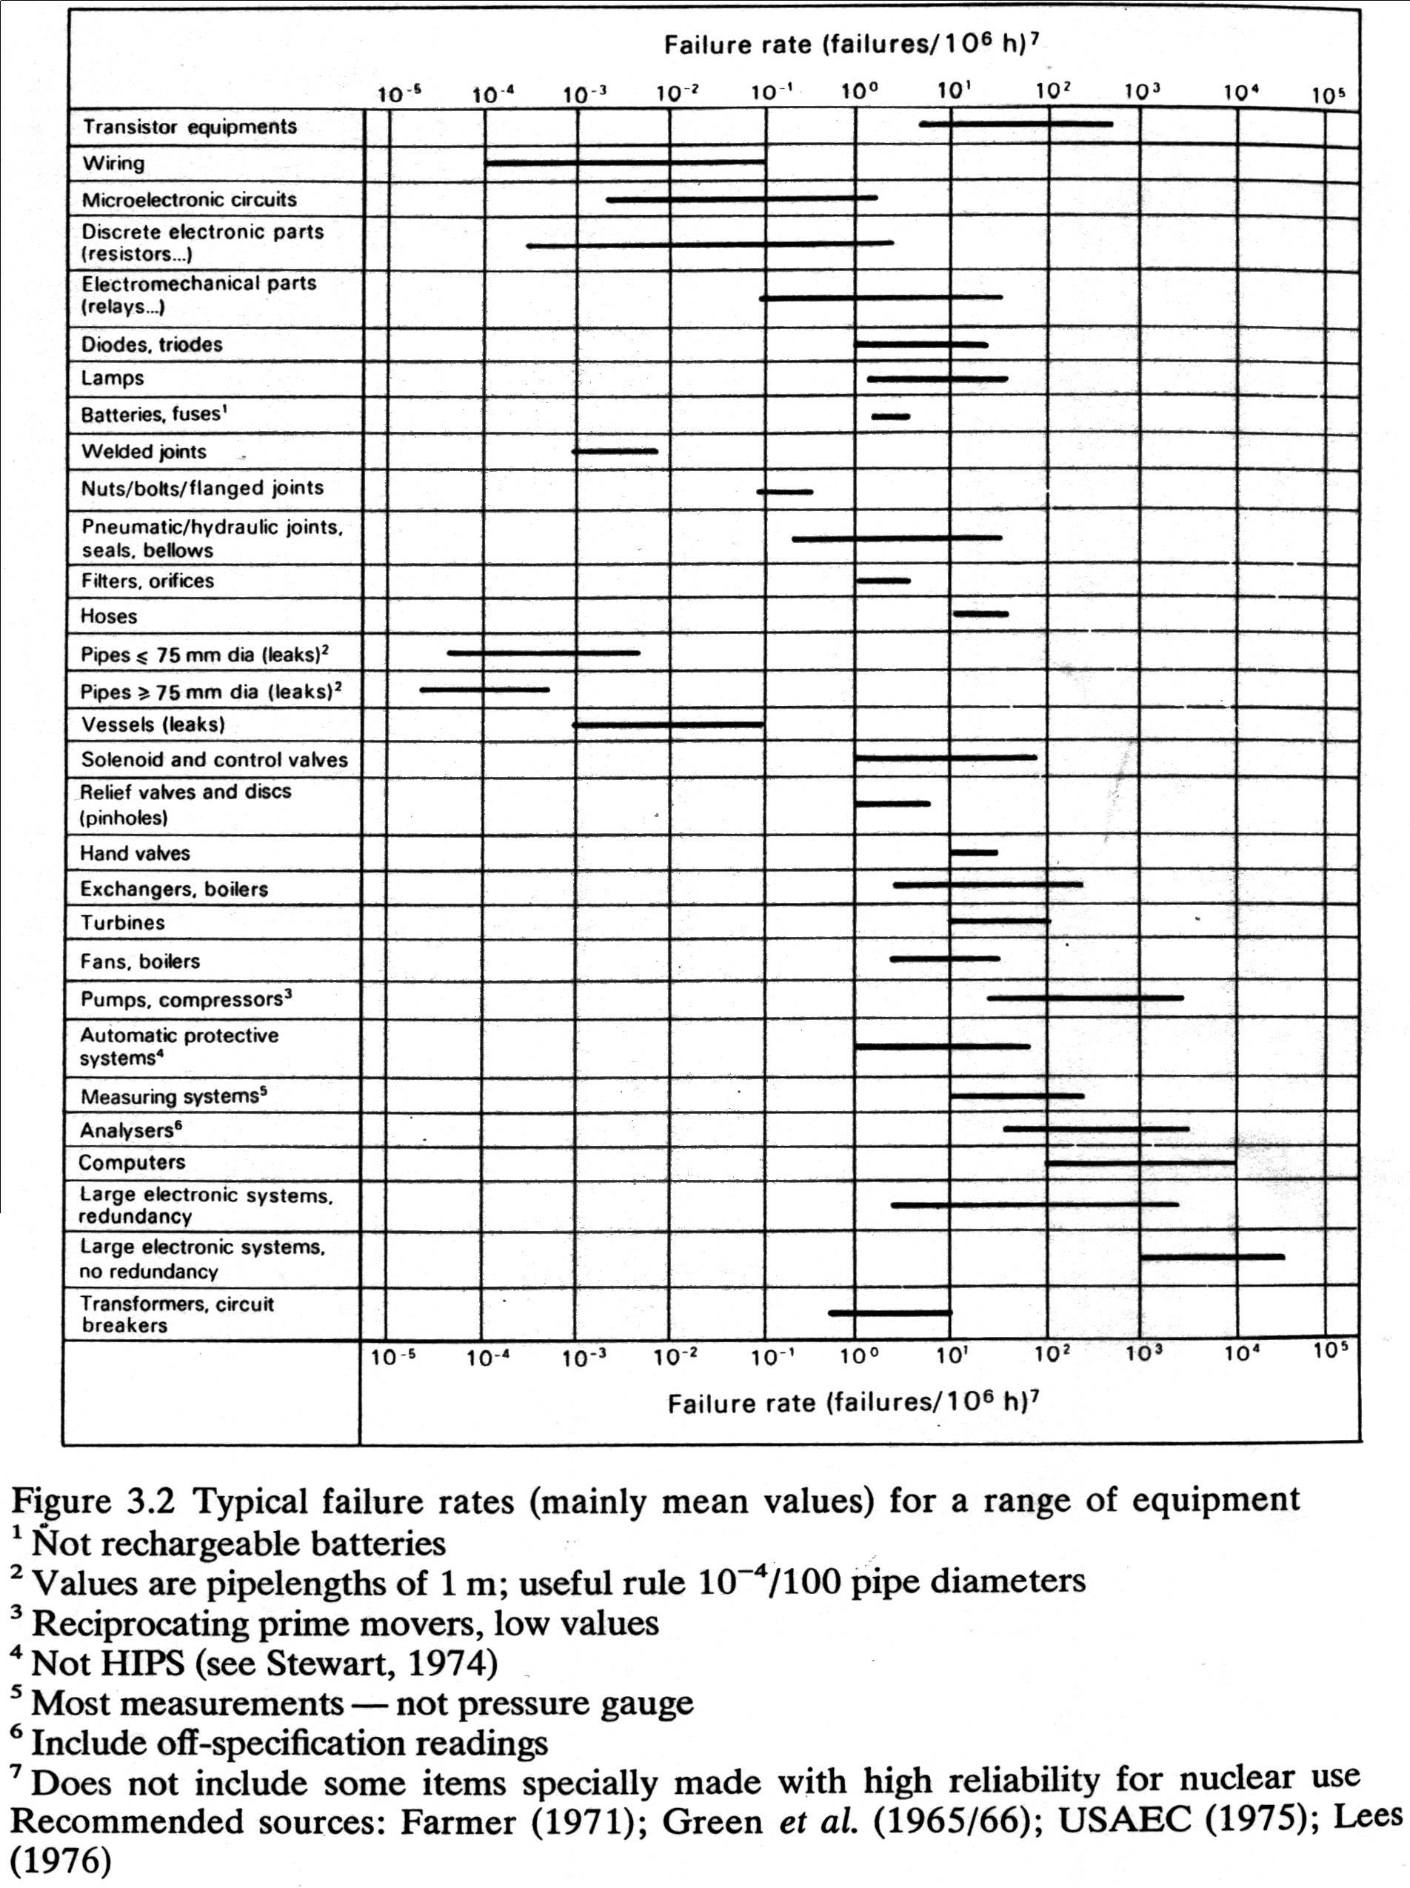
Key Operability issues
1. Operating window
2. Flexibility/
controllability
3. Reliability
4. Safety & equipment protection
5. Efficiency & profitability
6. Operation during transitions
7. Dynamic Performance
8. Monitoring & diagnosis
Chapter 4 Reliability
Reliability data, Wells
Data from Wells (1980) gives a good visual display of relative reliabilities of categories of process equipment.
Citation 3. Wells, G., Safety in Process Plant Design, John Wiley & Sons, New York, 1980.

Slide 16
Key Operability issues
1. Operating window
2. Flexibility/
controllability
3. Reliability
4. Safety & equipment protection
5. Efficiency & profitability
6. Operation during transitions
7. Dynamic Performance
8. Monitoring & diagnosis

Slide 17
Key Operability issues
1. Operating window
2. Flexibility/
controllability
3. Reliability
4. Safety & equipment protection
5. Efficiency & profitability
6. Operation during transitions
7. Dynamic Performance
8. Monitoring & diagnosis
Reliability Data, CCPS Data Base
Guidelines for Process Equipment Reliability Data, CCPS (AIChE)
Citation 4

Slide 18
Key Operability issues
1. Operating window
2. Flexibility/
controllability
3. Reliability
4. Safety & equipment protection
5. Efficiency & profitability
6. Operation during transitions
7. Dynamic Performance
8. Monitoring & diagnosis
Chapter 4 Reliability
Definition, Reliability Mean Times
Mean time to failure (MTTF): The average time between a device being placed in operation and it’s first failure.
Mean time between failures (MTBF): Can include repairable systems, with time to repair and wait included.
When the failure rate is constant,
R(t) = reliability
λ = failure rate

Slide 19
Key Operability issues
1. Operating window
2. Flexibility/
controllability
3. Reliability
4. Safety & equipment protection
5. Efficiency & profitability
6. Operation during transitions
7. Dynamic Performance
8. Monitoring & diagnosis
Chapter 4 Reliability
Definition of Availability
Availability: The ratio of the time a plant is producing product to the total time.
MTTF = mean time to failure
MTTR = mean time to repair
MTOW = mean time of waiting (for spare parts, etc.)
Availability = MTTF/(MTTF+MTTR+MTOW)

Slide 20
Key Operability issues
1. Operating window
2. Flexibility/
controllability
3. Reliability
4. Safety & equipment protection
5. Efficiency & profitability
6. Operation during transitions
7. Dynamic Performance
8. Monitoring & diagnosis
Chapter 4 Reliability
Class Exercise 1
Is equipment reliability good when Availability has a high value of 99.9%? Explain your answer.
Solution
Not necessarily! If MTTR (repair) and MTOW (waiting) are very low, we could have a very high Availability with many failures.
An example would be lots of computer failures with a fast reboot after each one. If the control computer keeps failing, that is not good!

Slide 21
Key Operability issues
1. Operating window
2. Flexibility/
controllability
3. Reliability
4. Safety & equipment protection
5. Efficiency & profitability
6. Operation during transitions
7. Dynamic Performance
8. Monitoring & diagnosis
Chapter 4 Reliability
Process Structure Affects Reliability
Structure: A plant consists of many components connected in complex structures. These structures influence the reliability of the overall system.
Series
• • •
Parallel
If we know the reliability
of each component, can we
determine the reliability
of the system?
• • •

Slide 22
Key Operability issues
1. Operating window
2. Flexibility/
controllability
3. Reliability
4. Safety & equipment protection
5. Efficiency & profitability
6. Operation during transitions
7. Dynamic Performance
8. Monitoring & diagnosis
Chapter 4 Reliability
Series Structure
System functions only when all components function.
1
2
• • •
N
If each reliability is independent (e.g., no common-cause failure), what is the reliability of a series structure which requires all to function?
What are “common-cause” failures?

Slide 23
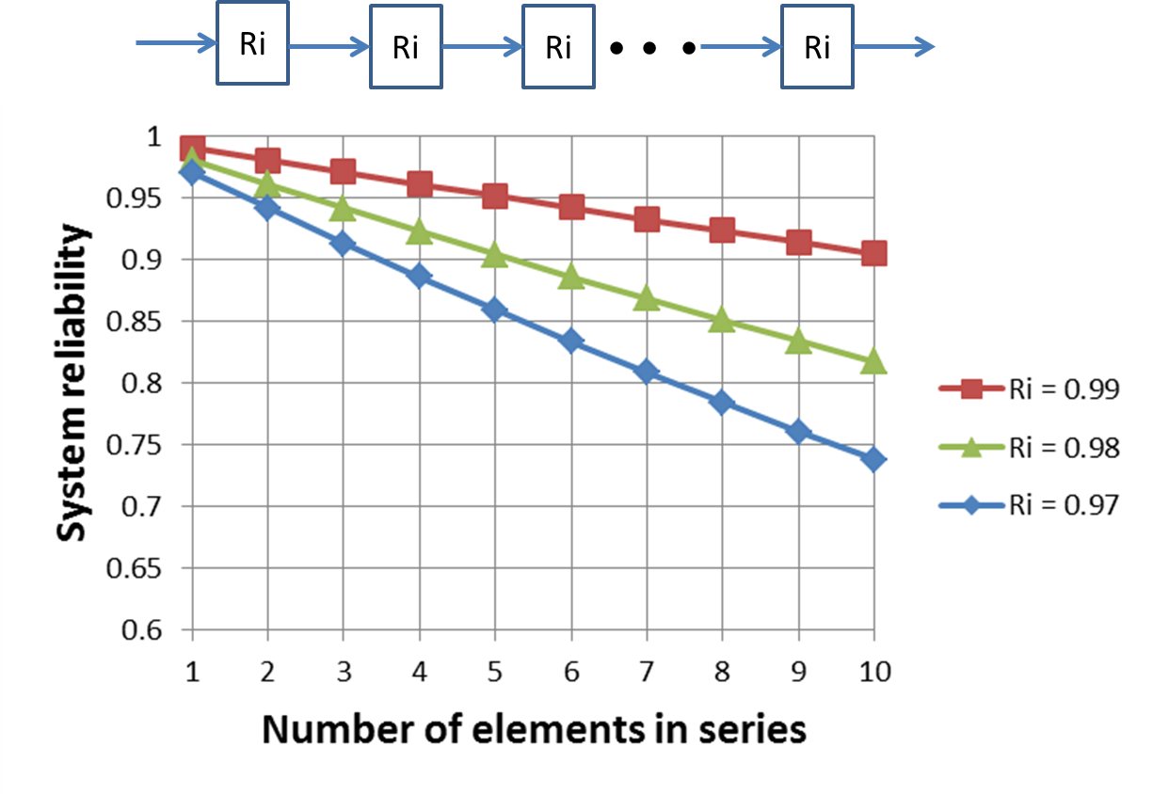
Key Operability issues
1. Operating window
2. Flexibility/
controllability
3. Reliability
4. Safety & equipment protection
5. Efficiency & profitability
6. Operation during transitions
7. Dynamic Performance
8. Monitoring & diagnosis
Chapter 4 Reliability
Series Structure

Slide 24
Key Operability issues
1. Operating window
2. Flexibility/
controllability
3. Reliability
4. Safety & equipment protection
5. Efficiency & profitability
6. Operation during transitions
7. Dynamic Performance
8. Monitoring & diagnosis
Chapter 4 Reliability
Class Exercise 2
Give some examples of series equipment structures in process plants.
Structure: Simple series structure.
1
2
• • •
N

Slide 25
Key Operability issues
1. Operating window
2. Flexibility/
controllability
3. Reliability
4. Safety & equipment protection
5. Efficiency & profitability
6. Operation during transitions
7. Dynamic Performance
8. Monitoring & diagnosis
Chapter 4 Reliability
Class Exercise – Solution 1
Series Structure: Equipment in a “process chain”
What equipment has to function well for the process to be operable?

Slide 26
Key Operability issues
1. Operating window
2. Flexibility/
controllability
3. Reliability
4. Safety & equipment protection
5. Efficiency & profitability
6. Operation during transitions
7. Dynamic Performance
8. Monitoring & diagnosis
Chapter 4 Reliability
Class Exercise – Solution 2
Series Structure: All elements in a control loop
Thermocouple temperature sensor, mV signal
Analog signal transmission
(4-20 mA)
Analog to digital conversion
Digital number
7.734 mV
11.2 mA
A/D
transmitter
Digital controller
145 °C
Pneumatic signal transmission
(3-15 psig)
63% open
fc
i/p
D/A
Digital number
11.56 psig
14.08 mA
Valve stem position
0-100%)
Analog signal transmission
(4-20 mA)
Digital to analog conversion
Heating medium

Slide 27
Key Operability issues
1. Operating window
2. Flexibility/
controllability
3. Reliability
4. Safety & equipment protection
5. Efficiency & profitability
6. Operation during transitions
7. Dynamic Performance
8. Monitoring & diagnosis
Chapter 4 Reliability
Parallel Structure
System functions when either path (or both) function (no common-cause faults)
• • •
Two Parallel: The system fails when both fail at the same time.
N Parallel: The system fails when all fail at the same time.

Slide 28
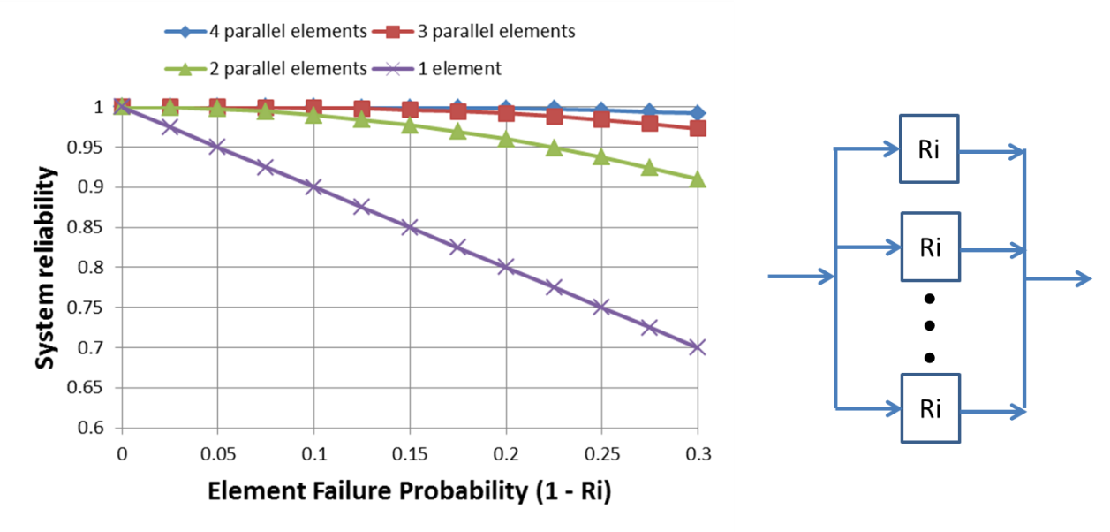
Key Operability issues
1. Operating window
2. Flexibility/
controllability
3. Reliability
4. Safety & equipment protection
5. Efficiency & profitability
6. Operation during transitions
7. Dynamic Performance
8. Monitoring & diagnosis
Chapter 4 Reliability
Parallel Structure

Slide 29
Key Operability issues
1. Operating window
2. Flexibility/
controllability
3. Reliability
4. Safety & equipment protection
5. Efficiency & profitability
6. Operation during transitions
7. Dynamic Performance
8. Monitoring & diagnosis
Chapter 4 Reliability
Class Exercise 3
Give some examples of parallel equipment in process plants.
Parallel pumps
T2
Redundant sensors on same stream
T3

Slide 30
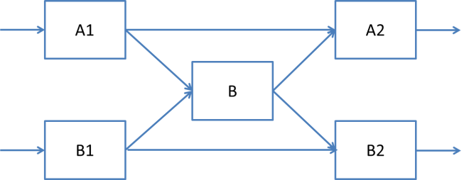
Key Operability issues
1. Operating window
2. Flexibility/
controllability
3. Reliability
4. Safety & equipment protection
5. Efficiency & profitability
6. Operation during transitions
7. Dynamic Performance
8. Monitoring & diagnosis
Chapter 4 Reliability
Additional Structures are Presented in the Chapter
Bridge systems
R₁
Standby systems
R₂
• • •
“k of N” systems

Slide 31
Key Operability issues
1. Operating window
2. Flexibility/
controllability
3. Reliability
4. Safety & equipment protection
5. Efficiency & profitability
6. Operation during transitions
7. Dynamic Performance
8. Monitoring & diagnosis
Chapter 4 Reliability
Class Exercise 4
Determine the reliability of structures by condensing simple series or parallel sections. Assume the each device (box) has a reliability of 0.90.
A)
System functions successfully if at least one path from input to output functions
B)
C)

Slide 32
Key Operability issues
1. Operating window
2. Flexibility/
controllability
3. Reliability
4. Safety & equipment protection
5. Efficiency & profitability
6. Operation during transitions
7. Dynamic Performance
8. Monitoring & diagnosis
Chapter 4 Reliability
Class Exercise - Solution
No redundancy
A)
System-level redundancy
B)
Module-level redundancy
C)
Increased reliability with increased complexity and cost. We have added redundancy with parallel paths.

Slide 33
Chapter 4 Reliability
Lesson Outline
Reliability: Qualitative Overview
Reliability: Data and Models
Design and Operations for Reliability
- Equipment specification
- Isolation and repair
- Process structure
- Operations
- Inventory
Maintenance for Reliability
Economic Analysis: Life Cycle Costing
Quiz
Workshops
Done
Done
Let’s do this
Notes:
This lesson provides an overview of the Operability topic. Some key issues are explained that students will apply throughout their study of the topic and in engineering practice thereafter. These issues will provide helpful checklists for identifying operability challenges and introducing modification to achieve desired performance.
Workshops are essential to enable students to struggle with issues, propose solutions, and obtain feedback for the instructor. In addition, many of the most common designs for operability will be covered, which will provide a common toolkit for all students in the class. Students will extend their learning when working on group projects that will involve the standard operability issues, but require novel and innovative designs. The novel designs will be similar in concept but different in detail to the workshop examples.
For example, the safety analysis method “HAZOP” will the introduced in the operability lessons and a few exercises will be performed; HAZOP is performed to ensure that workers and the local community is not exposed to unacceptable hazards.
Students working on projects involving food production will encounter a similar concept with the acronym “HACCP”, which is performed to ensure that the food products will be safe for the consumer. The background in operability issues and specific coverage of HAZOP will enable students to assimilate and apply newly learned safety approaches, including HACCP, where applicable.

Slide 34
Key Operability issues
1. Operating window
2. Flexibility/
controllability
3. Reliability
4. Safety & equipment protection
5. Efficiency & profitability
6. Operation during transitions
7. Dynamic Performance
8. Monitoring & diagnosis
Chapter 4 Reliability
Equipment specification
Some actions that improve the reliability of
each device/element.
Match equipment to process conditions and requirements (pressure, temperature, clean-in-place, capacity, etc.)
Operate after “break in” and before “worn out”
Perform appropriate maintenance
Use high quality components (resistance to corrosion, compatible with process conditions, well manufactured, etc.)
Repair quickly by highly trained personnel using spare parts stores

Slide 35
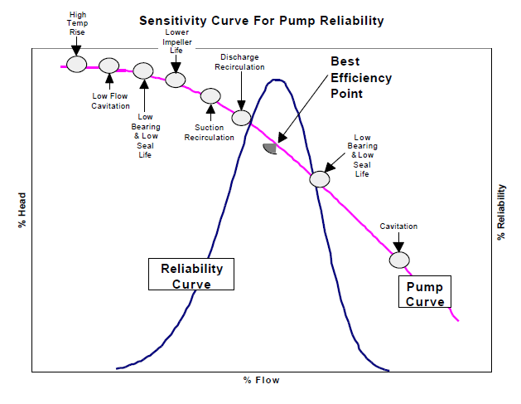
Key Operability issues
1. Operating window
2. Flexibility/
controllability
3. Reliability
4. Safety & equipment protection
5. Efficiency & profitability
6. Operation during transitions
7. Dynamic Performance
8. Monitoring & diagnosis
Chapter 4 Reliability
Equipment specification – pump specification
Pumps operating near design points have high reliability
Oversized pumps have low reliability
Is there a general conclusion here?
Undersized pumps have low reliability
Courtesy of Barringer (Citation 5)

Slide 36
Key Operability issues
1. Operating window
2. Flexibility/
controllability
3. Reliability
4. Safety & equipment protection
5. Efficiency & profitability
6. Operation during transitions
7. Dynamic Performance
8. Monitoring & diagnosis
Chapter 4 Reliability
Equipment specification – pump specification
Important conclusion: There is no “safe side” in equipment sizing. Sometimes, engineers think that no harm can occur if they oversize equipment. Result can be poor reliability (as well as poor regulation).
“Pumps don’t die; engineers kill them”
Courtesy of Barringer

Slide 37
Key Operability issues
1. Operating window
2. Flexibility/
controllability
3. Reliability
4. Safety & equipment protection
5. Efficiency & profitability
6. Operation during transitions
7. Dynamic Performance
8. Monitoring & diagnosis
Chapter 4 Reliability
Equipment specification – Materials of Constr.
What is correct position (open-closed) for manual valves during R-101 regeneration?
Water treatment for Boilers

Slide 38
Key Operability issues
1. Operating window
2. Flexibility/
controllability
3. Reliability
4. Safety & equipment protection
5. Efficiency & profitability
6. Operation during transitions
7. Dynamic Performance
8. Monitoring & diagnosis
Chapter 4 Reliability
Equipment specification – Materials of Constr.
v102 | open |  | v120 | open
v104 | open |  | v122 | closed
v106 | closed |  | v124 | open
v108 | closed |  | v126 | closed
v110 | open

Slide 39
Key Operability issues
1. Operating window
2. Flexibility/
controllability
3. Reliability
4. Safety & equipment protection
5. Efficiency & profitability
6. Operation during transitions
7. Dynamic Performance
8. Monitoring & diagnosis
Chapter 4 Reliability
Equipment isolation and repair
What design is required so that we replace or repair equipment without stopping plant production?
Only one pump needed; we want to switch between the two
The valve is leaking; therefore, we need to replace it
The heat exchanger is fouled; we need to take it out of service for mechanical cleaning
CW

Slide 40
Key Operability issues
1. Operating window
2. Flexibility/
controllability
3. Reliability
4. Safety & equipment protection
5. Efficiency & profitability
6. Operation during transitions
7. Dynamic Performance
8. Monitoring & diagnosis
Chapter 4 Reliability
Equipment isolation and repair
Class Exercise 5
Only one pump is needed, we will have to switch between the two during maintenance.
Manual (hand) valve
Check (one-way) valve

Slide 41
Key Operability issues
1. Operating window
2. Flexibility/
controllability
3. Reliability
4. Safety & equipment protection
5. Efficiency & profitability
6. Operation during transitions
7. Dynamic Performance
8. Monitoring & diagnosis
Chapter 4 Reliability
Equipment isolation and repair
Class Exercise 6
The valve is leaking, we need to replace it.
A person will have to adjust the by-pass valve manually until the control valve has been repaired.
Manual (hand) valve
Check (one-way) valve

Slide 42
Key Operability issues
1. Operating window
2. Flexibility/
controllability
3. Reliability
4. Safety & equipment protection
5. Efficiency & profitability
6. Operation during transitions
7. Dynamic Performance
8. Monitoring & diagnosis
Chapter 4 Reliability
Equipment isolation and repair
Class Exercise 7
The heat exchanger is fouled, we need to take it out of service for mechanical cleaning
CW
Manual (hand) valve
Check (one-way) valve

Slide 43
Key Operability issues
1. Operating window
2. Flexibility/
controllability
3. Reliability
4. Safety & equipment protection
5. Efficiency & profitability
6. Operation during transitions
7. Dynamic Performance
8. Monitoring & diagnosis
Chapter 4 Reliability
Equipment isolation and repair
Lesson Learned
Some equipment is not essential for acceptable plant operation, at least for a short time, and other equipment has a spare in a parallel configuration.
This equipment can be taken out of service for repair, if the design provides components for required reliability.
Result – many more valves and more parallel equipment than you might initially expect.

Slide 44
Key Operability issues
1. Operating window
2. Flexibility/
controllability
3. Reliability
4. Safety & equipment protection
5. Efficiency & profitability
6. Operation during transitions
7. Dynamic Performance
8. Monitoring & diagnosis
Chapter 4 Reliability
Process Structure
Class Exercise 8
Two pump designs with different structures. What is the advantage of each design and which has the higher reliability?
Series
Centrifugal pumps
Parallel

Slide 45
Key Operability issues
1. Operating window
2. Flexibility/
controllability
3. Reliability
4. Safety & equipment protection
5. Efficiency & profitability
6. Operation during transitions
7. Dynamic Performance
8. Monitoring & diagnosis
Chapter 4 Reliability
Process Structure
Centrifugal pumps
Flow: Same through each pump
Pressure: Sum of pressure rises
Series
Higher reliability – if it satisfies flow & pressure
Flow: Sum through each pump
Pressure: Same pressure rise
Parallel

Slide 46
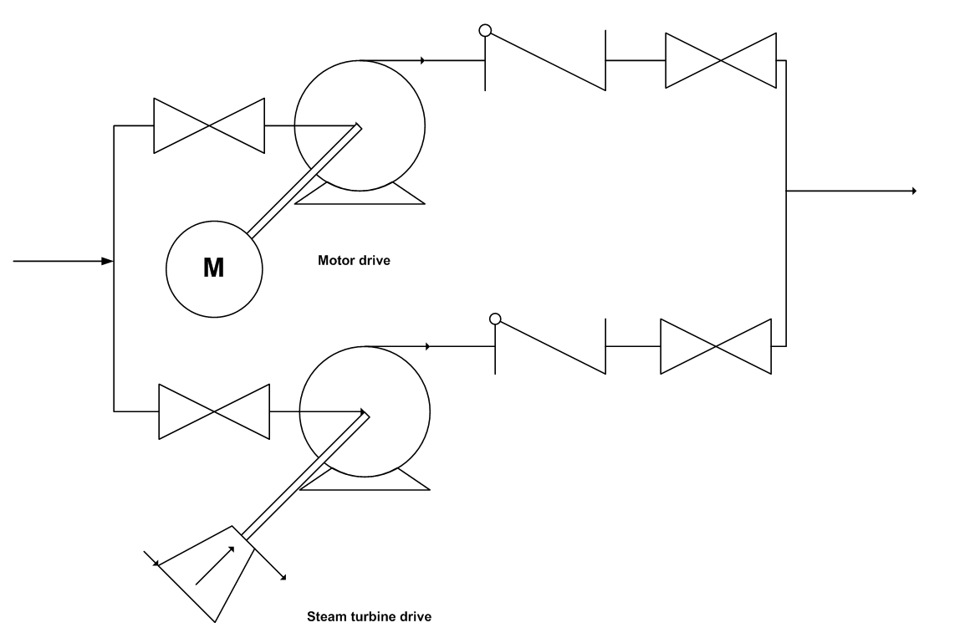
Key Operability issues
1. Operating window
2. Flexibility/
controllability
3. Reliability
4. Safety & equipment protection
5. Efficiency & profitability
6. Operation during transitions
7. Dynamic Performance
8. Monitoring & diagnosis
Chapter 4 Reliability
Process Structure
Class Exercise 9
Pumps need a source of power to function. How could the reliability of the power source in this design be improved?

Slide 47
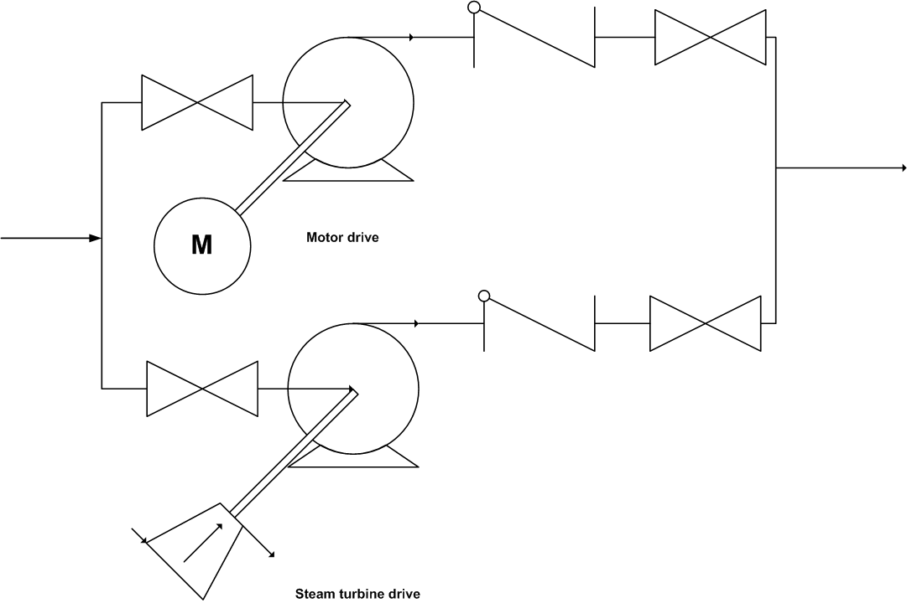
Key Operability issues
1. Operating window
2. Flexibility/
controllability
3. Reliability
4. Safety & equipment protection
5. Efficiency & profitability
6. Operation during transitions
7. Dynamic Performance
8. Monitoring & diagnosis
Chapter 4 Reliability
Process Structure
Solution - Provide two independent sources of power, electric motor and steam turbine. What are other advantages of this design? Could the same power affect be achieved at a lower cost?

Slide 48
Key Operability issues
1. Operating window
2. Flexibility/
controllability
3. Reliability
4. Safety & equipment protection
5. Efficiency & profitability
6. Operation during transitions
7. Dynamic Performance
8. Monitoring & diagnosis
Chapter 4 Reliability
Process Structure
Class Exercise 10
The design includes redundant level sensors for reliability. How is the reliability improved further in this design?
Sensor based on float to sense interface
Diversity!
Sensor based on pressure difference between two elevations
Sensors selected to have different failure root causes

Slide 49
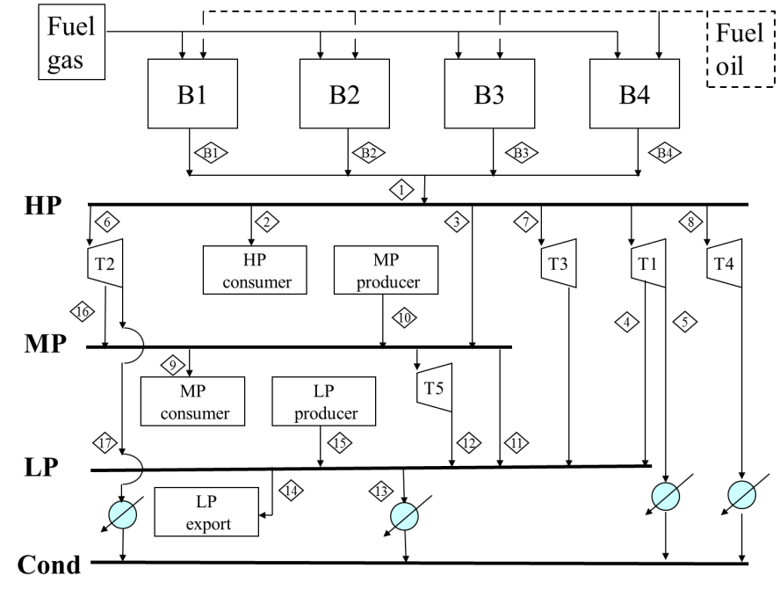
Key Operability issues
1. Operating window
2. Flexibility/
controllability
3. Reliability
4. Safety & equipment protection
5. Efficiency & profitability
6. Operation during transitions
7. Dynamic Performance
8. Monitoring & diagnosis
Chapter 4 Reliability
Process Structure
How about a little help by explaining this network process?

Slide 50
Key Operability issues
1. Operating window
2. Flexibility/
controllability
3. Reliability
4. Safety & equipment protection
5. Efficiency & profitability
6. Operation during transitions
7. Dynamic Performance
8. Monitoring & diagnosis
Chapter 4 Reliability
Process Structure
For critical systems, a “network” provides multiple sources (and sinks) that can supply (deplete) any consumer. System must be fast and reliable! Features of the steam system:
Multiple boilers providing steam
Two fuels to each boiler
All steam from fired boilers distributed through common HP header
External sources and sinks of steam integrated in the distribution system
Multiple paths from higher to lower-pressure headers
Condensate collected and recovered

Slide 51

Key Operability issues
1. Operating window
2. Flexibility/
controllability
3. Reliability
4. Safety & equipment protection
5. Efficiency & profitability
6. Operation during transitions
7. Dynamic Performance
8. Monitoring & diagnosis
Chapter 4 Reliability
Process Structure
Lesson Learned
When equipment is essential and component reliability is too low, redundancy and diversity can be provided in various plant structures to increase system reliability.
Results
Low reliability equipment: Redundancy
Prevent common cause: Diversity
Highly critical functions: Networks of suppliers and consumers

Slide 52
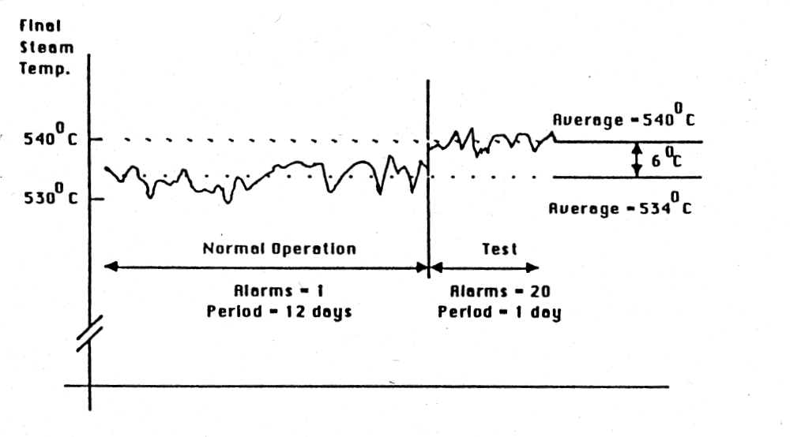
Key Operability issues
1. Operating window
2. Flexibility/
controllability
3. Reliability
4. Safety & equipment protection
5. Efficiency & profitability
6. Operation during transitions
7. Dynamic Performance
8. Monitoring & diagnosis
Chapter 4 Reliability
Process Operations
Steam generated in a boiler is further heated to improve efficiency in a turbo-generator. However, high temperatures (above the alarm value) severely reduces turbine reliability. The following data is from a real plant. Discuss the two regions of operation.
Citation 6

Slide 53
Key Operability issues
1. Operating window
2. Flexibility/
controllability
3. Reliability
4. Safety & equipment protection
5. Efficiency & profitability
6. Operation during transitions
7. Dynamic Performance
8. Monitoring & diagnosis
Chapter 4 Reliability
Process Operations
Moving a variable towards a constraint should be combined with changes to reduce variability.
Operating conditions must consider all performance factors; short-term (efficiency) and long-term (turbine failure rate).

Slide 54
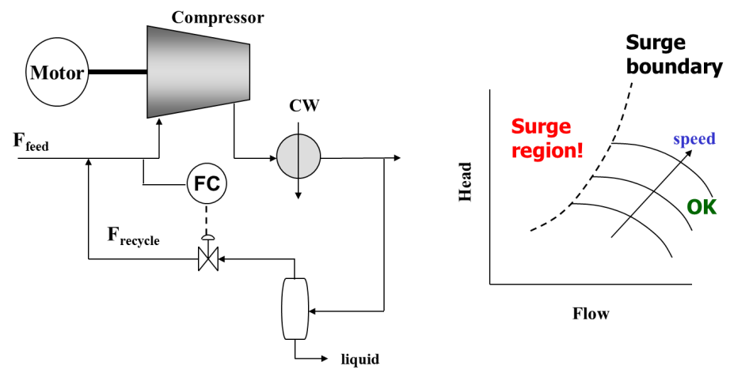
Key Operability issues
1. Operating window
2. Flexibility/
controllability
3. Reliability
4. Safety & equipment protection
5. Efficiency & profitability
6. Operation during transitions
7. Dynamic Performance
8. Monitoring & diagnosis
Chapter 4 Reliability
Process Operations
Class Exercise 11
Centrifugal compressors require a minimum flow. Flows below the minimum result in “surge” that can severely damage the compressor within seconds. What additions are needed in the following design?
Surge?

Slide 55
Key Operability issues
1. Operating window
2. Flexibility/
controllability
3. Reliability
4. Safety & equipment protection
5. Efficiency & profitability
6. Operation during transitions
7. Dynamic Performance
8. Monitoring & diagnosis
Chapter 4 Reliability
Plant Inventory
Plants contain lots of material inventory. The inventory can be in any state; solid, liquid, or gas. Discuss advantages and disadvantages of inventory.
Hints:
Some engineers and all operators love inventory
Some engineers hate inventory
All accountants hate inventory

Slide 56
Key Operability issues
1. Operating window
2. Flexibility/
controllability
3. Reliability
4. Safety & equipment protection
5. Efficiency & profitability
6. Operation during transitions
7. Dynamic Performance
8. Monitoring & diagnosis
Chapter 4 Reliability
Table 4.1. Reasons for Inventories in Process Plants
Reason for inventory | Process examples
Required for process performance | Provide continuous flow of liquid to pumps Residence time for chemical reactors Provide environment to achieve vapor-liquid equilibrium, e.g., liquid on each tray of distillation column Store materials between series batch-batch and batch-continuous plant structures
Mixing to reduce effects of stream property variation | Feed drum to distillation tower or chemical reactor
Flow rate modulation | Control level by adjusting one flow using averaging level control (See Chapter 6) For large storage vessels, set both flows in and out constant for long periods of time, allowing inventory to vary
Allow periodic feed delivery and product dispatch | Feed inventory used to segregate different feed materials and to allow periodic delivery with constant feed rate to plant Product inventory used to segregate different product materials and to allow periodic dispatch to customers with constant production rate from plant
Isolate different materials for multi-product, flexible manufacturing | Store intermediate products for subsequent processing in downstream equipment, with isolation of materials required for different final products
Capture materials during unusual operation | Store material that is off-specification made during startup, shut down, or upsets for recycle to process Store materials for processing to benign components and release to the environment
Increase reliability | Maintain partial plant operation when one unit in shutdown, either intentionally or unintentionally Continue plant operation when raw materials delivery or product dispatch does not meet schedule

Slide 57
Key Operability issues
1. Operating window
2. Flexibility/
controllability
3. Reliability
4. Safety & equipment protection
5. Efficiency & profitability
6. Operation during transitions
7. Dynamic Performance
8. Monitoring & diagnosis
Chapter 4 Reliability
Table 4.2 Negative Aspects of Inventory
Negative aspect | Process examples
Hazards | Combustible materials, e.g., crude oil, gasoline, Toxic materials Pressure vessels
Product quality degradation | Over time, e.g., food, pharmaceuticals, even liquid fuels
Space in plant | Space can be very costly in some locations
Capital cost | Vessel and piping costs Additional costs for inert blanking and other special needs
Working capital cost | Stored materials are work-in-progress and handled as working capital
Operating costs | Heating or refrigeration is required for storage at temperatures different from ambient temperature
Slow plant dynamics | Longer time to change product quality when switching operations
Therefore, the engineer must find a balance of advantages and disadvantages by locating and sizing the inventories appropriately.

Slide 58
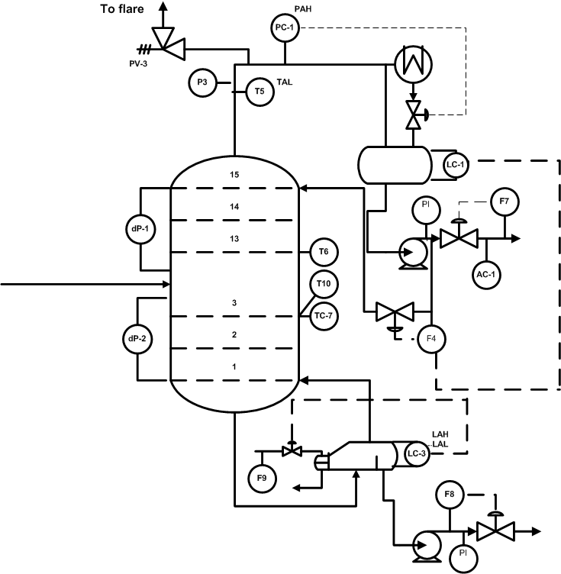
Key Operability issues
1. Operating window
2. Flexibility/
controllability
3. Reliability
4. Safety & equipment protection
5. Efficiency & profitability
6. Operation during transitions
7. Dynamic Performance
8. Monitoring & diagnosis
Chapter 4 Reliability
Plant Inventory – Small Unit Volumes
Inventory to store liquid before pump; guideline holdup time of 5-10 minutes
Left of weir, liquid to cover heat exchanger tubes.
Right of weir, about 5 minutes holdup in “boot”.

Slide 59
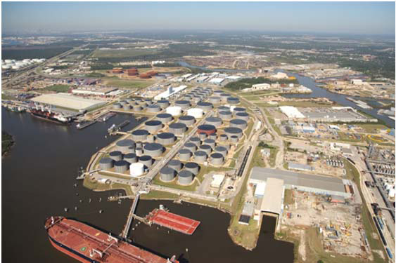
Key Operability issues
1. Operating window
2. Flexibility/
controllability
3. Reliability
4. Safety & equipment protection
5. Efficiency & profitability
6. Operation during transitions
7. Dynamic Performance
8. Monitoring & diagnosis
Chapter 4 Reliability
Plant Inventory – Large Feed/Product
Storage consisting of sixty large tanks, cumulatively capable of storing more than 10 million barrels (1.6 million cubic meters) of oil. At a crude oil value of $100 per barrel, a full inventory of working capital would have a value of one billion dollars!
Picture of Houston Ship Channel oil terminal (Citation 7)

Slide 60
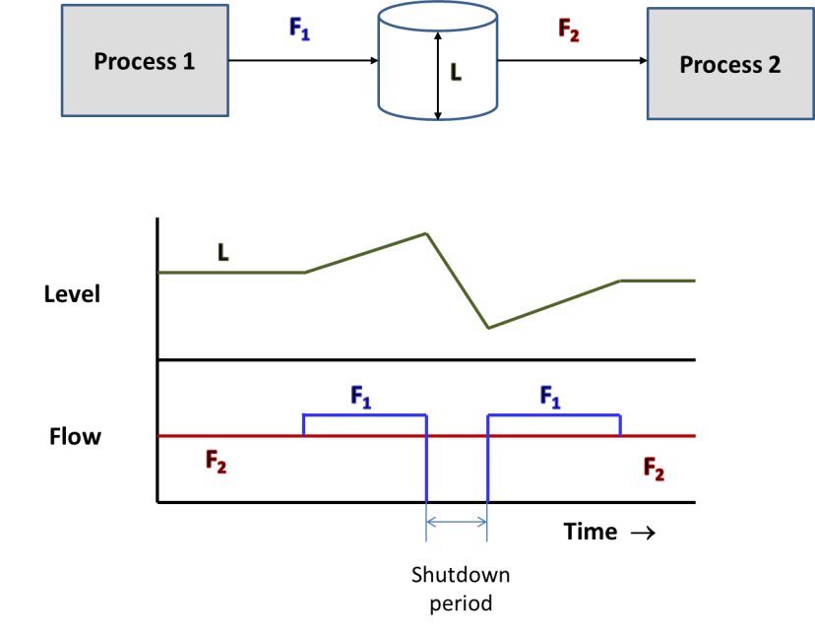
Key Operability issues
1. Operating window
2. Flexibility/
controllability
3. Reliability
4. Safety & equipment protection
5. Efficiency & profitability
6. Operation during transitions
7. Dynamic Performance
8. Monitoring & diagnosis
Chapter 4 Reliability
Plant Inventory variation
Inventory strategy for a planned shutdown of Process 1
product
Determine the strategy for a P1 shutdown that does not shutdown P2

Slide 61
Key Operability issues
1. Operating window
2. Flexibility/
controllability
3. Reliability
4. Safety & equipment protection
5. Efficiency & profitability
6. Operation during transitions
7. Dynamic Performance
8. Monitoring & diagnosis
Chapter 4 Reliability
Plant Inventory
Effect of inventory on total plant reliability for unplanned shutdowns in Process 1
P1 repair time is exponentially distributed
P1 Reliability is 0.15
P2 Reliability is 0.95
Sketch the system reliability (ability to provide continuous product from P2) as the volume of the tank is increased
Holdup time is Volume divided by flow

Slide 62
Chapter 4 Reliability
Lesson Outline
Reliability: Qualitative Overview
Reliability: Data and Models
Design and Operations for Reliability
Maintenance for Reliability
- Reactive
- Preventive
- Predictive
- Proactive
Economic Analysis: Life Cycle Costing
Quiz
Workshops
Done
Done
Done
Let’s do this
Notes:
This lesson provides an overview of the Operability topic. Some key issues are explained that students will apply throughout their study of the topic and in engineering practice thereafter. These issues will provide helpful checklists for identifying operability challenges and introducing modification to achieve desired performance.
Workshops are essential to enable students to struggle with issues, propose solutions, and obtain feedback for the instructor. In addition, many of the most common designs for operability will be covered, which will provide a common toolkit for all students in the class. Students will extend their learning when working on group projects that will involve the standard operability issues, but require novel and innovative designs. The novel designs will be similar in concept but different in detail to the workshop examples.
For example, the safety analysis method “HAZOP” will the introduced in the operability lessons and a few exercises will be performed; HAZOP is performed to ensure that workers and the local community is not exposed to unacceptable hazards.
Students working on projects involving food production will encounter a similar concept with the acronym “HACCP”, which is performed to ensure that the food products will be safe for the consumer. The background in operability issues and specific coverage of HAZOP will enable students to assimilate and apply newly learned safety approaches, including HACCP, where applicable.

Slide 63
Key Operability issues
1. Operating window
2. Flexibility/
controllability
3. Reliability
4. Safety & equipment protection
5. Efficiency & profitability
6. Operation during transitions
7. Dynamic Performance
8. Monitoring & diagnosis
Chapter 4 Reliability
Maintenance for Reliability

Slide 64
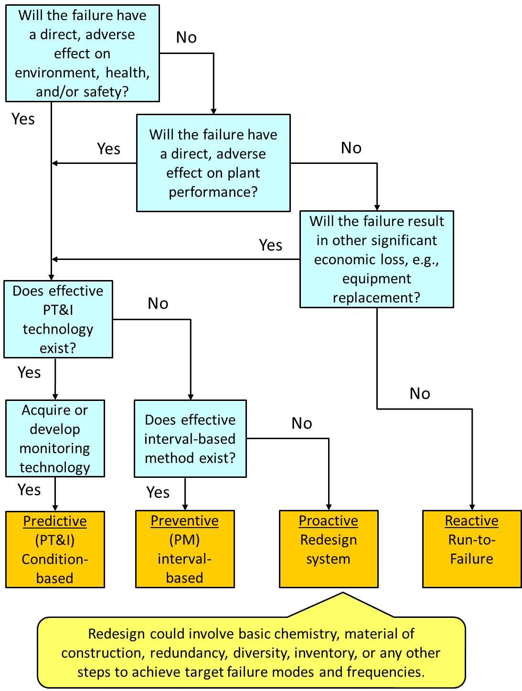
Key Operability issues
1. Operating window
2. Flexibility/
controllability
3. Reliability
4. Safety & equipment protection
5. Efficiency & profitability
6. Operation during transitions
7. Dynamic Performance
8. Monitoring & diagnosis
Chapter 4 Reliability
Maintenance for Reliability
adapted from NASA, 2000;see citation 2

Slide 65
Chapter 4 Reliability
Lesson Outline
Reliability: Qualitative Overview
Reliability: Data and Models
Design and Operations for Reliability
Maintenance for Reliability
Economic Analysis: Life Cycle Costing
Quiz
Workshops
Done
Done
Done
Done
Let’s do this
Notes:
This lesson provides an overview of the Operability topic. Some key issues are explained that students will apply throughout their study of the topic and in engineering practice thereafter. These issues will provide helpful checklists for identifying operability challenges and introducing modification to achieve desired performance.
Workshops are essential to enable students to struggle with issues, propose solutions, and obtain feedback for the instructor. In addition, many of the most common designs for operability will be covered, which will provide a common toolkit for all students in the class. Students will extend their learning when working on group projects that will involve the standard operability issues, but require novel and innovative designs. The novel designs will be similar in concept but different in detail to the workshop examples.
For example, the safety analysis method “HAZOP” will the introduced in the operability lessons and a few exercises will be performed; HAZOP is performed to ensure that workers and the local community is not exposed to unacceptable hazards.
Students working on projects involving food production will encounter a similar concept with the acronym “HACCP”, which is performed to ensure that the food products will be safe for the consumer. The background in operability issues and specific coverage of HAZOP will enable students to assimilate and apply newly learned safety approaches, including HACCP, where applicable.

Slide 66
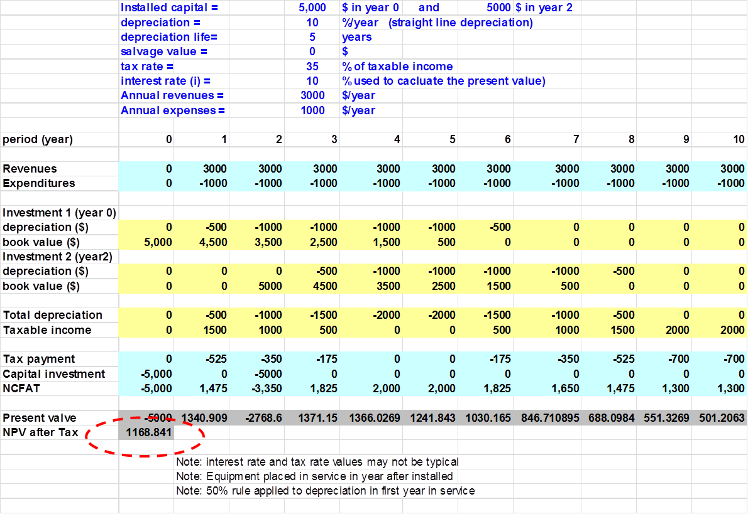
Key Operability issues
1. Operating window
2. Flexibility/
controllability
3. Reliability
4. Safety & equipment protection
5. Efficiency & profitability
6. Operation during transitions
7. Dynamic Performance
8. Monitoring & diagnosis
Chapter 4 Reliability
Life-Cycle Costing Analysis (LCC)
LCC applies all of the principles of standard profitability analysis. In addition, it includes project features that are affected by equipment reliability, e.g.,
Maintenance costs, including spare parts
Failure rate
Failure costs (equip., personnel, loss of production)
Equipment and engineering costs for more complex system, e.g., with redundancy
Process material inventory costs
More details by Barringer

Slide 67
Key Operability issues
1. Operating window
2. Flexibility/
controllability
3. Reliability
4. Safety & equipment protection
5. Efficiency & profitability
6. Operation during transitions
7. Dynamic Performance
8. Monitoring & diagnosis
Chapter 4 Reliability
Life-Cycle Costing Analysis (LCC)
Example: How many pumps in standby-series (1 to 4)?
data
2 pumps
analysis

Slide 68
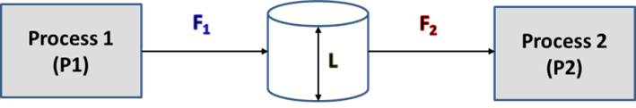
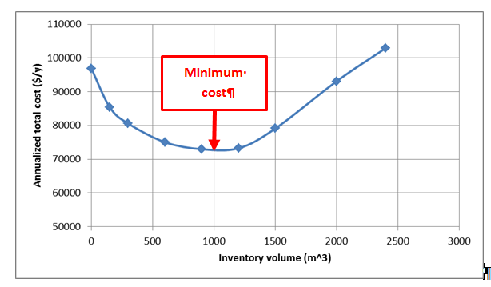
Key Operability issues
1. Operating window
2. Flexibility/
controllability
3. Reliability
4. Safety & equipment protection
5. Efficiency & profitability
6. Operation during transitions
7. Dynamic Performance
8. Monitoring & diagnosis
Chapter 4 Reliability
Life-Cycle Costing Analysis (LCC)
Low reliability
High reliability
Discuss the shape of this graph. What are the major factors that increase and decrease annualized cost as we increase inventory volume?
Does an optimum exist between the minimum and maximum volumes?

Slide 69
Key Operability issues
1. Operating window
2. Flexibility/
controllability
3. Reliability
4. Safety & equipment protection
5. Efficiency & profitability
6. Operation during transitions
7. Dynamic Performance
8. Monitoring & diagnosis
Chapter 4 Reliability
RELIABILITY INDUSTRIAL PRACTICE (1)
We design a highly reliable process structure (e.g., redundant, diverse equipment in a parallel) when
- The consequence of a failure is high
- The probability of a failure is too large
We design to prevent a single cause from affecting several units or equipment.
- Prevent common cause failures
Safety first! Then, economics (NPV, DCFRR, etc.).
Cost of reliable design
Benefit of reliable design

Slide 70
Key Operability issues
1. Operating window
2. Flexibility/
controllability
3. Reliability
4. Safety & equipment protection
5. Efficiency & profitability
6. Operation during transitions
7. Dynamic Performance
8. Monitoring & diagnosis
Chapter 4 Reliability
RELIABILITY INDUSTRIAL PRACTICE (2)
We automate the adjustment of redundant elements when the time to respond to an incident is short
We provide by-passes around equipment that can be removed without requiring a process shutdown
We isolate sections of a large plant with inventory to reduce the impact of a single failure
We ensure that repair and replacement can be effected rapidly

Slide 71
Key Operability issues
1. Operating window
2. Flexibility/
controllability
3. Reliability
4. Safety & equipment protection
5. Efficiency & profitability
6. Operation during transitions
7. Dynamic Performance
8. Monitoring & diagnosis
Chapter 4 Reliability
RELIABILITY INDUSTRIAL PRACTICE (3)
Managing reliability analysis to identify and address important issues is integrated with process safety analysis.
Therefore, managing analysis is not covered in this lesson. Please refer to the Reliability chapter for an introduction and to the safety learning materials for a thorough presentation of HAZOP studies.

Slide 72
Key Operability issues
1. Operating window
2. Flexibility/
controllability
3. Reliability
4. Safety & equipment protection
5. Efficiency & profitability
6. Operation during transitions
7. Dynamic Performance
8. Monitoring & diagnosis
Chapter 4 Reliability
RELIABILITY
This is a big topic, and we have covered only a small slice! Many topics would require further study.
No worries, I have mastered
life-long learning!
We can propose various designs, determine the advantages/ disadvantages of these structures, determine reliability for typical structures and perform LCC analysis.
We cannot determine reliability, MTBF or Availability for highly complex structures, with maintenance, etc.

Slide 73
Chapter 4 Reliability
Lesson Outline
How did we do?
Reliability: Qualitative Overview
Reliability: Data and Models
Design and Operations for Reliability
Maintenance for Reliability
Economic Analysis: Life Cycle Costing
Quiz
Workshops
Done
Done
Done
Done
Done
Lot’s of improvement! Refer to the next slides
for activities to build on your learning progress.
Notes:
This lesson provides an overview of the Operability topic. Some key issues are explained that students will apply throughout their study of the topic and in engineering practice thereafter. These issues will provide helpful checklists for identifying operability challenges and introducing modification to achieve desired performance.
Workshops are essential to enable students to struggle with issues, propose solutions, and obtain feedback for the instructor. In addition, many of the most common designs for operability will be covered, which will provide a common toolkit for all students in the class. Students will extend their learning when working on group projects that will involve the standard operability issues, but require novel and innovative designs. The novel designs will be similar in concept but different in detail to the workshop examples.
For example, the safety analysis method “HAZOP” will the introduced in the operability lessons and a few exercises will be performed; HAZOP is performed to ensure that workers and the local community is not exposed to unacceptable hazards.
Students working on projects involving food production will encounter a similar concept with the acronym “HACCP”, which is performed to ensure that the food products will be safe for the consumer. The background in operability issues and specific coverage of HAZOP will enable students to assimilate and apply newly learned safety approaches, including HACCP, where applicable.

Slide 74
Key Operability issues
1. Operating window
2. Flexibility/
controllability
3. Reliability
4. Safety & equipment protection
5. Efficiency & profitability
6. Operation during transitions
7. Dynamic Performance
8. Monitoring & diagnosis
Chapter 4 Reliability
CITATIONS
1. Beauhaus, 9/11/2012, CC 3.0, http://www.vectorfree.com/american-muscle-cars
2. National Aeronautics and Space Administration (NASA) (2000) Reliability Centered
Maintenance Guide For Facilities And Collateral Equipment, February, 2000.
(http://www.hq.nasa.gov/office/codej/codejx/Assets/Docs/RCMGuideMar2000.pdf)
3. Wells, G., Safety in Process Plant Design, John Wiley & Sons, New York, 1980.
4. CCPS, Guidelines for Process Equipment Reliability Data, AIChE, 1989
5. Barringer, H.P. and D. Weber, Life Cycle Cost Tutorial, Fifth International Conference on Process Plant Reliability, Houston, Texas, October 2-4, 1996
(http://www.barringer1.com/pdf/lcctutorial.pdf)
6. Johnman, P., K.Hitz, E. Fyvie, H. Morris, D. Gosden, and B. Taber, Eraring Power Station Control Study, in Marlin, Thomas, John Perkins, Geoff Barton, and Mike Brisk (1988) Advanced Process Control Applications, Warren Centre Industrial Case Studies of Opportunities and Benefits, ISA, Research Triangle Park. (Copyright transferred to
editors in 1995).
7. Picture of Houston Ship Channel oil terminal: LUDB, 2014; Creative Commons share alike 3.0, http://clui.org/ludb/site/houston-fuel-oil-terminal

Slide 75
Key Operability issues
1. Operating window
2. Flexibility/
controllability
3. Reliability
4. Safety & equipment protection
5. Efficiency & profitability
6. Operation during transitions
7. Dynamic Performance
8. Monitoring & diagnosis
LEARNING RESOURCES
CHAPTER 4:
SITE PC-EDUCATION WEB
Operability Section Chapter 4 on Reliability
See References, especially good are;
Barringer, H.P. and D. Weber, Life Cycle Cost Tutorial, Fifth International Conference on Process Plant Reliability, Houston, Texas, October 2-4, 1996 (http://www.barringer1.com/pdf/lcctutorial.pdf)
Barringer WEB site with many learning resources, http://www.barringer1.com/
Modarres, M. (1993) What Every Engineer should know about Reliability and Risk, Marcel Dekker, New York.
Moubray, J. (1997) Reliability Centered Maintenance, Industrial Press, Oxford, 1997
National Aeronautics and Space Administration (NASA) (2000) Reliability Centered Maintenance Guide For Facilities And Collateral Equipment, February, 2000.
(http://www.hq.nasa.gov/office/codej/codejx/Assets/Docs/RCMGuideMar2000.pdf)

Slide 76
Key Operability issues
1. Operating window
2. Flexibility/
controllability
3. Reliability
4. Safety & equipment protection
5. Efficiency & profitability
6. Operation during transitions
7. Dynamic Performance
8. Monitoring & diagnosis
LEARNING RESOURCES
CHAPTER 4:
WORKSHOPS
Flip the Classroom: Since you have engaged the basic material in the eLearning format, you are prepared to perform these workshops as class exercises.
You have complained that lectures are boring; now, you get to be active by solving problems during class !
To improve the learning experience, we recommend that you perform these exercises in small groups.
Please be sure to record your questions and bring them to the attention of your instructor.

Slide 77
Chapter 4 Reliability
Workshop 1: Overview of Reliability
Select one complex device you use in your every-day life; an automobile, computer, refrigerator, etc. Brainstorm causes of low reliability. Organize your answer in a table, with each row containing columns for each of the three characteristics;
(1) causes,
(2) consequences, and
(3) responses

Slide 78
Chapter 4 Reliability
Workshop 2: Failure Rate
Typically, we expect the failure rate to increase as equipment time-in-service increases. Discuss why.
Describe situations in which failure rates will increase as equipment time-in-service increases.
Describe situations in which failure rates will be essentially constant. Do you have any restrictions/ assumptions to limit the cases where constant failure rate will likely occur?

Slide 79
Chapter 4 Reliability
Workshop 3: Chain Reliability
A common saying is that, “a chain is only as strong as its weakest link.” We’ll consider a chain to be a series system. Discuss the utility of the saying and whether the weakest link characterizes the reliability of the system.
Ri
Ri
Ri
• • •
Ri

Slide 80
Chapter 4 Reliability
Workshop 4: Calculate MTTF
Each of the following systems has four identical elements, each with a failure rate of 4x10⁻³ failures/h. Determine the MTTF for each system.
Series
Parallel
Standby
Ri
Ri
Ri
• • •
Ri
Guess its time to read the chapter.
Ri
Ri
• • •
Ri

Slide 81
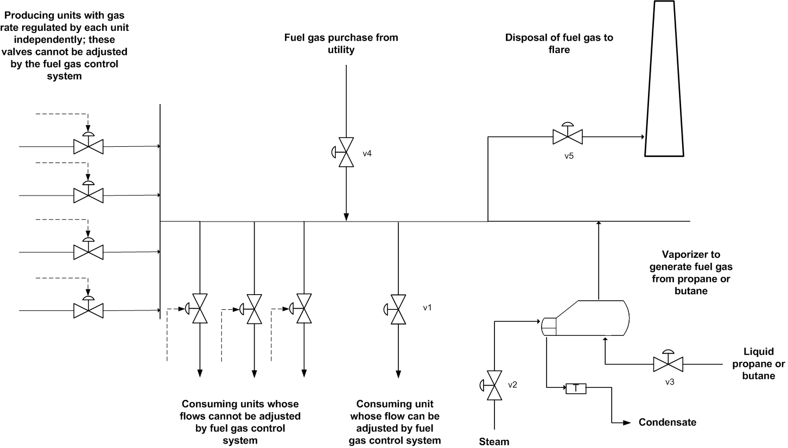
Chapter 4 Reliability
Workshop 5: Fuel Gas Network
Fuel gas is produced and consumed in many places in a plant. Discuss the good and poor aspects of this fuel gas distribution network, concentrating on reliability.

Slide 82
Chapter 4 Reliability
Workshop 6: Reduction of Block Diagrams
Determine the system reliability of the two block diagrams for
R1 = 0.95 and R2 = 0.95
R1 = 0.90 and R2 = 0.95
System I
System II
R1
R2
R1
R2
R1
R1
R2
R1

