Slide 1
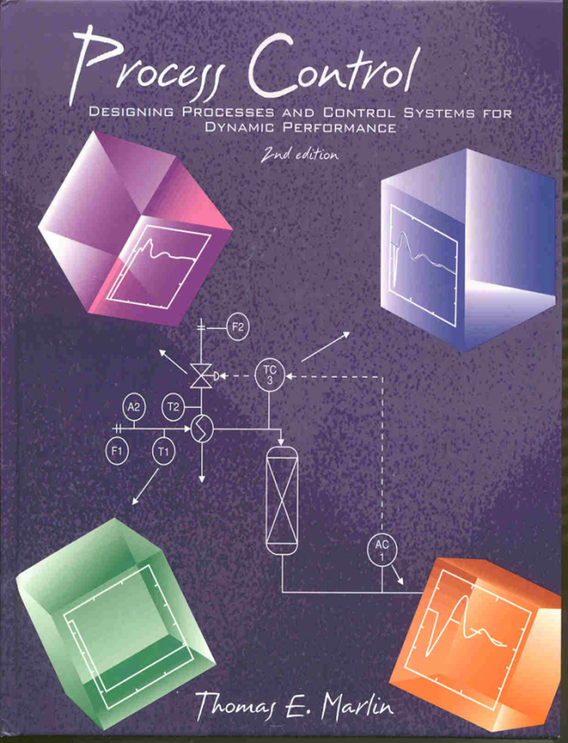
Process Control: Designing Process and Control Systems for Dynamic Performance
Chapter 24. Process Control Design: Definition and Decisions
Copyright © Thomas Marlin 2013
The copyright holder provides a royalty-free license for use of this material at non-profit educational institutions

Slide 2
CHAPTER 24: CONTROL DESIGN
When I complete this chapter, I want to be
able to do the following.
Define the control problem
Evaluate if desired performance is possible; if not, modify process
Select instrumentation
Design loop pairing for control
Provide sensors for process monitoring

Slide 3
CHAPTER 24: CONTROL DESIGN
Outline of the lesson.
THE CONTROL DESIGN PROCEDURE
Define the control problem (challenge)
Evaluate/achieve operability
- Degrees of freedom
- Controllability
- Operating Window
Process dynamics for good performance
Loop pairing
Control for safety
Monitoring and diagnosis

Slide 4
CHAPTER 24: CONTROL DESIGN
Let’s design controls for this process
How do we start?
What are the common steps?
When are we finished?
Vapor
product
T6
P1
Let’s
review
the
process
T1
T2
T5
P ≈ 1000 kPa
T ≈ 298 K
Feed
Methane
Ethane (LK)
Propane
Butane
Pentane
F1
T4
T3
L1
F2
F3
A1
Liquid
product
Process
fluid
Steam
L. Key

Slide 5
CHAPTER 24: CONTROL DESIGN
Design is a goal-oriented task. We must determine
the goals before we start to design.
This is consistent with
the problem solving methods
used widely in engineering education.
Woods, Donald, Problem Based Learning: How to Gain the Most from PBL, Griffin Printing, Hamilton, Ontario, 1994.
Fogler, H. Scott and Steve LeBlanc, Strategies for Creative Problem Solving, Prentice Hall PTR, Upper Saddle River, 1995.
We will use the Control Design Form to summarize the problem definition.
Danger, sharks!

Slide 6
CHAPTER 24: CONTROL DESIGN
1. Safety
2. Environmental protection
3. Equipment protection
4. Smooth operation
5. Product quality
6. Profit
7. Monitoring and diagnosis
WORKSHOP: Define at least one for
each category. But, do not design the
controls (yet)!
Control Design Form
Objectives
Measurements
Manipulated variables
Constraints
Disturbances
Dynamic responses
Additional considerations
Vapor
product
T6
P1
T4
T1
T2
T5
F1
T5
L1
T3
F2
F3
A1
Liquid
product
Process
fluid
Steam
L. Key

Slide 7
CHAPTER 24: CONTROL DESIGN
1. Safety
Maintain vessel pressure below 1200 kPa
2. Environmental protection
Prevent release of hydrocarbons to the atmosphere
3. Equipment protection
Ensure that liquid flows through the pump
4. Smooth operation
When possible, make slow adjustments to liquid product product flow rate
5. Product quality
Maintain the liquid product at 10 ± 1 mole% L. Key.
6. Profit
Maximize the use of the expensive steam for heating
7. Monitoring and diagnosis
Provide alarms for immediate attention by operating personnel
Well done! Now find some
more and check the textbook.
Vapor
product
T6
P1
T4
T1
T2
T5
F1
T5
L1
T3
F2
F3
A1
Liquid
product
Process
fluid
Steam
L. Key

Slide 8
CHAPTER 24: CONTROL DESIGN
WORKSHOP: Propose sensors for one
F, T, P, L measurement.
Sensors to achieve objectives
Feasibility
Accuracy
Reproducibility
Dynamics
Reliability
Cost
Control Design Form
Objectives
Measurements
Manipulated variables
Constraints
Disturbances
Dynamic responses
Additional considerations
Vapor
product
T6
P1
T4
T1
T2
T5
F1
T5
L1
T3
F2
F3
A1
Liquid
product
Process
fluid
Steam
L. Key

Slide 9
CHAPTER 24: CONTROL DESIGN
WORKSHOP: Propose sensors for one
F, T, P, L measurement.
Sensors
Feasibility
Accuracy
Reproducibility
Dynamics
Reliability
Cost
Vapor
product
T6
P1
Flexible diaphraghm with capacitance to measure deflection
T4
T1
T2
T5
Thermocouple
Pressure differential
F1
X
T5
L1
T3
Orifice plate
F2
F3
A1
Typically, the sensor range covers the expected values of the variable (including disturbances), but not more.
An orifice meter would typically read the design value at ~ 70% of its maximum range.
Liquid
product
Process
fluid
Steam
L. Key

Slide 10
CHAPTER 24: CONTROL DESIGN
Low cost
Low accuracy
OK reproducibility
High cost
High accuracy
High reproducibility
We need to balance cost and accuracy.
Which sensors require high accuracy?
heating stream
F
2
MV₂
MV_{ff}
F
1
T
2
CV₂
TC
3
TY
3
feed
T
1
A
2
secondary
MV₁
AY
2
packed bed
reactor
feedforward
primary
AC
1
SP₁ from
person
CV₁

Slide 11
CHAPTER 24: CONTROL DESIGN
FINAL ELEMENTS
Capacity
Precision
Range
Characteristic
Failure position
Dynamics
Reliability
Cost
WORKSHOP:
Define failure position (as best possible,
without the remainder of plant design).
Select the body for a valve
Control Design Form
Objectives
Measurements
Manipulated variables
Constraints
Disturbances
Dynamic responses
Additional considerations
Vapor
product
T6
P1
T4
T1
T2
T5
F1
T5
L1
T3
F2
F3
A1
Liquid
product
Process
fluid
Steam
L. Key

Slide 12
CHAPTER 24: CONTROL DESIGN
FINAL ELEMENTS
Capacity
Precision
Range
Characteristic
Failure position
Dynamics
Reliability
Cost
WORKSHOP:
Define failure position (as best possible,
without the remainder of plant design).
Select the body for a valve
Vapor
product
Fail opened to relieve pressure in vessel. (we assume that the downstream unit can accept the material and not release.)
T6
P1
T4
T1
T2
T5
F1
T5
L1
Globe valve for clean fluid with moderate pressure loss acceptable.
T3
F2
F3
The maximum flow should occur near 100% valve opening. Remember to consider all operating conditions!
A1
Liquid
product
Process
fluid
Steam
L. Key

Slide 13
CHAPTER 24: CONTROL DESIGN
WORKSHOP: Determine some constraints
Control Design Form
Objectives
Measurements
Manipulated variables
Constraints
Disturbances
Dynamic responses
Additional considerations
CONSTRAINTS
Safety
Equipment protection
- Short term
- Long term
Product quality
Vapor
product
T6
P1
T4
T1
T2
T5
F1
T5
L1
T3
F2
F3
A1
Liquid
product
Process
fluid
Steam
L. Key

Slide 14
CHAPTER 24: CONTROL DESIGN
CONSTRAINTS
Safety
Operating range of equipment
Equipment protection
- Short term
- Long term
Product quality
WORKSHOP: Determine some constraints
Vapor
product
T6
P1
Pressure less than maximum for safety
T4
T1
T2
T5
Liquid should not file the vessel and exit through the top pipe.
F1
T5
L1
T3
F2
F3
A1
Liquid
product
Process
fluid
Steam
L. Key

Slide 15
CHAPTER 24: CONTROL DESIGN
WORKSHOP: Determine some likely
disturbances
Control Design Form
Objectives
Measurements
Manipulated variables
Constraints
Disturbances
Dynamic responses
Additional considerations
DISTURBANCES
Variables
Magnitude
Sign
Frequency
Vapor
product
T6
P1
T4
T1
T2
T5
F1
T5
L1
T3
F2
F3
A1
Liquid
product
Process
fluid
Steam
L. Key

Slide 16
CHAPTER 24: CONTROL DESIGN
DISTURBANCES
Variables
Magnitude
Sign
Frequency
WORKSHOP: Determine some likely
disturbances
Vapor
product
Why is this important?
T6
P1
FEED COMPOSITION
Due to upstream processing
Components change in a correlated manner
Magnitude is estimated
T4
T1
T2
T5
F1
T5
L1
T3
F2
F3
A1
Liquid
product
Process
fluid
Steam
L. Key

Slide 17
CHAPTER 24: CONTROL DESIGN
WORKSHOP: How would you use models
in control design?
Control Design Form
Objectives
Measurements
Manipulated variables
Constraints
Disturbances
Dynamic responses
Additional considerations
DYNAMIC MODELS
Fundamental modelling
Empirical identification
Vapor
product
T6
P1
T4
T1
T2
T5
F1
T5
L1
T3
F2
F3
A1
Liquid
product
Process
fluid
Steam
L. Key

Slide 18
CHAPTER 24: CONTROL DESIGN
THE CONTROL DESIGN PROCEDURE
Define the control problem (challenge)
Evaluate/achieve operability
- Degrees of freedom
- Controllability
- Operating Window
Process dynamics for good performance
Loop pairing
Control for safety
Monitoring and diagnosis

Slide 19
CHAPTER 24: CONTROL DESIGN
DYNAMIC MODELS
Fundamental modelling
Empirical identification
WORKSHOP: How would you use models
in control design?
Vapor
product
T6
P1
T4
T1
T2
T5
F1
T5
L1
T3
F2
F3
A1
Liquid
product
Process
fluid
Steam
L. Key

Slide 20
CHAPTER 24: CONTROL DESIGN
DYNAMIC MODELS
Fundamental modelling
Empirical identification
WORKSHOP: How would you use models
in control design?
Vapor
product
T6
P1
Determining controllability
Estimating operating windows
Pairing loops
Tuning controllers
T4
T1
T2
T5
F1
T5
L1
Models required, do not
design entirely on
qualitative model.
T3
F2
F3
A1
Liquid
product
Process
fluid
Steam
L. Key

Slide 21
CHAPTER 24: CONTROL DESIGN
PROCESS OPERABILITY
Degrees of freedom
Controllability
Operating Window
Is control possible given the manipulated
and control variables?
If not, the process (or objectives) must
be changed
Inputs
Outputs
PROCESS
Controlled variables, related to control objectives
Manipulated variables
final
element
sensor
final
element
sensor
Majority of variables remain unmeasured
Disturbances variables

Slide 22
CHAPTER 24: CONTROL DESIGN
DEGRESS OF FREEDOM
QUICK REVIEW: The system is has sufficient degrees of freedom if
# of manipulated variables ≥ # of controlled variables
Inputs
Outputs
PROCESS
Controlled variables, related to control objectives
Manipulated variables
final
element
sensor
final
element
sensor
Majority of variables remain unmeasured
Disturbances variables

Slide 23
CHAPTER 24: CONTROL DESIGN
CONTROLLABILITY
QUICK REVIEW: Controllability ensures that the selected controlled variables can be changed to desired values
The system is controllable if
Det [K_{p}] ≠ 0
Inputs
Outputs
PROCESS
Controlled variables, related to control objectives
Manipulated variables
final
element
[K_{p}]
sensor
final
element
sensor
Majority of variables remain unmeasured
Disturbances variables

Slide 24
CHAPTER 24: CONTROL DESIGN
CONTROLLABILITY
QUICK REVIEW: Controllability ensures that the selected controlled variables can be changed to desired values
Controlled variables, related to control objectives
Manipulated variables
final
element
[K_{p}]
sensor
final
element
sensor
Why might we come to an incorrect result from qualitative analysis?
Some seemingly independent variables are “linked” through
material balance
energy balance
equilibrium
reaction stoichiometry

Slide 25
CHAPTER 24: CONTROL DESIGN
OPERATING WINDOW
QUICK REVIEW: This is the “reachable” region of steady-state values as disturbances occur and set points are changed.
Covers a wide range - linear models not usually adequate
Sometimes called the feasible region
Usually plotted in one of the forms sketched below
Constant set points
Constant disturbances
Disturbance 2
Set point 2
Disturbance 1
Set point 1

Slide 26
CHAPTER 24: CONTROL DESIGN
DEGRESS OF FREEDOM
Vapor
product
What is the maximum number of variables
that can be controlled?
T6
P1
T4
T1
T2
T5
F1
T5
L1
T3
F2
F3
A1
Liquid
product
Process
fluid
Steam
L. Key

Slide 27
CHAPTER 24: CONTROL DESIGN
DEGRESS OF FREEDOM
Vapor
product
What is the maximum number of variables
that can be controlled?
T6
P1
T4
T1
T2
T5
Can we control any
combination of
variables?
F1
T5
L1
T3
F2
F3
A1
Liquid
product
Process
fluid
Steam
L. Key

Slide 28
CHAPTER 24: CONTROL DESIGN
CONTROLLABILITY
Vapor
product
Which variables do we want to control?
Can we control these with the valves
shown?
v5
T6
P1
T4
T1
T2
T5
Let’s select:
F1 production rate
T6 feed vaporization
A1 product quality
P1 safety
L1 liquid to pump
F1
T5
v3
L1
v1
v2
T3
F2
F3
v4
A1
Liquid
product
Process
fluid
Steam
L. Key

Slide 29
CHAPTER 24: CONTROL DESIGN
CONTROLLABILITY
Can we control these with the valves
shown, i.e., is the system controllable?
Let’s select:
F1 production rate
T6 feed vaporization
A1 product quality
P1 safety
L1 liquid to pump

Slide 30
CHAPTER 24: CONTROL DESIGN
CONTROLLABILITY
The effects of v1 and v2 are identical, within a constant. Therefore, the five CVs cannot be independently affected by the five valves.
Can we control these
with the valves
shown, i.e., is the
system controllable?
Let’s select:
F1 production rate
T6 feed vaporization
A1 product quality
P1 safety
L1 liquid to pump
Det [K_{P}] = 10⁻⁷

Slide 31
CHAPTER 24: CONTROL DESIGN
CONTROLLABILITY
The effects of v1 and v2 are identical, within a constant. Therefore, the five CVs cannot be independently affected by the five valves.
Can we control these
with the valves
shown, i.e., is the
system controllable?
T2
v1
A1
Let’s select:
F1 production rate
T6 feed vaporization
A1 product quality
P1 safety
L1 liquid to pump
P1
T6
v2
sL1
Both v1 and v2 affect CVs of interest through T6. This is a contraction that reduces the controllability.

Slide 32
CHAPTER 24: CONTROL DESIGN
CONTROLLABILITY
The effects of v1 and v2 are identical, within a constant. Here, we remove v1 (arbitrarily).
Can we control these
with the valves
shown, i.e., is the
system controllable?
Yes, controllable!
Let’s select:
F1 production rate
T6 feed vaporization
A1 product quality
P1 safety
L1 liquid to pump
Det [K_{P}] = 10⁻¹ ≠ 0

Slide 33
CHAPTER 24: CONTROL DESIGN
OPERATING WINDOW
Vapor
product
v5
Can we achieve the desired set points for any
values of process disturbances?
T6
P1
T4
T1
T2
T5
F1
T5
v3
L1
v1
v2
T3
F2
F3
v4
A1
Liquid
product
Process
fluid
Steam
L. Key

Slide 34
CHAPTER 24: CONTROL DESIGN
OPERATING WINDOW
To achieve this large window, both v1 and v2 must be adjusted.
We will take this into consideration when we complete the design.
feasible

Slide 35
CHAPTER 24: CONTROL DESIGN
THE CONTROL DESIGN PROCEDURE
Define the control problem (challenge)
Evaluate/achieve operability
- Degrees of freedom
- Controllability
- Operating Window
Process dynamics for good performance
Loop pairing
Control for safety
Monitoring and diagnosis

Slide 36
CHAPTER 24: CONTROL DESIGN
DYNAMICS FOR GOOD PERFORMANCE
The importance of disturbance dynamics
- Large time constants decrease the effect of the disturbance on the controller variable
- Dead time has no effect
The importance of feedback dynamics
- Large dead times and time constants are bad!!
The importance of the disturbance frequency
- Low frequencies are easy to control. Critical frequency cannot be controlled.

Slide 37
CHAPTER 24: CONTROL DESIGN
What process changes
are appropriate
for this process?

Slide 38
CHAPTER 24: CONTROL DESIGN
Averaging level control to smooth flow to downstream process
Small inventory for fast feedback
By-pass to control preheat, reduce disturbances from bottoms
Averaging level control to smooth flow to downstream process

Slide 39
CHAPTER 24: CONTROL DESIGN
THE CONTROL DESIGN PROCEDURE
Define the control problem (challenge)
Evaluate/achieve operability
- Degrees of freedom
- Controllability
- Operating Window
Process dynamics for good performance
Loop pairing
Control for safety
Monitoring and diagnosis

Slide 40
CHAPTER 24: CONTROL DESIGN
LOOP PAIRING QUALITATIVE GUIDELINES
CV_{i} - MV_{j} pairing that has strong effect (large K_{p})
CV_{i} - MV_{j} pairing that has fast dynamics
CV_{i} - MV_{j} pairing that has large range (MV min to max)
CV_{i} - MV_{j} pairing with causal relationship that is independent of other loops
Adjust MV_{j} that has lowest cost; keep high cost MV near zero
Often, these guidelines cannot all be satisfied. In some cases, they must be violated to achieve good performance. See the next slide for quantitative metrics for control design.

Slide 41
CHAPTER 24: CONTROL DESIGN
REQUIRED: DOF, Controllability, Operating Window
HIGHLY DESIRED
Integrity - Performance is “acceptable after one or more controllers become inactive (RGA)
Control performance
- CVs achieve zero offset and low deviations from SP
- MVs have acceptable dynamic variability
Robustness - Performance (not just stability) is achieved for a range of plant dynamics
Range - Strong effect to compensate large disturbances
We have seen analysis methods
in Chapter 21.

Slide 42
CHAPTER 24: CONTROL DESIGN
Let’s evaluate the Relative Gain Array, which can be used to evaluate integrity.
Vapor
product
v5
T6
P1
T4
T1
T2
T5
Interpret the pairings
that yield good
integrity.
F1
T5
v3
L1
v1
v2
T3
F2
F3
v4
A1
Liquid
product
Process
fluid
Steam
L. Key

Slide 43
CHAPTER 24: CONTROL DESIGN
THE CONTROL DESIGN PROCEDURE
Define the control problem (challenge)
Evaluate/achieve operability
- Degrees of freedom
- Controllability
- Operating Window
Process dynamics for good performance
Loop pairing
Control for safety
Monitoring and diagnosis

Slide 44
CHAPTER 24: CONTROL DESIGN
CONTROL FOR SAFETY
EMERGENCY RESPONSE
Strength in Reserve
BPCT - Basic process control
Alarms - draw attention
SIS - Safety interlock system to stop/start equipment
Relief - Prevent excessive pressure
Containment - Prevent materials from reaching community or environment
CONTAINMENT
RELIEF
SIS
ALARMS
BPCT
See extra lecture on “Control for Safety”

Slide 45
CHAPTER 24: CONTROL DESIGN
THE CONTROL DESIGN PROCEDURE
Define the control problem (challenge)
Evaluate/achieve operability
- Degrees of freedom
- Controllability
- Operating Window
Process dynamics for good performance
Loop pairing
Control for safety
Monitoring and diagnosis

Slide 46
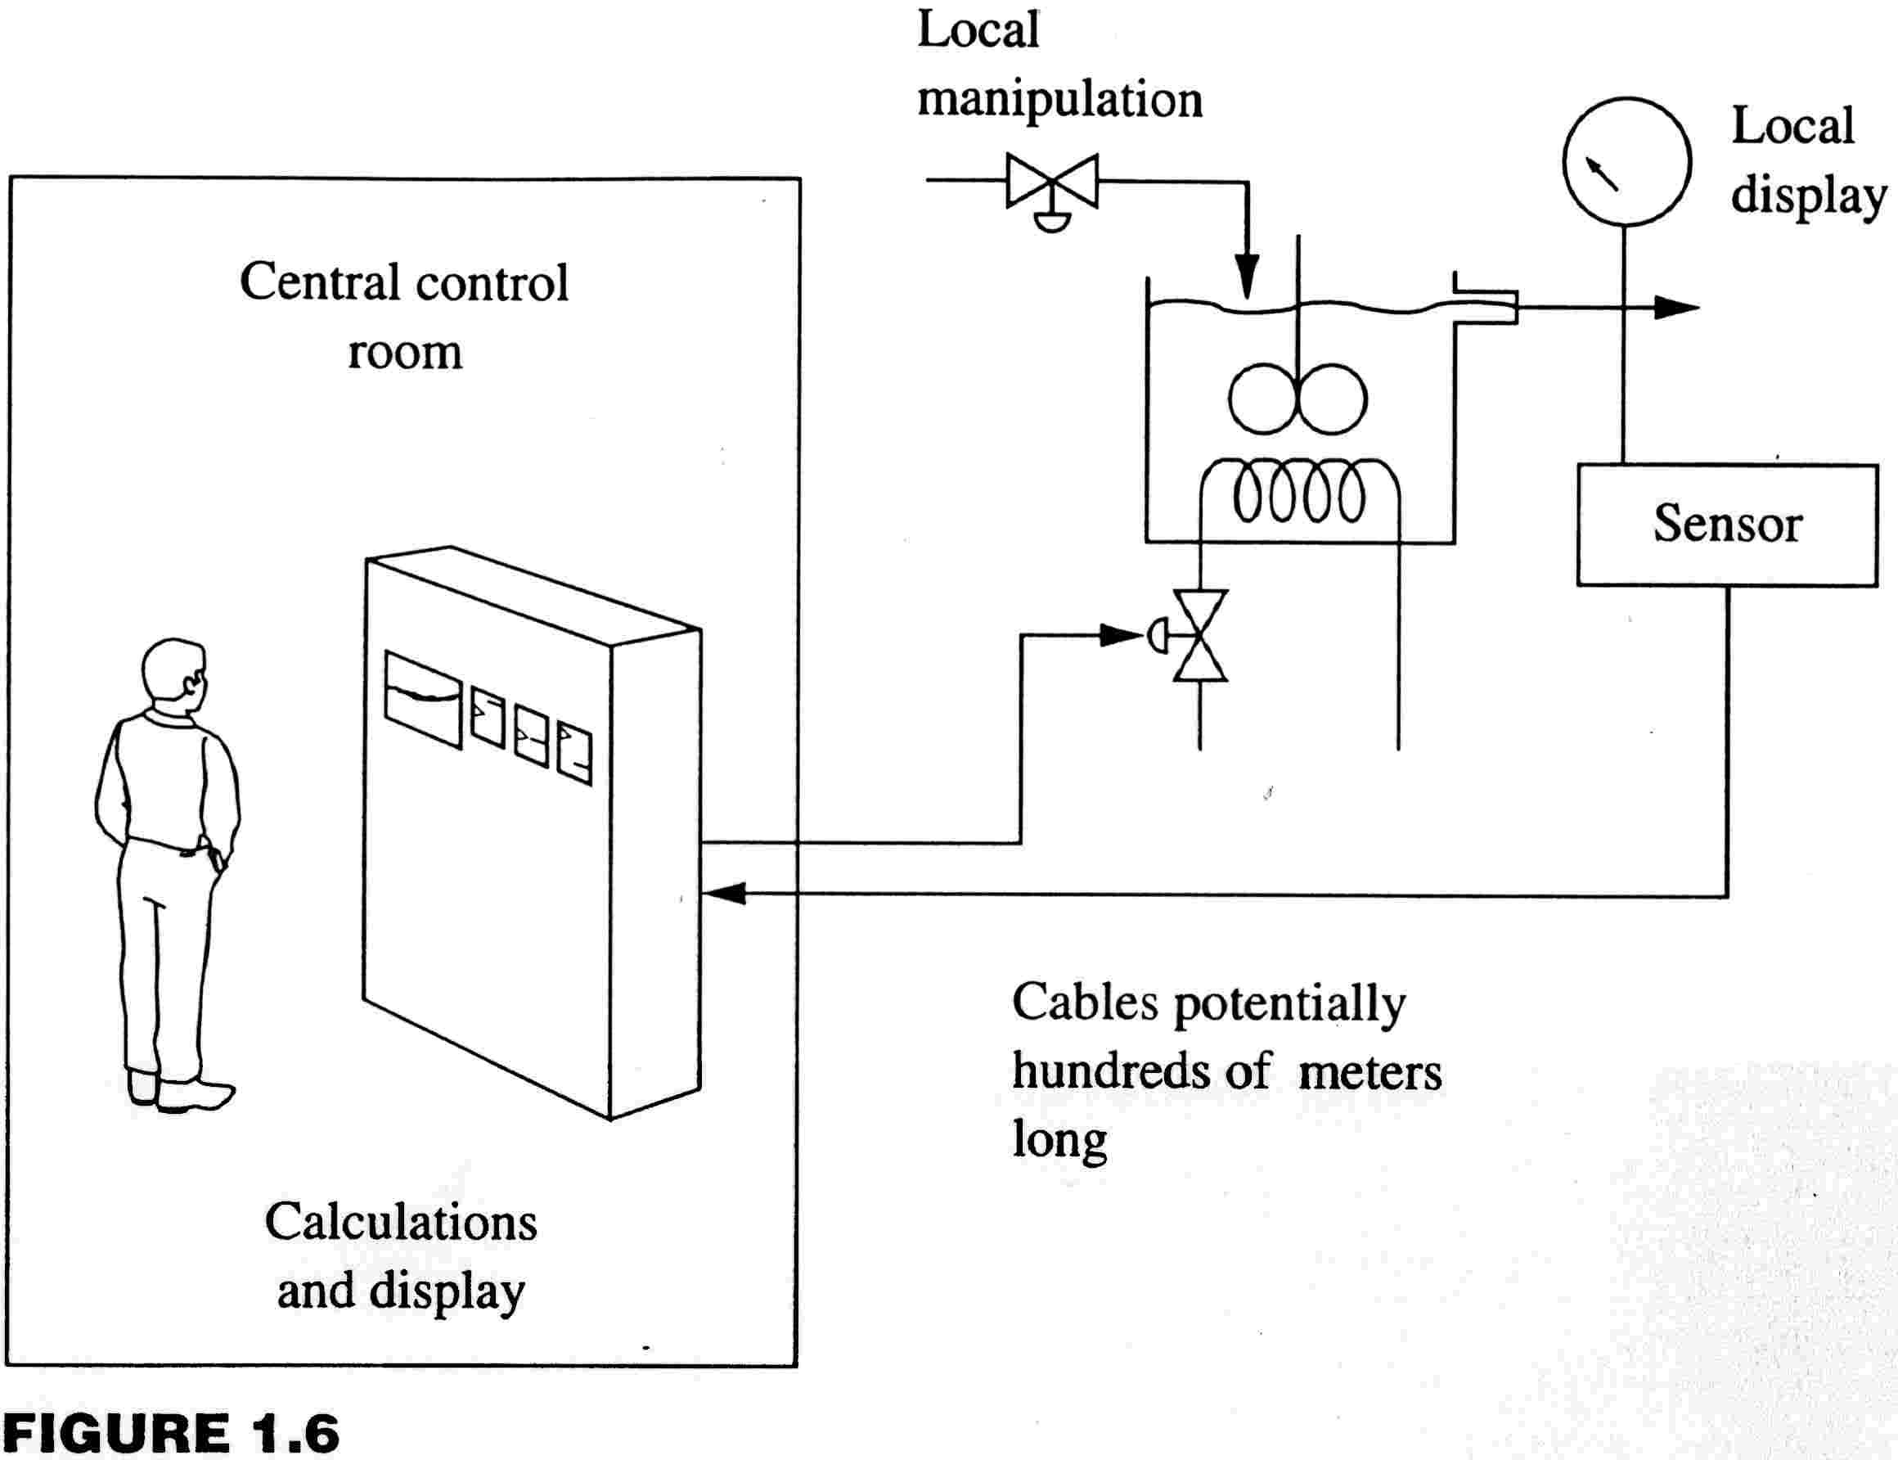
CHAPTER 24: CONTROL DESIGN
People monitor and diagnose the plant and control system. They are responsible for intervening quickly when needed and for planning non-critical maintenance corrections.
Sensors, local indicators, and valves in the process
Central control room
Displays of variables, calculations, and commands to valves are in the centralized control center.

Slide 47
CHAPTER 24: CONTROL DESIGN
LOCAL INSTRUMENTATION
Local manipulated variables are needed for start-up, shutdown, and actions taken infrequently.
Local displays are needed by plant operators when working at the process equipment, e.g., starting a pump or opening a manual by-pass.
Central control room
They are also used for longer-term monitoring of slow changes, when shift or daily measurements are OK.

Slide 48
CHAPTER 24: CONTROL DESIGN
SHORT-TERM DATA ANALYSIS
The centralized control room provides information on the integrated plant.
Trouble shooting
product quality
production control
Information must be presented in a easily understood manner, graphically in context with process schematics.
Mainly used by plant operators.
Central control room

Slide 49
CHAPTER 24: CONTROL DESIGN
LONGER-TERM DATA ANALYSIS
The centralized control room provides information on the integrated plant.
Process performance
(energy/kg of product)
Equipment performance
(compressor efficiency, heat exchanger fouling, etc.)
Information must be in a format that can be used by other programs.
Mainly used by engineers.
Central control room

Slide 50
CHAPTER 24: CONTROL DESIGN
THE CONTROL DESIGN PROCEDURE
Define the control problem (challenge)
Evaluate/achieve operability
- Degrees of freedom
- Controllability
- Operating Window
Process dynamics for good performance
Loop pairing
Control for safety
Monitoring and diagnosis

Slide 51
CHAPTER 24: CONTROL DESIGN
Let’s design controls for this process!
Vapor
product
T6
P1
T1
T2
T5
P ≈ 1000 kPa
T ≈ 298 K
Feed
Methane
Ethane (LK)
Propane
Butane
Pentane
F1
T3
L1
F2
F3
A1
Liquid
product
Process
fluid
Steam
L. Key

Slide 52
CHAPTER 24: CONTROL DESIGN
cascade
PAH
Vapor
product
Split range
TC-6
PC-1
T1
T2
T5
Feed
Methane
Ethane (LK)
Propane
Butane
Pentane
LAL
LAH
FC-1
T3
LC-1
F2
F3
AC-1
Liquid
product
Process
fluid
Steam
L. Key

Slide 53
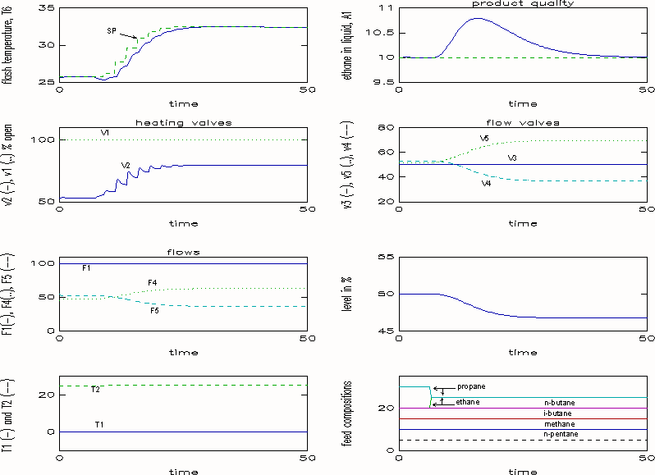
Response of design to a step change in feed composition

Slide 54
CHAPTER 24: CONTROL DESIGN WORKSHOP 1
Determine the operating window for the three-tank mixer. Plot the set point of effluent concentration and the feed flow. Base case data is summarized in the figure and further information is available in Example 7.2.
50%
open
F_{S}
solvent
6.9 m³/min
1% A
50%
open
7.0 m³
3% A
pure A
7.0 m³
F_{A}
0.14 m³/min
7.0 m³
AC

Slide 55
CHAPTER 24: CONTROL DESIGN WORKSHOP 2
Discuss how the concepts of partial control were used in design controls for the flash process. (Note, safety elements not shown on diagram.) See Chapter 24 for partial control.
cascade
Split range
TC-6
PC-1
PAH
Vapor
product
Feed
Methane
Ethane (LK)
Propane
Butane
Pentane
T1
T2
T5
LAL
LAH
FC-1
T3
LC-1
F2
F3
AC-1
Liquid
product
Process
fluid
Steam
L. Key

Slide 56
CHAPTER 24: CONTROL DESIGN WORKSHOP 3
Give a process example for a situation in which each of the factors below affect the controllability of a process. See lecture slides for Chapter 20 as a refresher.
Some seemingly independent variables are “linked” through
material balance
energy balance
equilibrium
reaction stoichiometry
Connected by beam
F
v1
T
L
F
A
C_{A}
v2

Slide 57
CHAPTER 24: CONTROL DESIGN WORKSHOP 4
Develop a control design form for the fired heater in the figure.
Flue gas
feed
product
air
fuel

Slide 58
CHAPTER 24: CONTROL DESIGN WORKSHOP 4
When I complete this chapter, I want to be
able to do the following.
Define the control problem
Evaluate if desired performance is possible; if not, modify process
Select instrumentation
Design loop pairing for control
Provide sensors for process monitoring
Lot’s of improvement, but we need some more study!
Read the textbook
Review the notes, especially learning goals and workshop
Try out the self-study suggestions
Naturally, we’ll have an assignment!

Slide 59
CHAPTER 24: LEARNING RESOURCES
SITE PC-EDUCATION WEB
- Textbook, Chapter 24
- Interactive Learning Module (Chapter 2)
- Tutorials (Chapter 24)
Other views of control design
- Luyben, W., Tyreus, B. and Luyben, M., Plantwide Process Control, McGraw-Hill, New York, 1999

Slide 60
CHAPTER 24:
SUGGESTIONS FOR SELF-STUDY
1. Compare the control design procedure presented here with the design procedure that you learned in your process design course.
2. Discuss how you could evaluate the steady-state controllability of a process using a flowsheeting program (such as ASPEN, HYSYS, or PROII).
3. Review the bonus lecture slides for Control for Safety. Apply the safety principles to the fired heater example in Workshop 4.

Slide 61
CHAPTER 24:
SUGGESTIONS FOR SELF-STUDY
4. Search the WWW for information on the control design for a process of interest to you.
- Separation (distillation, membrane, settling)
- Chemical Reactor
- Biological reactor (waste water treating or pasteurization)
- Rotating equipment (pump or compressor)
- Heat exchanger
- Flow and pressure system
- Combustion system

