Slide 1
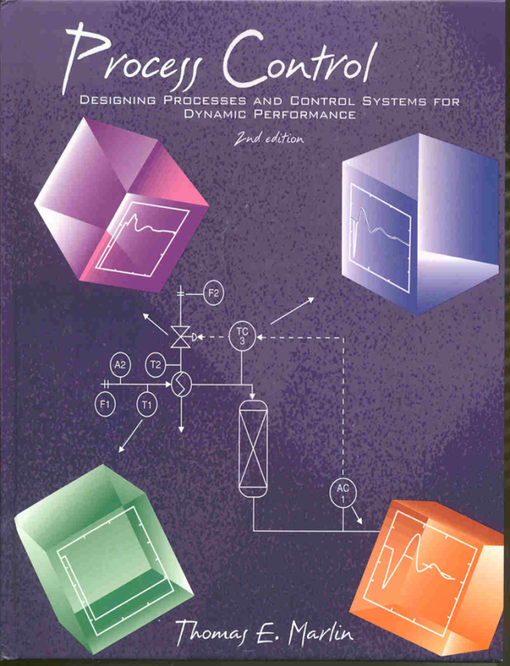
Process Control: Designing Process and Control Systems for Dynamic Performance
Chapter 21. Multiloop Control: Performance Analysis
Copyright © Thomas Marlin 2013
The copyright holder provides a royalty-free license for use of this material at non-profit educational institutions

Slide 2
CHAPTER 21: Multiloop Control Performance
When I complete this chapter, I want to be
able to do the following.
Distinguish favorable and unfavorable interaction
Balance controllability, integrity and dynamic performance
Apply two methods for decoupling
Properly select applications for decoupling

Slide 3
CHAPTER 21: Multiloop Control Performance
Outline of the lesson.
Some observations on multiloop design performance
The RDG, Relative Disturbance Gain
Controllability and interaction
Disturbance directionality
Decoupling

Slide 4
MULTILOOP CONTROL PERFORMANCE
REQUIRED: DOF, Controllability, Operating Window
HIGHLY DESIRED
Integrity - Performance is “acceptable after one or more controllers become inactive
Control performance
- CVs achieve zero offset and low deviations from SP
- MVs have acceptable dynamic variability
Robustness - Performance (not just stability) is achieved for a range of plant dynamics
Range - Strong effect to compensate large disturbances
Let’s learn how to achieve these
good properties

Slide 5
MULTILOOP CONTROL PERFORMANCE
Motivating Example
No. 1 - Blending
F_{A}, x_{A}
F_{M}, x_{AM}
F_{S}, x_{AS} = 0
The design with RGA nearer 1.0 is better
Must retune when flow controller is in manual!

Slide 6
MULTILOOP CONTROL PERFORMANCE
Motivating Example No. 2 - Distillation SP Response
FR → XD
FRB → XB
FD → XD
FRB → XB
For set point response, RGA closer to 1.0 is better
RGA = 6.09
RGA = 0.39

Slide 7
MULTILOOP CONTROL PERFORMANCE
Motivating Example No. 3 - Distillation disturb. Response
FR → XD
FRB → XB
FD → XD
FRB → XB
For set point response, RGA farther from 1.0 is better
RGA = 6.09
RGA = 0.39

Slide 8
MULTILOOP CONTROL PERFORMANCE
Conclusion from examples - RGA Alone does not provide sufficient information for control design
Key missing information is disturbance type
Key factor is the DISTURBANCE DIRECTION
Disturbances in this direction are difficult to correct.
Disturbances in this direction are easily corrected.

Slide 9
MULTILOOP CONTROL PERFORMANCE
Short-cut Measure of Multiloop Control Performance
We want to predict the performance using limited information and calculations
We would like to have the following features
- Dimensionless
- Based on process characteristics
- Related to the disturbances type
Let’s recall if the RGA
had these features

Slide 10
MULTILOOP CONTROL PERFORMANCE
Relative Disturbance Gain
dimensionless
only s-s gains
can be +/- and > or < 1.0
different for each disturbance
Usually the dominant term for interaction
Tune Factor
Change in tuning for multi-loop
Single-loop performance (dead times, large disturbances, etc. are bad)

Slide 11
MULTILOOP CONTROL PERFORMANCE
Relative disturbance gain
What is the typical range?
What unique information is here?
What is this term?

Slide 12
MULTILOOP CONTROL PERFORMANCE
Process Example: Binary Distillation with XD=.98, XB = 0.02
FR → XD
FRB → XB
FD → XD
FRB → XB
Energy Balance:
Material Balance:
1. Calculate the RGA, RDG, f_{tune}, and Ratio of integral errors for both loop pairings
2. Select best loop pairings

Slide 13
MULTILOOP CONTROL PERFORMANCE
Distillation tower (R,V) with both controllers in automatic for feed composition disturbance
XD XB
Good performance in spite of the large RGA

Slide 14
MULTILOOP CONTROL PERFORMANCE
Distillation tower (R,V) with only XD controller in automatic for feed composition disturbance
XD XB
Favorable interaction results in small XB deviation although it is not controlled!
No control!

Slide 15
MULTILOOP CONTROL PERFORMANCE
Distillation Tower (R,V) with only XD controller in automatic and disturbance through FR model
XD XB
Example is change in reflux subcooling.
Good performance in spite of the large RGA
No control!

Slide 16
MULTILOOP CONTROL PERFORMANCE
PRELIMINARY LOOP PAIRING GUIDELINE
Pair loops with good single-loop performance and favorable interaction, as indicated by a small |RDG|.
Small = good SL performance
Small = favorable interaction

Slide 17
MULTILOOP CONTROL PERFORMANCE
TAKING ADVANTAGE OF THE DYNAMICS
If unfavorable interaction exists in the best loop pairing, the effects of interaction can be reduced by tight tuning of the important loop and loose tuning of the less important loops.
FR → XD
FRB → XB
Loosely
tuned
Tightly
tuned
RGA = 6.09

Slide 18
MULTILOOP CONTROL PERFORMANCE
TAKING ADVANTAGE OF THE DYNAMICS
Seek MV-CV pairings that provide fast feedback control for the more important loops. This tends to match the dynamic performance with the control objectives.
Evaluate the loop pairing for this process example, which supplies gas to a consumer from two sources.
V-1
P-1
gas
P-2
PC
vaporizer
E-1
AC
gas
A = composition

Slide 19
MULTILOOP CONTROL PERFORMANCE
PROVIDING LARGE RANGE (OPERATING WINDOW)
For most important CVs, select an MV with large range.
- If other loops are in manual, the important loop retains large operating window.
Provide “extra” MV using split range capabilities.
Discuss the range available when
1. Both loops are in automatic.
2. Only one loop is in automatic.
AC
AC

Slide 20
MULTILOOP CONTROL PERFORMANCE
PROVIDING INTEGRITY
Favor loop pairings with positive relative gains.
- Only use negative RGA if very advantageous dynamics
- Use zero RGA very carefully for dynamic advantage
If non-positive RGA used, add monitor to alarm operator when other loop is inactive
Consider the effects of RGA on tuning. Avoid high multiloop gains that lead to unstable single-loop systems.

Slide 21
MULTILOOP CONTROL PERFORMANCE
RETAINING CONTROLLABILITY
Do not implement a loop that eliminates the causal relationship of another loop.
Evaluate the design, specifically the control of the concentration in the reactor
Suggest an alternative design
Solvent
T
A
Reactant
Coolant

Slide 22
MULTILOOP CONTROL PERFORMANCE
RETAINING CONTROLLABILITY
Do not control the same variable with two loops with the same set point.
Flows into the pipe
What problems could occur if the two PCs had the same set point?
Why would we use different set points?
Would the system function with different set points?
PC
PC
Flows exiting the pipe

Slide 23
MULTILOOP CONTROL PERFORMANCE
REDUCING EFFECTS OF DISTURBANCES
Implement loops that reduce the effects of disturbances before they affect the key controlled variables.
T
How does this design satisfy the rule above.
Suggest additional methods for reducing the effects of disturbances
Solvent
A
Reactant
Coolant

Slide 24
MULTILOOP CONTROL PERFORMANCE
REDUCING THE EFFECTS OF UNFAVORABLE INTERACTION USING DECOUPLING
Retains the single-loop control algorithms
Reduces (eliminates) the effects of interaction
Three approaches
- Implicit decoupling: Calculated MVs
- Implicit decoupling: Calculated CVs
- Explicit decoupling: Controller compensation

Slide 25
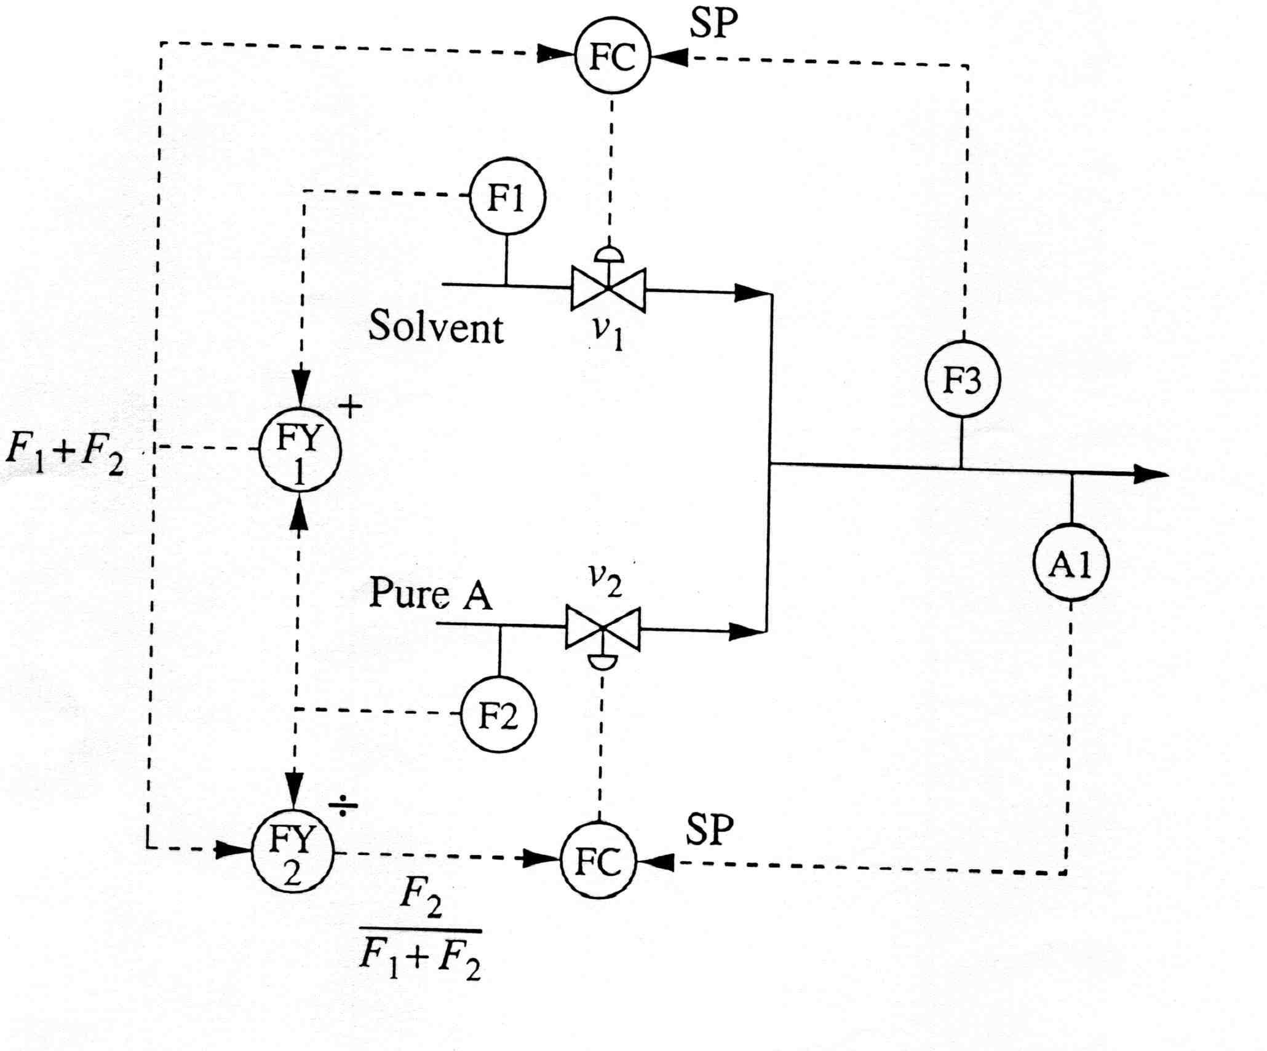
MULTILOOP CONTROL PERFORMANCE
IMPLICIT DECOUPLING: CALCULATED MVs
How can we adjust these calculated variables?
Are there any special tuning guidelines?

Slide 26
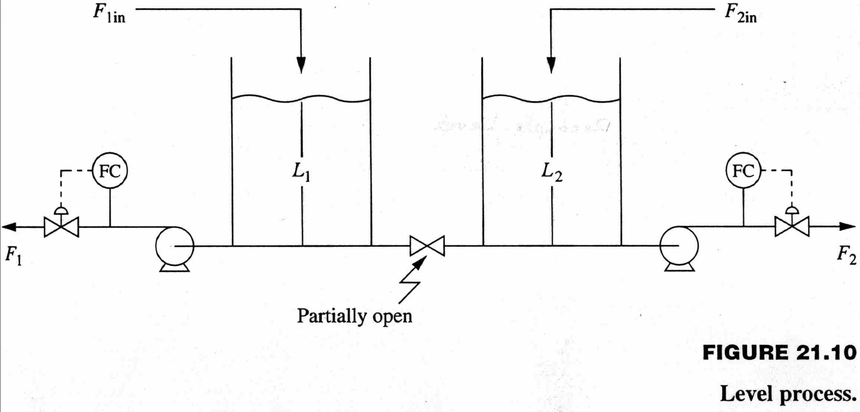
MULTILOOP CONTROL PERFORMANCE
IMPLICIT DECOUPLING: CALCULATED CVs
How can we control these calculated variables?
Are there any special tuning guidelines?

Slide 27
MULTILOOP CONTROL PERFORMANCE
REDUCING THE EFFECTS OF UNFAVORABLE INTERACTION USING EXPLICIT DECOUPLING
Compensates for the effects of interaction
SP₁(s)
-
CV₁(s)
+
G_{c1}(s)
+
G₁₁(s)
+
+
G_{D21}(s)
MV₁(s)
G₂₁(s)
G_{d1}(s)
D(s)
G_{D12}(s)
MV₂(s)
G₁₂(s)
G_{d2}(s)
+
G_{c2}(s)
G₂₂(s)
+
+
+
SP₂(s)
-
CV₂(s)

Slide 28
MULTILOOP CONTROL PERFORMANCE
Decoupling - Perfect decoupling compensates for interactions
One design approach:
SP₁(s)
-
CV₁(s)
G_{c1}(s)
G₁₁(s)/λ11
+
+
+
G_{d1}(s)
D(s)
G_{d2}(s)
+
G_{c2}(s)
G₂₂(s)/λ22
+
+
SP₂(s)
-
CV₂(s)

Slide 29
MULTILOOP CONTROL PERFORMANCE
Decoupling - Deciding when to decouple

Slide 30
MULTILOOP CONTROL PERFORMANCE
Which decoupling do you recommend?
FR → XD
FRB → XB

Slide 31
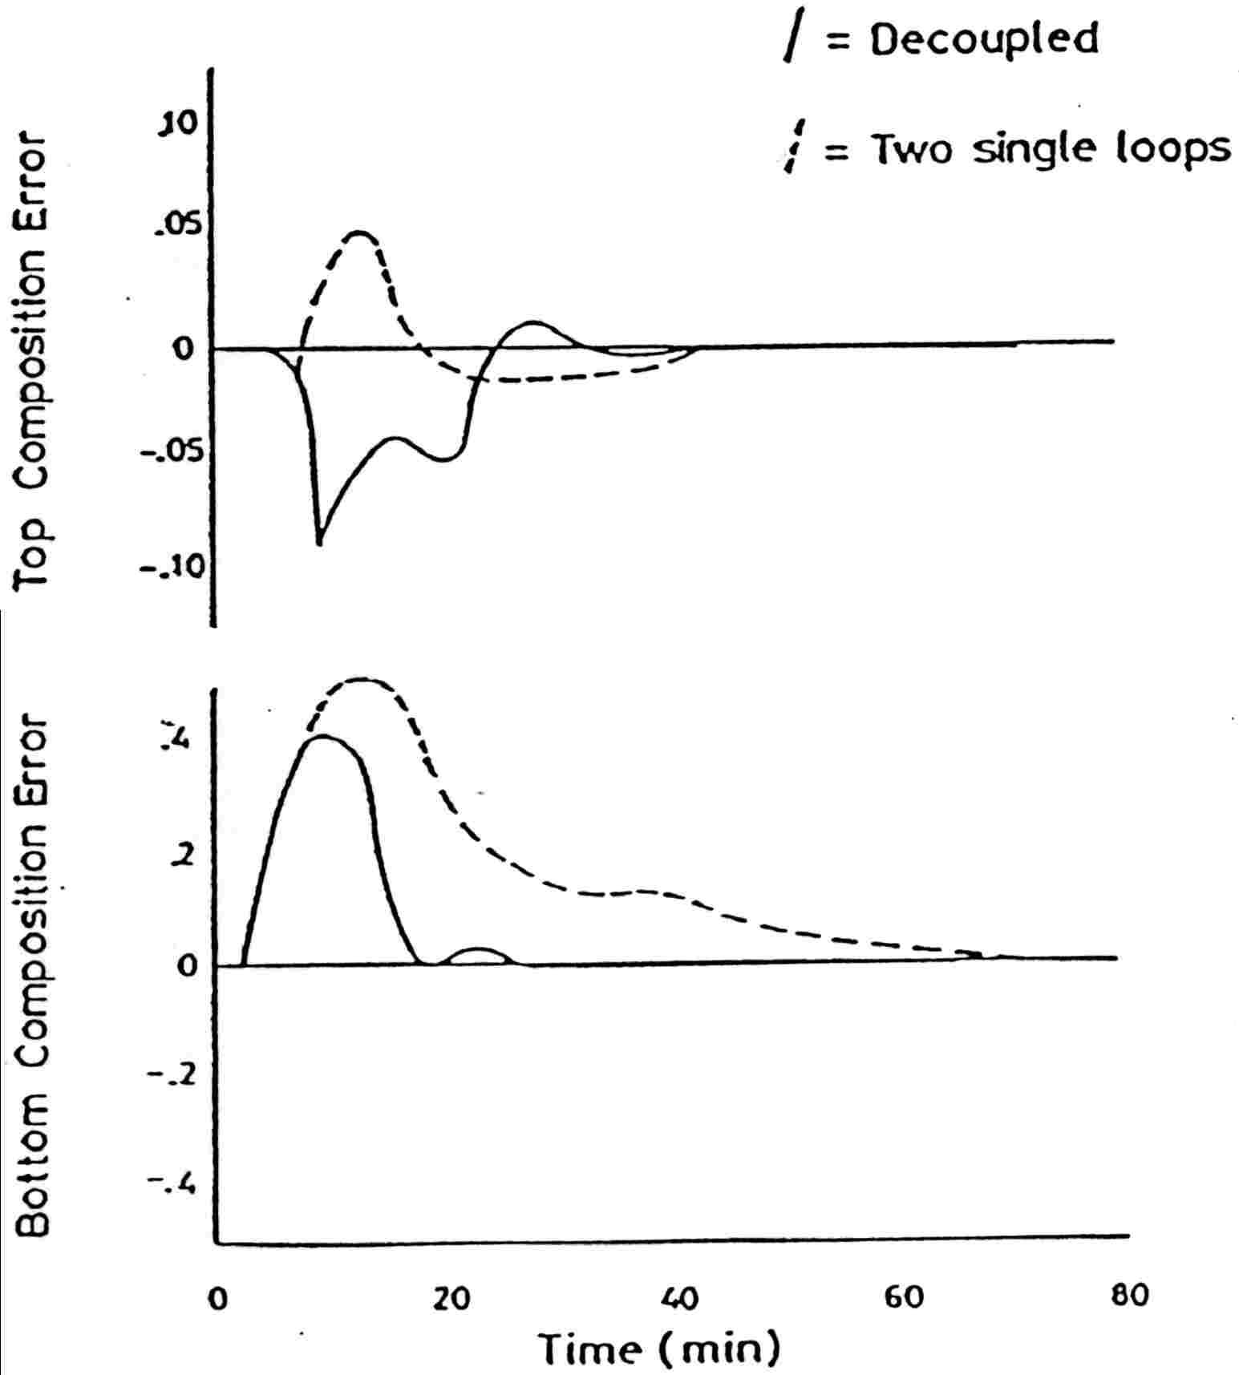
MULTILOOP CONTROL PERFORMANCE
Simulation confirms that top-to-bottom decoupling improves XB control performance.
|RDG*f_{tune} | > 1.0
improvement

Slide 32
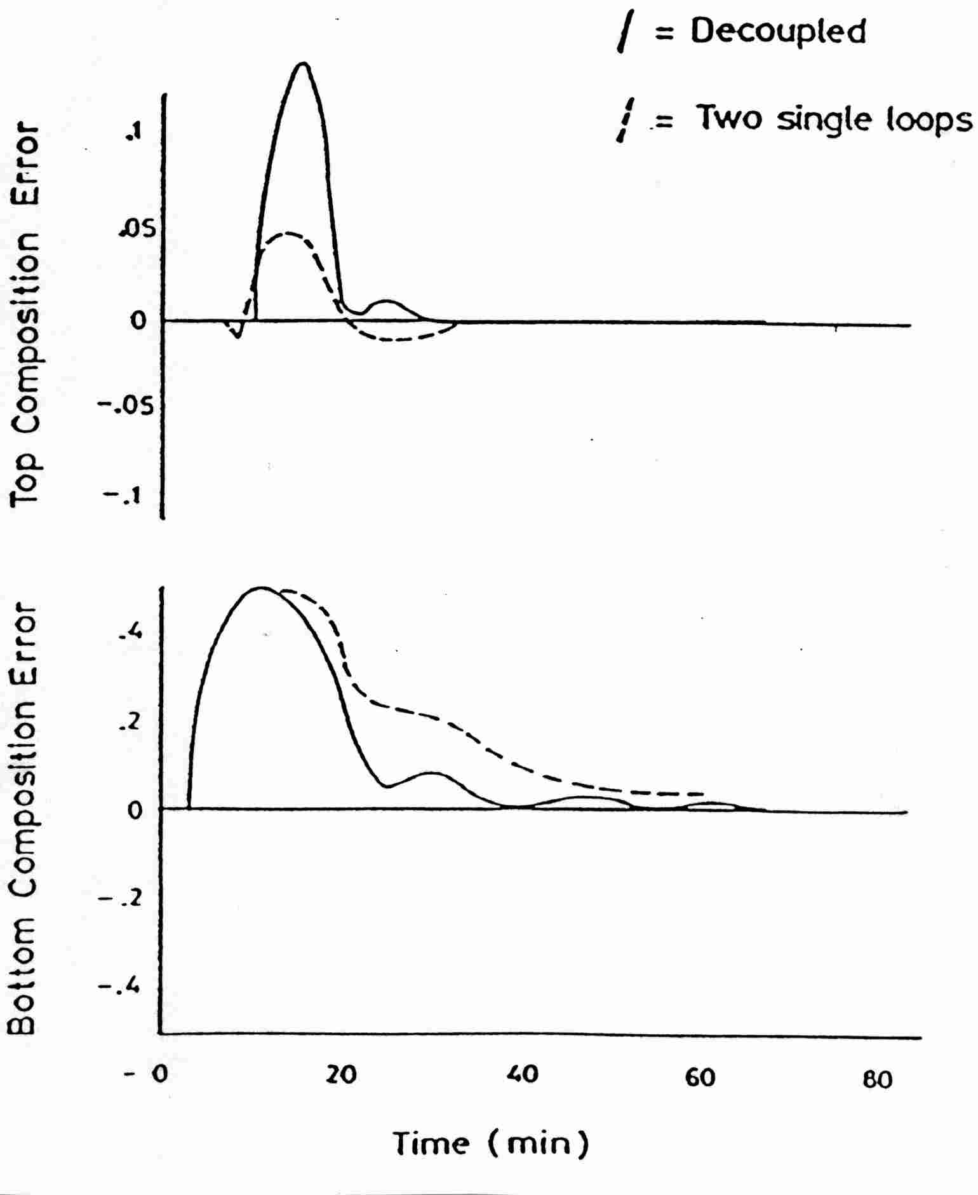
MULTILOOP CONTROL PERFORMANCE
Simulation confirms that bottom-to-top decoupling does not improve XD control performance.
|RDG*f_{tune} | < 1.0
No improvement
(a bit worse)

Slide 33
MULTILOOP CONTROL PERFORMANCE
Decoupling - A large relative gain indicates extreme sensitivity to modelling errors can occur
(Worst case mismatch)

Slide 34
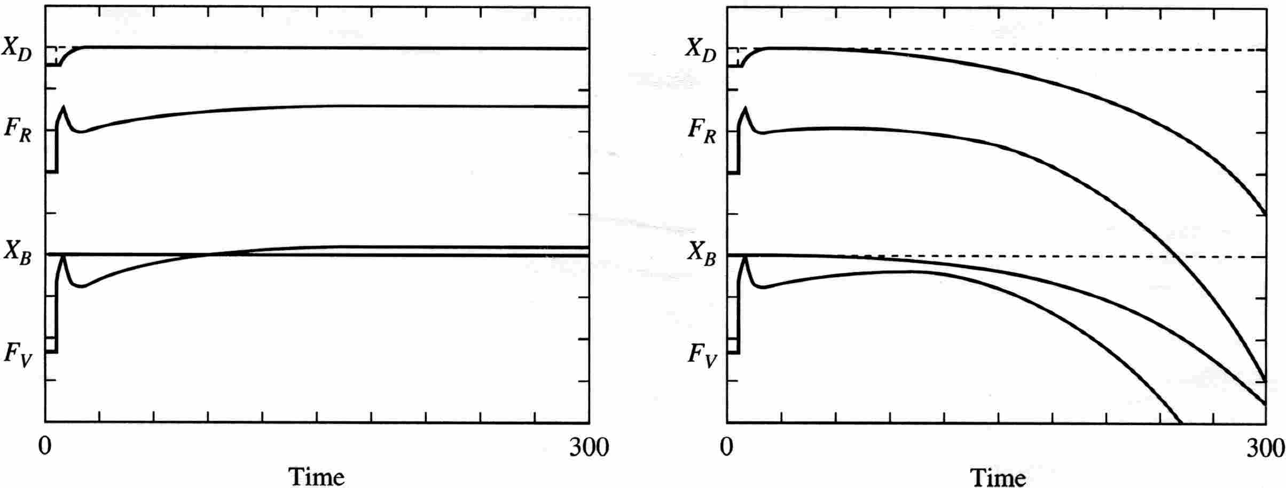
MULTILOOP CONTROL PERFORMANCE
Decoupler performance can be very sensitive to gain errors. If possible, use process knowledge in determining plant gains, K_{ij}.
Decoupler with no errors; excellent performance!
Decoupler with 15% gain errors, unstable!

Slide 35
MULTILOOP CONTROL PERFORMANCE
Decoupling
Because the closed-loop system changes, the controller must be retuned by approximately the relative gain, (Kc)_{dec} ≈ λ (Kc)_{SL} .
When a valve saturates, the “other” loops need to be retuned again!
The behavior with integral windup is complex.
Why not use MPC?

Slide 36
MULTILOOP CONTROL PERFORMANCE
CONCLUSIONS
CONTROL PERFORMANCE DEPENDS STRONGLY ON THE DISTURBANCE
- Multiloop systems have directions that are easy/difficult to achieve
- Multiloop performance can be worse or better than SL
SHORT-CUT METHOD IS AVAILABLE TO EVALUATE MULTILOOP PERFORMANCE
- RDG uses steady-state gains
- Large value is BAD; small value might be good
(careful of +/- cancellation)

Slide 37
MULTILOOP CONTROL PERFORMANCE
Complete the following table with recommendations for control design

