Slide 1
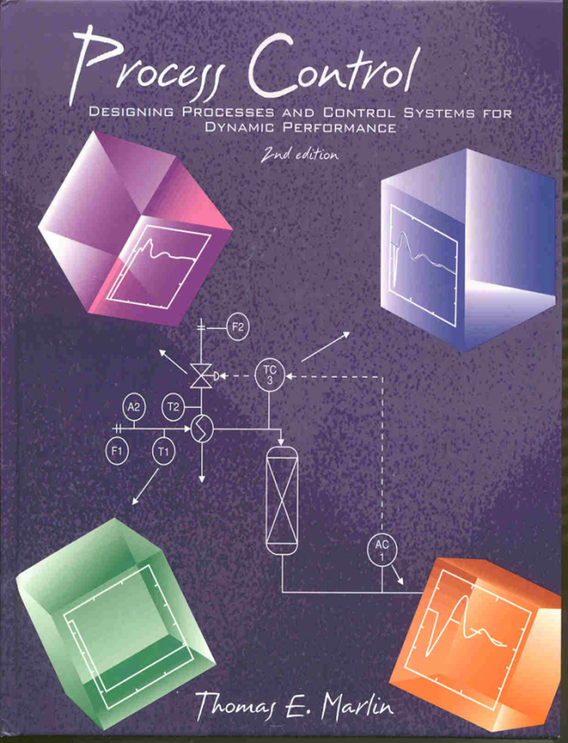
Process Control: Designing Process and Control Systems for Dynamic Performance
Chapter 19. Single-Loop IMC
Copyright © Thomas Marlin 2013
The copyright holder provides a royalty-free license for use of this material at non-profit educational institutions

Slide 2
CHAPTER 19: Single-Loop IMC Control
When I complete this chapter, I want to be
able to do the following.
Recognize that other feedback algorithms are possible
Understand the IMC structure and how it provides the essential control features
Tune an IMC controller
Correctly select between PID and IMC

Slide 3
CHAPTER 19: Single-Loop IMC Control
Outline of the lesson.
Thought exercise for model-based control
IMC structure
Desired control features
IMC algorithm and tuning
Application guidelines

Slide 4
CHAPTER 19: Single-Loop IMC Control
Let’s quickly review the PID algorithm
This is the de facto standard!
PID was developed in 1930-40’s
PID is not the only feedback algorithm
PID gives good balance of performance and robustness
PID does not always give the best performance
Multiple PIDs are used for multivariable systems

Slide 5
CHAPTER 19: Single-Loop IMC Control
Let’s look ahead to the IMC structure and algorithm
We will have another algorithm to learn!!!!
IMC was developed formally in 1980’s, but the ideas began in 1950’s
IMC uses a process model explicitly
IMC involves a different structure and controller
IMC could replace PID, but we chose to retain PID unless an advantage exists
A single “IMC” can be used for multivariable systems

Slide 6
CHAPTER 19: Single-Loop IMC Control
Let’s do a thought experiment:
1. We want to control the concentration in the tank.
2. Initially, A = 6 wgt%
We want A = 7 wgt%
3. From data, we know that
ΔA/Δv = 0.5 wgt%/% open
Solvent
A
Reactant
A wgt%
6%
What do we do?
Valve
% open
time

Slide 7
CHAPTER 19: Single-Loop IMC Control
Let’s do a thought experiment:
1. We want to control the concentration in the tank.
2. Initially, A = 6 wgt%
We want A = 7 wgt%
3. From data, we know that
ΔA/Δv = 0.5 wgt%/% open
Solvent
A
Reactant
A wgt%
6%
What do we expect
to happen?
Valve
% open
+ 2%
time

Slide 8
CHAPTER 19: Single-Loop IMC Control
Let’s do a thought experiment:
1. We want to control the concentration in the tank.
2. Initially, A = 6 wgt%
We want A = 7 wgt%
3. From data, we know that
ΔA/Δv = 0.5 wgt%/% open
Solvent
A
Reactant
7.3%
Should we be surprised?
What do we do now?
Devise 2 different responses
A wgt%
6%
Valve
% open
+ 2%
Hint: We used a model for the first calculation. What do we do if the model is in error?
time

Slide 9
CHAPTER 19: Single-Loop IMC Control
Let’s do a thought experiment:
1. We want to control the concentration in the tank.
2. Initially, A = 6 wgt%
We want A = 7 wgt%
3. From data, we know that
ΔA/Δv = 0.5 wgt%/% open
Solvent
A
Reactant
7.3%
We apply the feedback
until we have converged.
6%
6.91%
A wgt%
-0.6%
Valve
% open
+ 2%
time

Slide 10
CHAPTER 19: Single-Loop IMC Control
7.3%
6%
Solvent
A wgt%
5.91%
-0.6%
Valve
% open
+ 2%
A
time
Reactant
D(s)
G_{d}(s)
SP(s)
MV(s)
CV(s)
+
G_{C}(s)
G_{v}(s)
G_{P}(s)
+
-
+
Discuss this diagram and complete the closed-loop
block diagram for the IMC concept.

Slide 11
CHAPTER 19: Single-Loop IMC Control
7.3%
6%
Solvent
A wgt%
5.91%
-0.6%
Valve
% open
+ 2%
A
time
Reactant
D(s)
G_{d}(s)
SP(s)
MV(s)
CV(s)
+
G_{C}(s)
G_{v}(s)
G_{P}(s)
+
-
+
-
+
G_{m}(s)
This is a model of the feedback process.
“Model error” = E_{m}(s)

Slide 12
CHAPTER 19: Single-Loop IMC Control
D(s)
G_{d}(s)
SP(s)
T_{p}(s)
MV(s)
CV(s)
+
G_{CP}(s)
G_{v}(s)
G_{P}(s)
+
-
+
What is G_{CP}??
-
+
G_{m}(s)
E_{m}(s)
Transfer functions
G_{CP}(s) = controller
G_{v}(s) = valve
G_{P}(s) = feedback process
G_{m}(s) = model
G_{d}(s) = disturbance process
Variables
CV(s) = controlled variable
CV_{m}(s) = measured value of CV(s)
D(s) = disturbance
E_{m}(s) = model error
MV(s) = manipulated variable
SP(s) = set point
T_{p}(s) = set point corrected for model error

Slide 13
CHAPTER 19: Single-Loop IMC Control
What controller calculation gives good performance?
It is NOT a PID algorithm
Let’s set some key features and determine what G_{cp} will achieve these features
1. Zero steady-state offset for “step-like” inputs
2. Perfect control (CV=SP for all time)
3. Moderate manipulated variable adjustments
4. Robustness to model mismatch
5. Anti-reset-windup

Slide 14
CHAPTER 19: Single-Loop IMC Control
D(s)
G_{d}(s)
What controller calculation gives good performance?
SP(s)
T_{p}(s)
CV(s)
G_{CP}(s)
MV(s)
G_{v}(s)
G_{P}(s)
+
+
-
+
What is G_{CP}??
-
+
G_{m}(s)
E_{m}(s)
1. Zero steady-state offset:
What condition for G_{cp}(s) ensures zero steady-state
offset for a step disturbance?
Hint: Steady-state is at t = ∞.

Slide 15
CHAPTER 19: Single-Loop IMC Control
D(s)
G_{d}(s)
What controller calculation gives good performance?
SP(s)
T_{p}(s)
CV(s)
G_{CP}(s)
MV(s)
G_{v}(s)
G_{P}(s)
+
+
-
+
What is G_{CP}??
-
+
G_{m}(s)
E_{m}(s)
1. Zero steady-state offset:
CONCLUSION
K_{cp} = (K_{m})⁻¹
Easily achieved because
both are in computer!
Oh yeah, the final value theorem!

Slide 16
CHAPTER 19: Single-Loop IMC Control
D(s)
G_{d}(s)
What controller calculation gives good performance?
SP(s)
T_{p}(s)
CV(s)
G_{CP}(s)
MV(s)
G_{v}(s)
G_{P}(s)
+
+
-
+
What is G_{CP}??
-
+
G_{m}(s)
E_{m}(s)
2. Perfect dynamic control:
What is required for perfect dynamic control?
Do you expect that we will achieve this goal?

Slide 17
CHAPTER 19: Single-Loop IMC Control
D(s)
G_{d}(s)
What controller calculation gives good performance?
SP(s)
T_{p}(s)
CV(s)
G_{CP}(s)
MV(s)
G_{v}(s)
G_{P}(s)
+
+
-
+
What is G_{CP}??
-
+
G_{m}(s)
E_{m}(s)
2. Perfect dynamic control:
CONCLUSION
G_{cp}(s) = (G_{m}(s))⁻¹
Controller is inverse of model!
Can we achieve this?

Slide 18
CHAPTER 19: Single-Loop IMC Control
2. Perfect dynamic control:
3. Moderate manipulated variable adjustments
CONCLUSION
G_{cp}(s) = (G_{m}(s))⁻¹
Controller is inverse of model!
Can we achieve this?
This is a pure derivative, which will lead to excessive manipulated variable moves
This is a prediction into the future, which is not possible
Conclusion: Perfect control is not possible!
(See other examples in the workshops.)

Slide 19
CHAPTER 19: Single-Loop IMC Control
2. Perfect dynamic control:
3. Moderate manipulated variable adjustments
CONCLUSION
G_{cp}(s) = (G_{m}(s))⁻¹
Controller is inverse of model!
Can we achieve this?
This has a second derivative, which will lead to excessive manipulated variable moves
This could have an unstable controller, if τ₁ is negative. This is unacceptable.
Conclusion: Perfect control is not possible!
(See other examples in the workshops.)

Slide 20
CHAPTER 19: Single-Loop IMC Control
Let’s begin our IMC design with the results so far.
CONCLUSION
K_{cp} = (K_{m})⁻¹
Easily achieved because
both are in computer!
CONCLUSION
G_{cp}(s) ≈ (G_{m}(s))⁻¹
Controller is inverse of model!
We have loosened the restriction to a condition that can be achieved.
Now, what does “approximate” mean?
How can we define the meaning of approximate
so that we have a useful design approach?

Slide 21
CHAPTER 19: Single-Loop IMC Control
Separate the model into two factors, one invertible and the other with all non-invertible terms.
The “invertible” factor has an inverse that is causal and stable, which results in an acceptable controller. The gain is the model gain, K_{m}.
The “non-invertible” factor has an inverse that is non-causal or unstable. The factor contains models elements with dead times and positive numerator zeros. The gain is chosen to be 1.0.
What do we use for the controller?

Slide 22
CHAPTER 19: Single-Loop IMC Control
Separate the model into two factors, one invertible and the other with all non-invertible terms.
The IMC controller eliminates all non-invertible elements in the feedback process model by inverting G⁻_{m}(s).
Looks easy, but I need some practice.

Slide 23
CHAPTER 19: Single-Loop IMC Control
F_{S}
solvent
F_{A}
pure A
AC
Class exercise: We have two models for the feedback dynamics for the 3-tank mixer. Determine G_{cp}(s) for each.
Empirical model
Fundamental model

Slide 24
CHAPTER 19: Single-Loop IMC Control
Empirical model
Fundamental model
Discuss these results.
Do they “make sense”?
Are there any shortcomings?
(Hint: Look at other desirable features.)

Slide 25
CHAPTER 19: Single-Loop IMC Control
First derivative
Third derivative!
3. Moderate manipulated variable adjustments
4. Robustness to model mismatch
To achieve these features, we must be able to
“slow down” the controller.
We chose to include a filter in the feedback path.

Slide 26
CHAPTER 19: Single-Loop IMC Control
D(s)
G_{d}(s)
SP(s)
T_{p}(s)
MV(s)
CV(s)
+
G_{CP}(s)
G_{v}(s)
G_{P}(s)
+
-
+
-
+
G_{m}(s)
E_{m}(s)
G_{f}(s)
The value of N_{f} is selected so that the product of the controller and filter has a polynomial in “s” with a denominator order ≥ the numerator order.
The filter is designed to prevent pure derivatives and the filter constant is tuned to achieve “robust performance”.

Slide 27
CHAPTER 19: Single-Loop IMC Control
Class exercise: Determine the structure of the filter for the two possible controllers we just designed for the three tank mixing process.
Empirical model
Fundamental model

Slide 28
CHAPTER 19: Single-Loop IMC Control
Class exercise: Determine the structure of the filter for the two possible controllers we just designed for the three tank mixing process.
Empirical model
Fundamental model

Slide 29
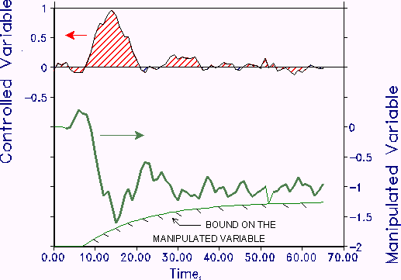
CHAPTER 19: Single-Loop IMC Control
Now, we must determine the proper value for the filter time constant - this is controller tuning again!
We know how to set the goals from experience with PID.
CV Dynamic Behavior:
Stable, zero offset, minimum IAE
MV Dynamic Behavior:
damped oscillations and small fluctuations due to noise.
MV can be more aggressive in early part of transient

Slide 30
CHAPTER 19: Single-Loop IMC Control
We can tune using a simulation and optimization or
Process reaction curve
Solve the tuning problem. Requires a computer program.
Apply, and fine tune.
1.5
1
0.5
0
-0.5
0
5
10
15
20
25
30
35
40
45
50
COMBINED DEFINITION OF TUNING
First order with dead time process model
Noisy measurement signal
± 25% parameters errors between model/plant
IMC controller: determine K_{f}
Minimize IAE with MV inside bound
1
0.8
v1
0.6
0.4
TC
0.2
0
0
5
10
15
20
25
30
35
40
45
50
v1
TC
v2
v2
Km = 1
θm = 5
τm = 5
τ_{f} =???
We can develop tuning correlations. These are available for a lead-lag controller, G_{cp}(s)G_{f}(s).

Slide 31
CHAPTER 19: Single-Loop IMC Control
IMC Tuning for a typical set of conditions and goals
Scaled filter time constant, τ_{f} /(θ+τ)
Fraction dead time, θ/(θ+τ)

Slide 32
CHAPTER 19: Single-Loop IMC Control
Class exercise: Determine the filter time constant for the IMC controller that we just designed for the three tank mixing process.
Empirical model

Slide 33
CHAPTER 19: Single-Loop IMC Control
Class exercise: Determine the filter time constant for the IMC controller that we just designed for the three tank mixing process.
Empirical model
1. The controller is lead-lag, so we can use the correlation.
2. θ/(θ+τ) = 5.5/16.0 = 0.34
3. τ_{f} /(θ+τ) = 0.38 ;
τ_{f} = (0.38)(15.5) = 6.1 minutes
4. See the next slide for the dynamic response.
5. We can fine tune to achieve the desired CV and MV behavior.

Slide 34
CHAPTER 19: Single-Loop IMC Control
F_{S}
solvent
F_{A}
pure A
AC
Discuss the control
performance.
AC
v_{A}

Slide 35
CHAPTER 19: Single-Loop IMC Control
Smith Predictor: A smart fellow named Smith saw the benefit for an explicit model in the late 1950’s. He invented the Smith Predictor, using the PI controller.
The elements in the box calculate an approximate inverse
D(s)
G_{d}(s)
SP(s)
MV(s)
CV(s)
+
+
G_{C}(s)
G_{v}(s)
G_{P}(s)
+
-
-
+
-
+
G⁻_{m}(s)
G_{m}(s)
E_{m}(s)
Notes: G_{c}(s) is a PI controller; G⁻_{m}(s) is the invertible factor.

Slide 36
CHAPTER 19: Single-Loop IMC Control
When do we select an IMC over a PID?
1. Very high fraction dead time, θ/(θ+τ) > 0.7.
2. Very strong inverse responses.
3. Cascade primary controller with slow secondary (inner) dynamics
4. Feedforward with disturbance dead time less than feedback dead time.
See the textbook for further discussion.

Slide 37
CHAPTER 19: IMC CONTROL WORKSHOP 1
Trouble shooting: You have determined the model below empirically and have tuned the IMC controller using the correlations. The closed-loop performance is not acceptable. What do you do?
Empirical model
Km = 1
θm = 5
τm = 5
IMC filter
τ_{f} = 3.5

Slide 38
CHAPTER 19: IMC CONTROL WORKSHOP 2
Design features: We want to avoid integral windup.
1. Describe integral windup and why it is undesirable.
2. Modify the structure to provide anti-reset windup.
D(s)
G_{d}(s)
SP(s)
T_{p}(s)
MV(s)
CV(s)
+
G_{CP}(s)
G_{v}(s)
G_{P}(s)
+
-
+
-
+
G_{m}(s)
E_{m}(s)
G_{f}(s)

Slide 39
CHAPTER 19: IMC CONTROL WORKSHOP 3
Design features: We want to obtain good performance for set point changes and disturbances. The filter below affects disturbances. Introduce a modification that enables us to influence set point responses independently.
D(s)
G_{d}(s)
SP(s)
T_{p}(s)
MV(s)
CV(s)
+
G_{CP}(s)
G_{v}(s)
G_{P}(s)
+
-
+
-
+
G_{m}(s)
E_{m}(s)
G_{f}(s)

Slide 40
CHAPTER 19: IMC CONTROL WORKSHOP 4
Design features: We discussed two reasons why we cannot achieve perfect feedback control. Identify other reasons and explain how they affect the IMC structure design.
D(s)
G_{d}(s)
SP(s)
T_{p}(s)
MV(s)
CV(s)
+
G_{CP}(s)
G_{v}(s)
G_{P}(s)
+
-
+
-
+
G_{m}(s)
E_{m}(s)
G_{f}(s)

Slide 41
CHAPTER 19: Single-Loop IMC Control
When I complete this chapter, I want to be
able to do the following.
Recognize that other feedback algorithms are possible
Understand the IMC structure and how it provides the essential control features
Tune an IMC controller
Correctly select between PID and IMC
Lot’s of improvement, but we need some more study!
Read the textbook
Review the notes, especially learning goals and workshop
Try out the self-study suggestions
Naturally, we’ll have an assignment!

Slide 42
CHAPTER 19: LEARNING RESOURCES
SITE PC-EDUCATION WEB
- Tutorials (Chapter 19)
The Textbook, naturally, for many more examples.
Addition information on IMC control is given in the following reference.
Brosilow, C. and B. Joseph, Techniques of Model-Based Control, Prentice-Hall, Upper Saddle River, 2002

Slide 43
CHAPTER 19: SUGGESTIONS FOR SELF-STUDY
1. Discuss the similarities and differences between IMC and Smith Predictor algorithms
2. Develop the equations that would be solved for a digital implementation of the IMC controller for the three-tank mixer.
3. Select a feedback control example in the textbook and determine the IMC tuning for this process.
4. Find a feedback control example in the textbook for which IMC is a better choice than PID.
5. Explain how you would implement a digital algorithm to provide good control for the process in Example 19.8 experiencing the flow variation described.

