Slide 1
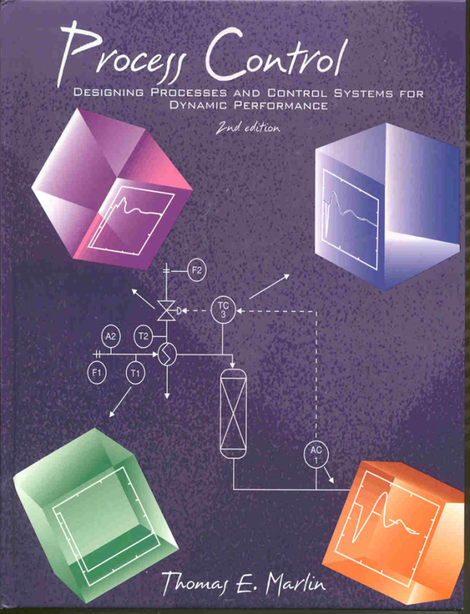
Process Control: Designing Process and Control Systems for Dynamic Performance
Chapter 12. Practical Issues
Copyright © Thomas Marlin 2013
The copyright holder provides a royalty-free license for use of this material at non-profit educational institutions

Slide 2
CHAPTER 12: PRACTICAL ISSUES
When I complete this chapter, I want to be
able to do the following.
Make PID work in practice!
Select proper field instrumentation
Use power of digital computation to validate and correct measurements
Use & tune various industrial PID algorithms
Improve performance of “simple” PID

Slide 3
CHAPTER 12: PRACTICAL ISSUES
Outline of the lesson.
Select appropriate sensors and valves
Determine the controller parameters for commercial systems
Tuning methods for noise reduction
Enhance the simple PID for shortcomings (windup, bumpless)

Slide 4
CHAPTER 12: PRACTICAL ISSUES
Let’s look at all
elements of the
feedback loop
Select best physical
principles and apply
corrections
Process, could be far from control room
v1
T
Central control room
v2
Digital PID
Account for idiosyncrasies of
commercial algorithms
Does the air open or
close the valve?

Slide 5
CHAPTER 12: PRACTICAL ISSUES
Let’s look at all
elements of the
feedback loop
PID Algo
Proportional
- sign
- units
Integral
- Windup
Derivative
- Filter
+
Set
point
-
Output processing
Bumpless transfer
Limits
Failure position
Input processing
Validity
Linearization
Filtering
Sensor
Process

Slide 6
CHAPTER 12: PRACTICAL ISSUES
Input - Sensor and Precalculations
Sensors - We must “see” key variables to apply control
Please define the following terms
Accuracy =
Reproducibility =

Slide 7
CHAPTER 12: PRACTICAL ISSUES
Input - Sensor and Pre-calculations
Sensors - We must “see” key variables to apply control
Please define the following terms
Accuracy = Degree of conformity to a standard (or true) value when a sensor is operated under specified conditions.
Reproducibility = Closeness of agreement among repeated sensor outputs for the same process variable.

Slide 8
CHAPTER 12: PRACTICAL ISSUES
Input - Sensor and Pre-calculations
Discuss the accuracy and reproducibility in these cases
A
B
C
D

Slide 9
CHAPTER 12: PRACTICAL ISSUES
Input - Sensor and Pre-calculations
Sensor range - The values over which the sensor can record the process variable. We need to “cover” expected range, but typically, the sensor accuracy decreases with increasing sensor range.
Temperature: Usually, the normal operating range
Flow: Usually, 0.0 to the maximum expected flow
Pressure: Usually, the normal operating range
Level: 0 - 100% (not meters, don’t have to memorize the height of every vessel)

Slide 10
CHAPTER 12: PRACTICAL ISSUES
Input - Sensor and Pre-calculations
PI
Usually, accuracy improves with
smaller sensor range.
How do we select the best range
for these sensors?
1
AI
PI
1
4
FT
TI
1
1
PI
5
TI
TI
5
feed
2
TI
PT
6
1
TI
3
TI
TC
7
TI
TI
10
product
4
FT
TI
FI
2
8
3
TI
11
fuel
air
PI
PI
PI
2
3
6

Slide 11
CHAPTER 12: PRACTICAL ISSUES
Input - Sensor and Pre-calculations
Analyzer measures the excess oxygen;
typical value 2%,
range 0 - 10%
PI
This sensor for control needs good accuracy within the normal operation, e.g., 350 - 450 C
1
AI
PI
1
4
FT
TI
1
1
PI
5
TI
This monitor should cover the entire range for startup and disturbances, e.g., 0 - 600 C
TI
5
feed
2
TI
PT
6
Feed flow control needs accuracy. Maximum range should be about 1.3 times design value
1
TI
3
TI
TC
7
TI
TI
10
product
4
FT
TI
FI
2
8
3
TI
11
fuel
air
PI
PI
PI
The pressure is low here. Do not have large range.
2
3
6

Slide 12
CHAPTER 12: PRACTICAL ISSUES
Input - Sensor and Pre-calculations
Typically, analog signal
Digital signal
Process
variable
Sensor signal
Analog filter
A/D
convert
Digital
filter
Lineariztion
PID
Digital computer
What is noise?
Why reduce
noise using a
filter?
20
15
10
Temperature
5
0
-5
0
5
10
15
20
25
30
35
40
45
50
Time (min)

Slide 13
CHAPTER 12: PRACTICAL ISSUES
Input - Sensor and Pre-calculations
Signal + noise
Signal?
20
15
10
Temperature
Noise?
5
0
-5
0
5
10
15
20
25
30
35
40
45
50
Time (min)
Noise: We think of noise as the non-repeatable component of the measurement.
Causes: Electrical interference, imperfect mixing, turbulence, ...
The distinction
is seldom as
clear-cut as
shown here!

Slide 14
CHAPTER 12: PRACTICAL ISSUES
Input - Sensor and Pre-calculations
Controllable disturbances
What we call noise tends
to be relatively fast.
Uncontrollable disturbances
Our plants are
relatively
slow
Sensor noise
Noise, electrical interference
10⁻⁴ 10⁻² 1.0 10²
Frequency (Hz)
[Values are typical for chemical processes, but vary over a wide range]

Slide 15
CHAPTER 12: PRACTICAL ISSUES
Input - Sensor and Pre-calculations
Process
variable
Sensor signal
Analog filter
A/D
convert
Digital
filter
Linearization
PID
Without filter
D(s)
G_{d}(s)
SP(s)
E(s)
MV(s)
CV(s)
+
G_{C}(s)
G_{v}(s)
G_{P}(s)
+
-
+
G_{S}(s)
0
5
10
15
20
25
30
35
40
45
50
CV_{m}(s)
Noise goes “around and around” in the feedback loop!

Slide 16
CHAPTER 12: PRACTICAL ISSUES
Input - Sensor and Pre-calculations
Process
variable
Sensor signal
Analog filter
A/D
convert
Digital
filter
Lineariztion
PID
With filter
D(s)
G_{d}(s)
SP(s)
E(s)
MV(s)
CV(s)
+
G_{C}(s)
G_{v}(s)
G_{P}(s)
+
-
+
G_{f}(s)
G_{S}(s)
0
5
10
15
20
25
30
35
40
45
50
CV_{f}(s)
CV_{m}(s)
The filter is in the feedback loop. What do we conclude about the favorable filter dynamics?

Slide 17
CHAPTER 12: PRACTICAL ISSUES
Input - Sensor and Pre-calculations
Process
variable
Sensor signal
Analog filter
A/D
convert
Digital
filter
Lineariztion
PID
How would the
perfect filter
behave ?
Amplitude ratio
Phase angle
signal
noise
Frequency, ω

Slide 18
CHAPTER 12: PRACTICAL ISSUES
Input - Sensor and Pre-calculations
Process
variable
Sensor signal
Analog filter
A/D
convert
Digital
filter
Lineariztion
PID
1.0
Perfectly eliminate
the noise
No dynamics
Sorry, not possible
Amplitude ratio
0.0
0.0
Phase angle
signal
noise
We have only a rough
estimate of
this boundary anyway!
Frequency, ω

Slide 19
CHAPTER 12: PRACTICAL ISSUES
Input - Sensor and Pre-calculations
In the process industries, we typically use a first order system for the filter; G_{f}(s) = 1.0/(τs+1) = CV_{f}(s)/CV_{m}(s).
10
0
FILTER BODE PLOT
Not a perfect step, but
has the desired trend.
-1
Amplitude Ratio
10
10
-2
-2
-1
0
1
2
10
10
10
10
10
Dimensionless Frequency, τω (rad/time)
0
Contributes dynamics to
the feedback loop, but
only one (small?)
time constant.
-20
-40
Phase Angle (degrees)
-60
-80
-100
-2
-1
0
1
2
10
10
10
10
10
Dimensionless Frequency, τω (rad/time)

Slide 20
CHAPTER 12: PRACTICAL ISSUES
Input - Sensor and Pre-calculations
Process
variable
Sensor signal
Analog filter
A/D
convert
Digital
filter
Lineariztion
PID
“Anti-Aliasing” filter
G_{f1}(s) = 1.0/(τ_{f1}s+1)
Time constant is small, e.g., few tenths of a second
Usually part of commercial control equipment
Digital Filter
G_{f2}(s) = 1.0/(τ_{f2}s+1)
Built by engineer for each application
Time constant is selected for each application

Slide 21
CHAPTER 12: PRACTICAL ISSUES
Input - Sensor and Pre-calculations
D(s)
G_{d}(s)
SP(s)
E(s)
MV(s)
CV(s)
+
G_{C}(s)
G_{v}(s)
G_{P}(s)
+
-
+
G_{f}(s)
G_{S}(s)
CV_{f}(s)
CV_{m}(s)
Guidelines to reduce the effects of noise on feedback
1. Reduce the derivative time (often to 0.0)
2. Set filter time constant small compared to feedback dynamics, τ_{f2} < 0.05 (θ+τ)
3. Set filter time constant large compared to disturbance frequency, τ_{f2} > 5/ω_{n} [but do not violate 2 above]

Slide 22
CHAPTER 12: PRACTICAL ISSUES
Feedback Controller - P, I and D
Continuous PID
Digital PID
Positional
form
velocity
form

Slide 23
CHAPTER 12: PRACTICAL ISSUES
Feedback Controller - P, I and D
Error - Let’s remember that two conventions are common.
E = SP - CV E = CV - SP
This is just a simple convention
that we must learn.
But, if we get it wrong, the
controller will be unstable!

Slide 24
CHAPTER 12: PRACTICAL ISSUES
Feedback Controller - P, I and D
Controller sense - In most systems, the controller gain (K_{c}) is ALWAYS positive. Therefore, we need a way to determine the controller sign. This is the controller “sense”.
K_{sense} Convention A Convention B
+1 Direct acting Increase/increase
-1 Reverse acting Increase/decrease

Slide 25
CHAPTER 12: PRACTICAL ISSUES
Feedback Controller - P, I and D
Proportional - The proportional mode can be formulated with various engineering units. Several common methods are used in commercial systems. They do not change the performance of the controller.
Scaled variables - Many digital (and all analog) systems represent variables in scaled (dimensionless) form.

Slide 26
CHAPTER 12: PRACTICAL ISSUES
Feedback Controller - P, I and D
This is the scaled proportional gain. In some software, the engineer must input (K_{c})_{s}.

Slide 27
CHAPTER 12: PRACTICAL ISSUES
Feedback Controller - P, I and D
This is the Proportional Band. In some software, the engineer must input PB.

Slide 28
CHAPTER 12: PRACTICAL ISSUES
Feedback Controller - P, I and D
This is the Reset Time. In some software, the engineer must input T_{R}.

Slide 29
CHAPTER 12: PRACTICAL ISSUES
Feedback Controller - P, I and D
Reset Windup - The integral is persistent, it doesn’t stop until the error is zero. But, if the final element (valve) has reached its maximum or minimum, the integral should “stop”; if it doesn’t, the calculated value could increase in magnitude towards infinity.
This is called reset windup and must be prevented.

Slide 30
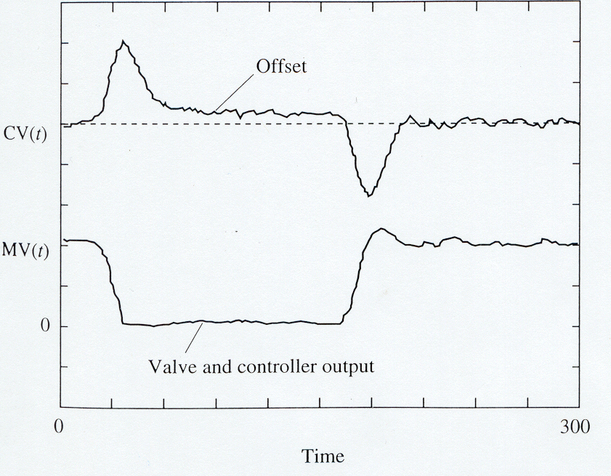
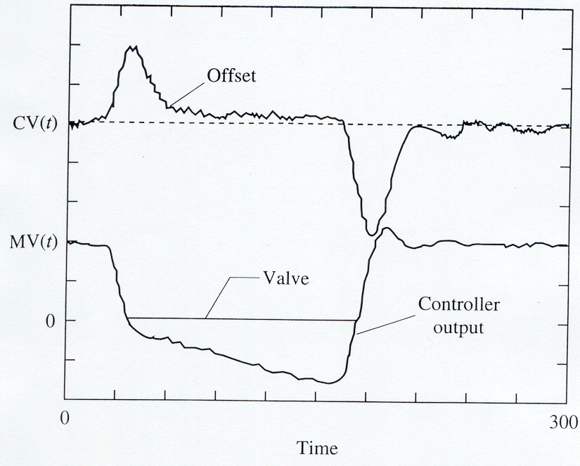
CHAPTER 12: PRACTICAL ISSUES
Feedback Controller - P, I and D
Behavior without anti-reset-windup: The controller output continues to change (winds up). It takes some time to return to a value where the controller output affects the valve.
Behavior with anti-reset-windup: The controller output stops at the boundary (doesn’t wind up). The increase in the controller output immediately affects the valve when needed
Windup. The controller output exceeds the range of the valve movement.
No windup!

Slide 31
CHAPTER 12: PRACTICAL ISSUES
Feedback Controller - P, I and D
Anti-reset-windup - Several approaches are used. One simple approach is demonstrated here.
Anti-reset-windup modification

Slide 32
CHAPTER 12: PRACTICAL ISSUES
Feedback Controller - P, I and D
Derivative Filter - If we filter the measurement, we “slow” all controller modes. An option exists to filter only the derivative mode.
α usually is specified as 0.1, which gives a filter of 10% of the derivative time.

Slide 33
CHAPTER 12: PRACTICAL ISSUES
Output processing
Bumpless transfer - When the controller is switched from manual (off) to automatic (on), the final element (valve) should start from its initial value.
Special calculation for initialization

Slide 34
CHAPTER 12: PRACTICAL ISSUES
Output processing
Fail closed
(air to open)
Fail opened
(air to close)
air
air
Flexible diaphragm
Flexible diaphragm

Slide 35
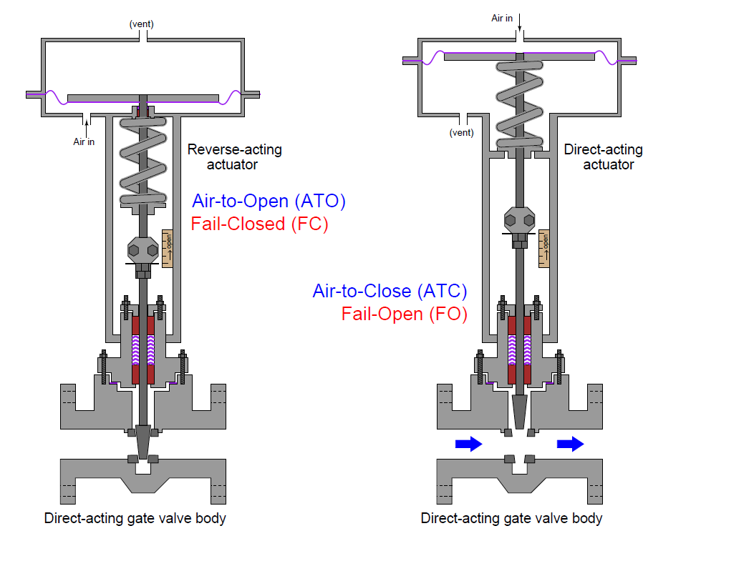
CHAPTER 12: PRACTICAL ISSUES
Output processing
Kuphalt, T. (2012) Lessons in Industrial Instrumentation, http://www.openbookproject.net/books/socratic/sinst/

Slide 36
CHAPTER 12: PRACTICAL ISSUES
Output processing
Failure position - This is selected based on safety. Remember that we must know the failure position to understand sign of the controller gain.
PI
Select the failure
positions for
the two control
valves.
1
AI
PI
1
4
FT
TI
1
1
PI
5
TI
TI
5
feed
2
TI
PT
6
1
TI
3
TI
TC
TI
TI
7
10
product
4
FT
TI
FI
2
8
3
TI
11
fuel
air
PI
PI
PI
2
3
6

Slide 37
CHAPTER 12: PRACTICAL ISSUES
Output processing
Failure position - This is selected based on safety.
PI
Fail closed: In all failure situations, we want to reduce the fuel flow to zero.
1
AI
PI
1
4
FT
TI
1
1
PI
5
TI
TI
5
2
feed
Fail opened: In all failure situations, we want to continue the flow. In not, the oil in the pipe will heat up, degrade and block the pipe.
TI
PT
6
1
TI
3
TI
TC
7
TI
TI
10
product
4
FT
TI
FI
2
8
3
TI
11
fuel
air
PI
PI
PI
2
3
6

Slide 38
CHAPTER 12: PRACTICAL ISSUES WORKSHOP 1
Process, could be far from control room
v1
T
Central control room
v2
Digital PID
You and a few friends started a company to design a new digital control system.
The company has decided to provide anti-reset-windup using the
“external feedback” method.
You have volunteered to provide “pseudo-code” for the PID and
external feedback calculation.

Slide 39
CHAPTER 12: PRACTICAL ISSUES WORKSHOP 2
D(s)
G_{d}(s)
SP(s)
E(s)
MV(s)
CV(s)
+
G_{C}(s)
G_{v}(s)
G_{P}(s)
+
-
+
G_{f}(s)
G_{S}(s)
CV_{f}(s)
CV_{m}(s)
You wonder why the first order filter is used often in process control. So, you perform the following investigation.
Determine the transfer function for a 4th order filter, with four equal time constants.
Calculate the frequency response for the fourth order filter.
Identify advantages and disadvantages with respect to a 1st order filter.
Decide which is generally best for feedback control.

Slide 40
CHAPTER 12: PRACTICAL ISSUES WORKSHOP 3
Sensors - Select one sensor for flow (F), temperature (T), Pressure (P) and level (L). For each
Estimate the accuracy and reproducibility
Discuss several reasons for sensor errors
For each reason for inaccuracy, suggest an method for reducing the inaccuracy, which could involve installation, calibration, other sensro principle, or other action.

Slide 41
CHAPTER 12: PRACTICAL ISSUES WORKSHOP 4
F_{S}
Fail open valve
solvent
Analyzer range 0 - 7%
Calculate the PI tuning for the continuous (or digital with small Δt) PID controller for the parameters in the table. See textbook Example 9.2 for initial tuning calculations.
Before determining these, select correct controller sense.
F_{A}
pure A
AC
Don’t forget the units for
each case.
Gain Kc (Kc)s PB PB
Integral TI TR TI TR
From Example 9.2

Slide 42
CHAPTER 12: PRACTICAL ISSUES
When I complete this chapter, I want to be
able to do the following.
Select appropriate sensors and valves
Determine the controller parameters for commercial systems
Tune methods for noise reduction
Enhance the simple PID for shortcomings (windup, bumpless)
Lot’s of improvement, but we need some more study!
Read the textbook
Review the notes, especially learning goals and workshop
Try out the self-study suggestions
Naturally, we’ll have an assignment!

Slide 43
CHAPTER 12: PRACTICAL ISSUES
SITE PC-EDUCATION WEB
- Instrumentation Notes - EVERYTHING!
- Interactive Learning Module (Chapter 12)
- Tutorials (Chapter 12)
The Textbook, naturally, for many more examples.

Slide 44
CHAPTER 12: SUGGESTIONS FOR SELF-STUDY
1. Determine the accuracy for two common sensors measuring each of the following; flow, temperature pressure and level.
2. For two common control valve bodies, determine the admissible fluid characteristics and summarize the +/- in selection criteria.
3. Search the WWW to locate suppliers of flow sensors. Find a specification sheet for an orifice meter and discuss how you would determine the information when designing a plant.

Slide 45
CHAPTER 18: SUGGESTIONS FOR SELF-STUDY
4. Search the WWW to locate suppliers of control valves. Find a specification sheet for a globe valve with diaphragm actuator and discuss how you would determine the information when designing a plant.
5. Locate the book “What Went Wrong” by Trevor Kletz. Skim the cases in the book to find one in which a sensor error lead to a hazardous condition. What was recommended to prevent this situation from reoccurring?
6. Search the WWW for digital instrumentation and communication (check “fieldbus”). Determine the enhanced features provided when the following have digital calculations; sensor and valve (positioner).

